Slide 1
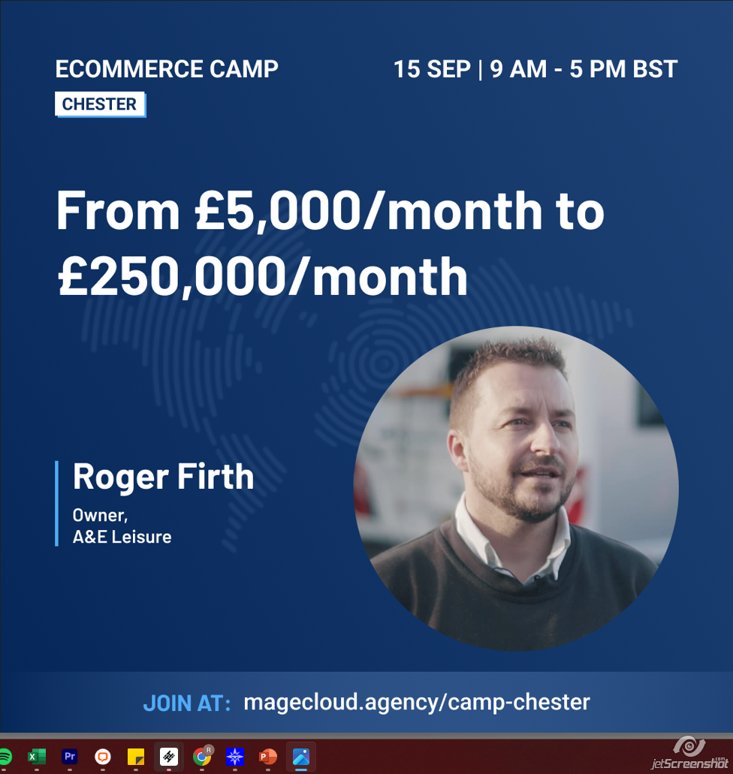
Introduction
Back Story
E-commerce Journey
Future Plans
Questions

Slide 2
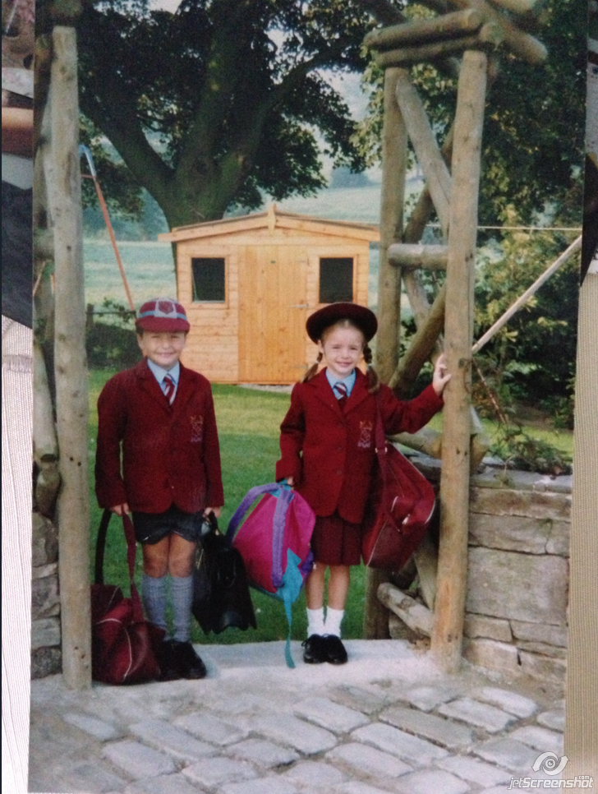

Slide 3
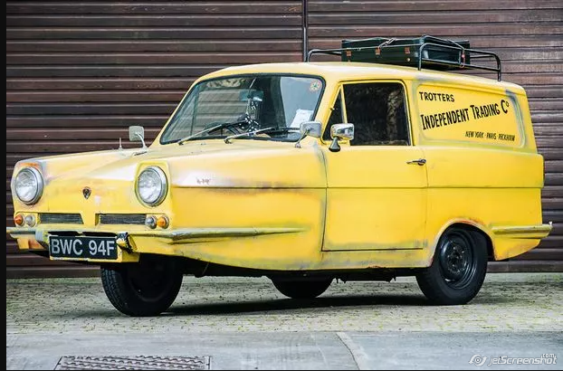
College – The Glory years!
££££££££££££££££££££££££££££££££££££££££££££££££££££££££££££££££££££

Slide 4
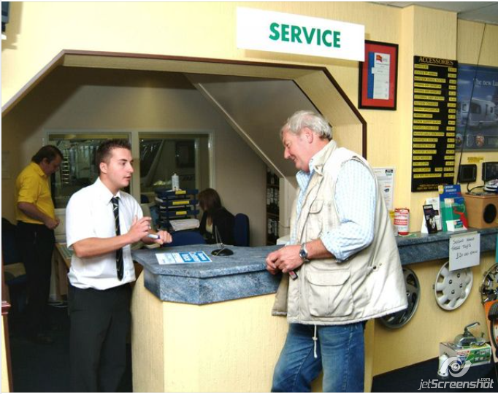
My First Real Job

Slide 5
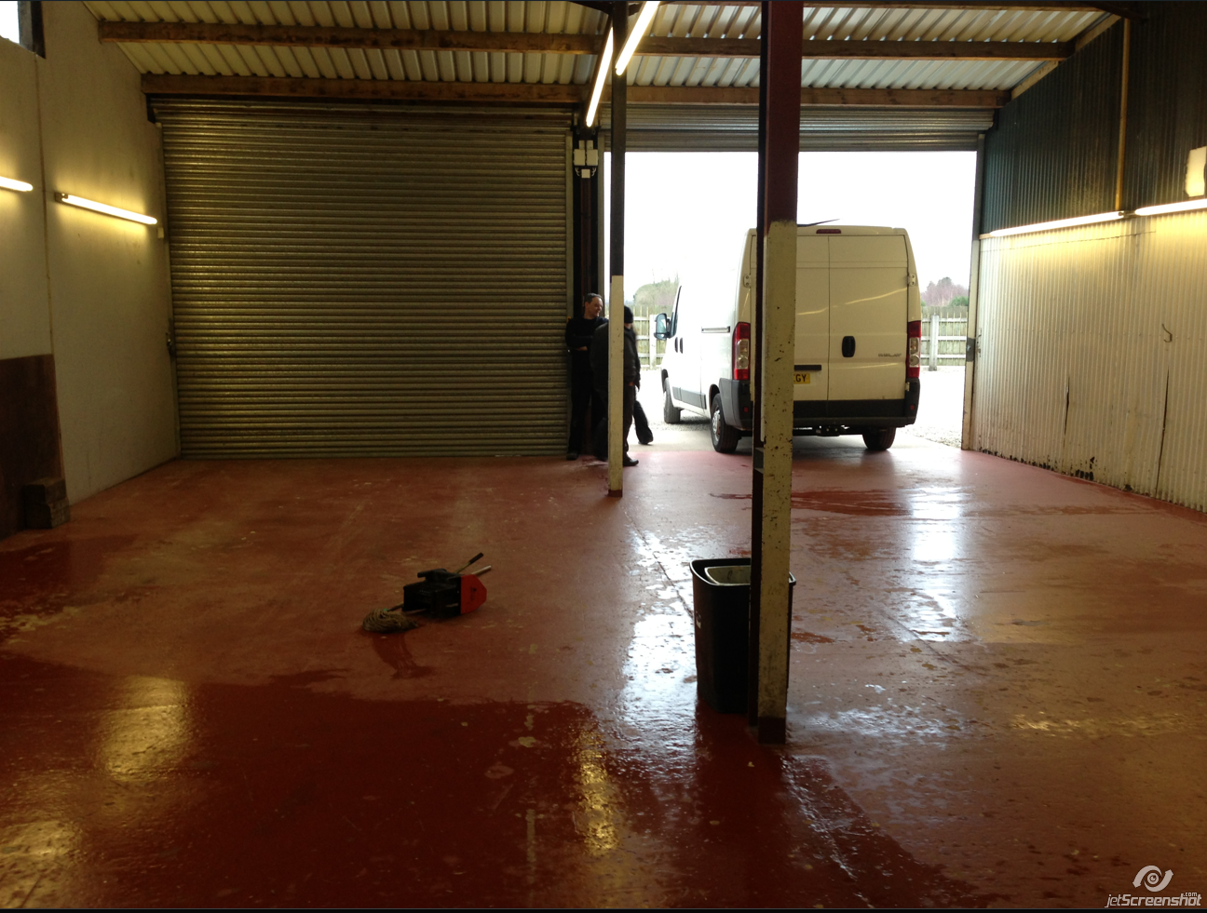

Slide 6
Magento 1 and Ebay
FF 2016/17- aandeleisure.co.uk – Ormit days
C-Progress – up until end of 2019

Slide 7
Magecloud

Slide 8
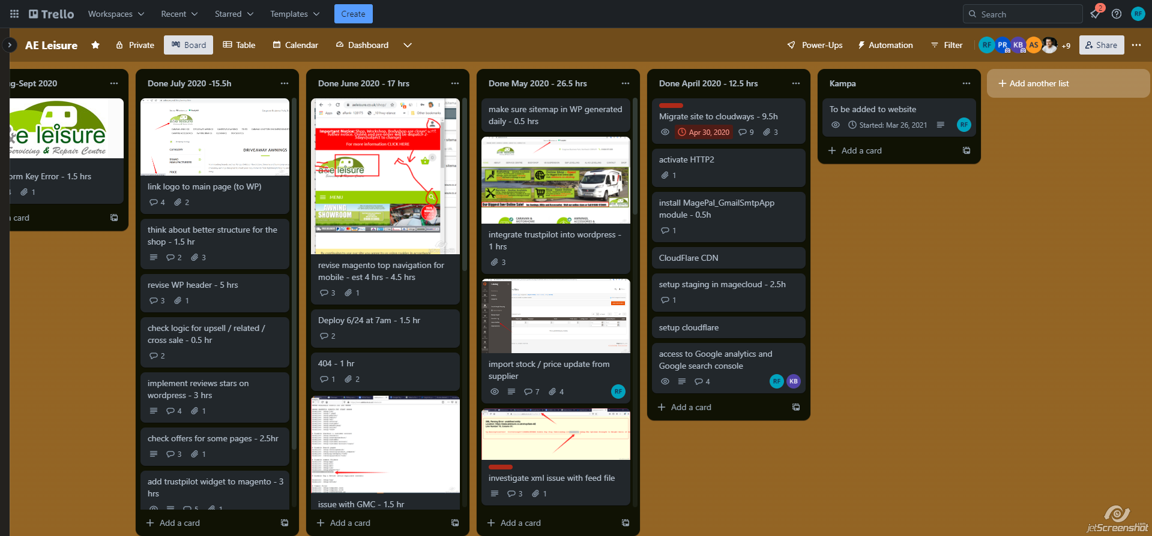

Slide 9
Staycation

Slide 10
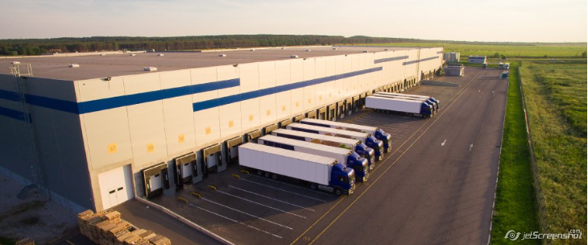

Slide 11
2019 - £68K
2020 - £400K
2021 - £800K
2022 - £1.2M

Slide 12
Future Plans
Moving our ERP, replenishment, warehousing systems
Email marketing
New product ranges
Winter lines

Slide 13
Any questions?

