Slide 1
Ecommerce Structure Made Simple(r)

Slide 2
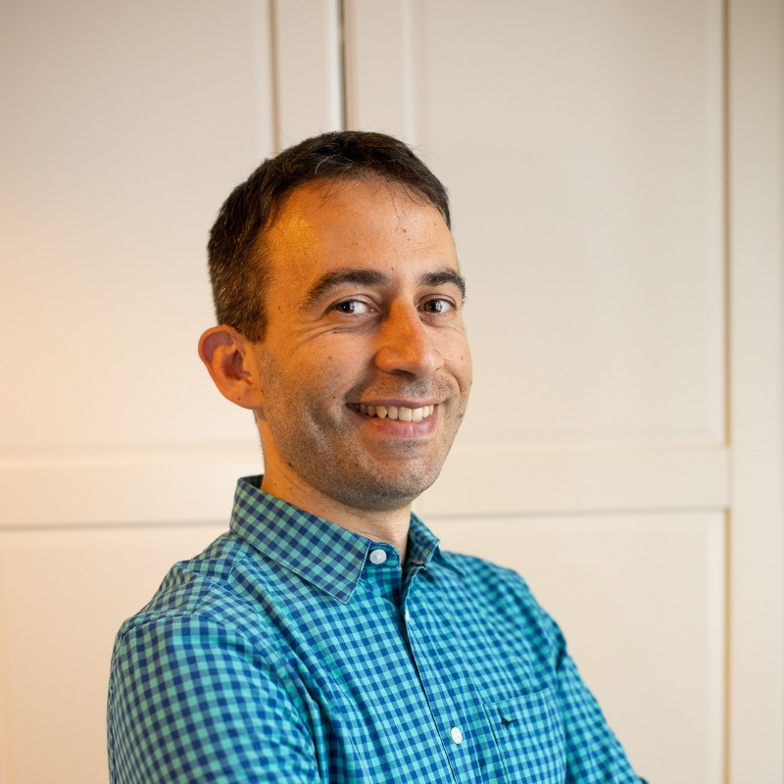
Francesco Baldini
Freelance SEO Consultant
Based in Italy, Canada, Ireland, United Kingdom
10+ years in digital marketing and business consulting
SEO contributor
Francesco Baldini
info@betakrea.net

Slide 3
SEO Pillars
[ ] Content
[ ] Technical SEO
[ ] Backlinks
Francesco Baldini
info@betakrea.net

Slide 4
What is “Content” (eCom)?
Francesco Baldini
info@betakrea.net

Slide 5
What is “Content”?
Product pages
Category listing pages (CLP)
Product listing pages (PLP)
Sub-Product listing pages (SPLP)
Educational content Size/Buying guides Promo pages
…
Francesco Baldini
info@betakrea.net

Slide 6
Starting out
The foundations
Francesco Baldini
info@betakrea.net

Slide 7
Why Keyword Topic* Research?
* shaving razor for him = shaving razor for men engagement rings for large fingers = engagement rings for large hands
Francesco Baldini
info@betakrea.net

Slide 8
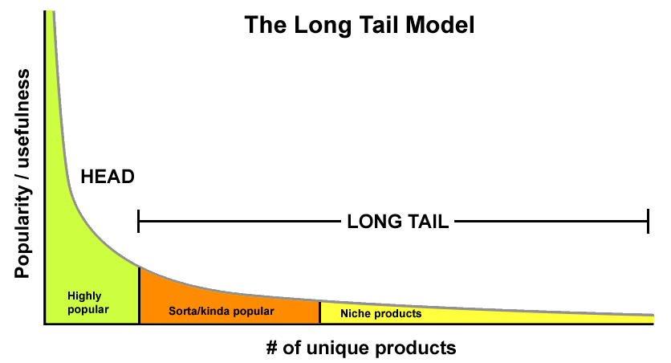
Why Topic Research is important: be realistic
Rings > Engagement rings > Diamond engagement ring white gold
Francesco Baldini
info@betakrea.net

Slide 9
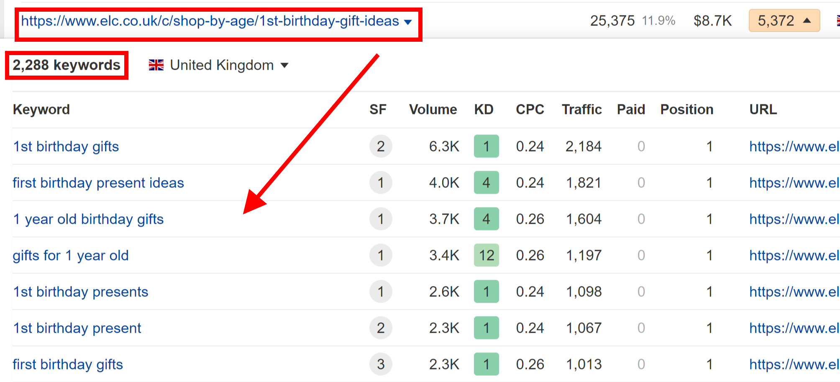
Why Topic Research is important
Every keyword is a different access point to your page.
Francesco Baldini
info@betakrea.net

Slide 10
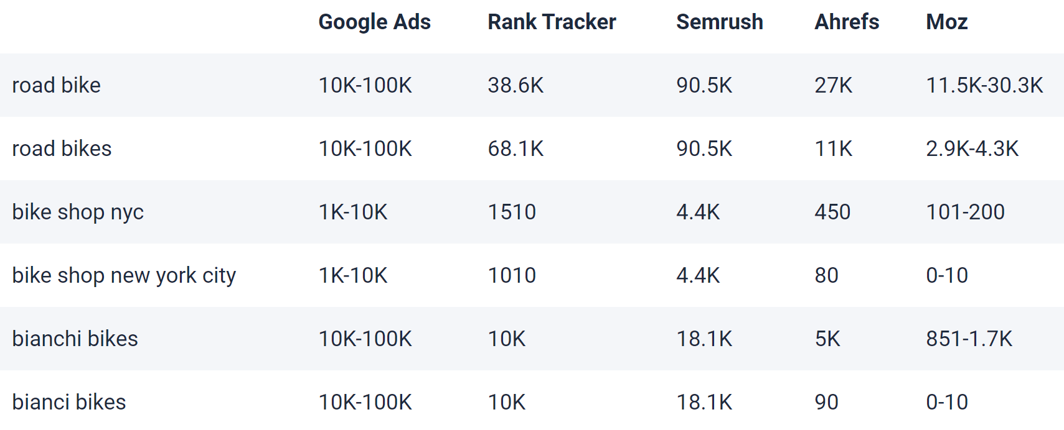
Why Topic Research is important
Search volume is often overrated metric.
Sources: SEO Powersuite, SearchEngineLand
Francesco Baldini
info@betakrea.net

Slide 11
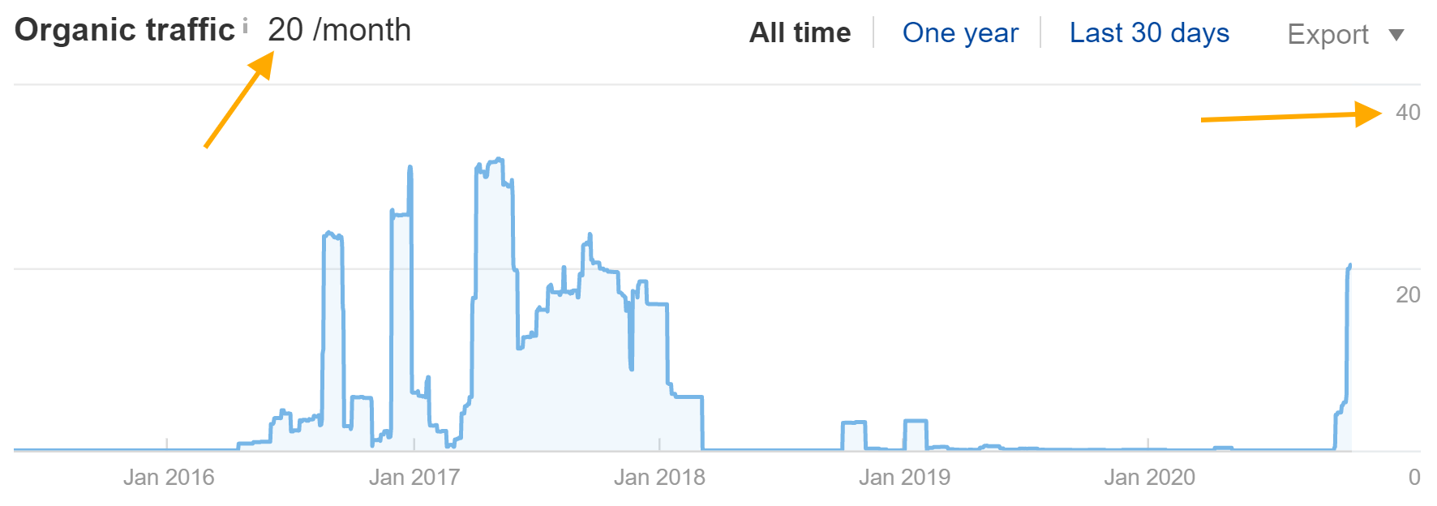
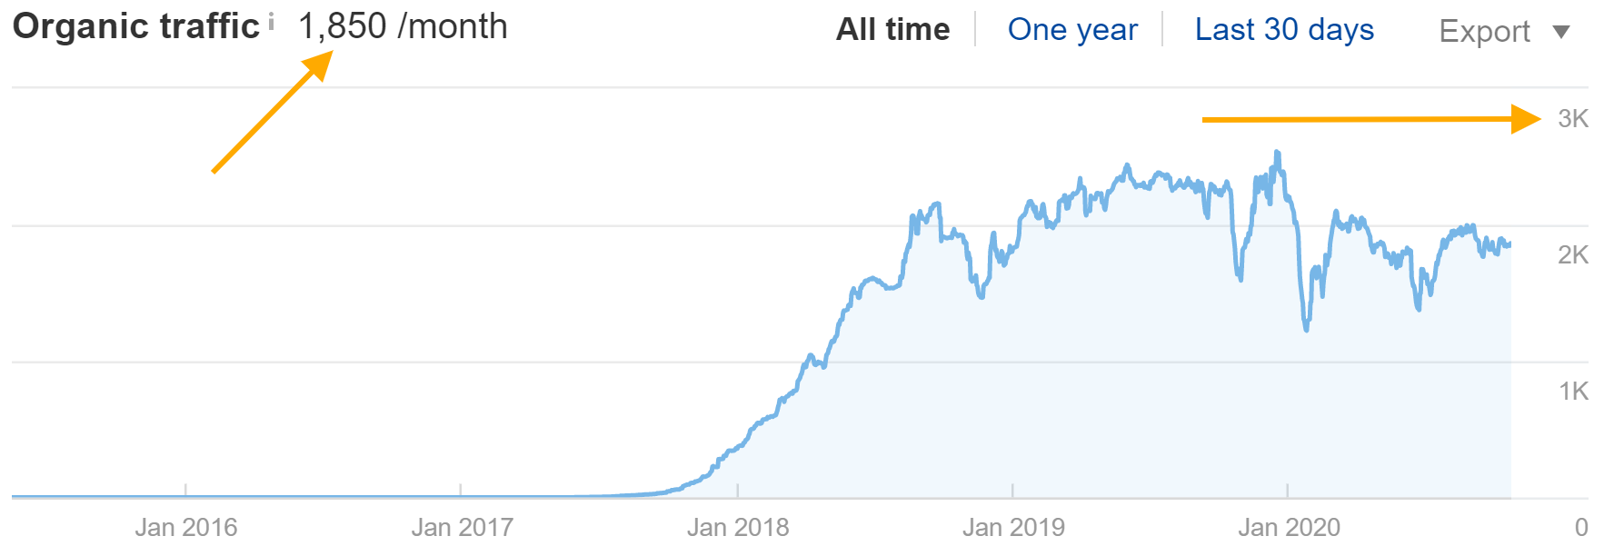
Why Topic Research is important
10+ year old website, ~120 pages
(keyword research)
3 year old website, ~20 pages
Francesco Baldini
info@betakrea.net

Slide 12
> Main Product Listing Pages
Francesco Baldini
info@betakrea.net

Slide 13
Main Product Listing Pages
Francesco Baldini
info@betakrea.net

Slide 14
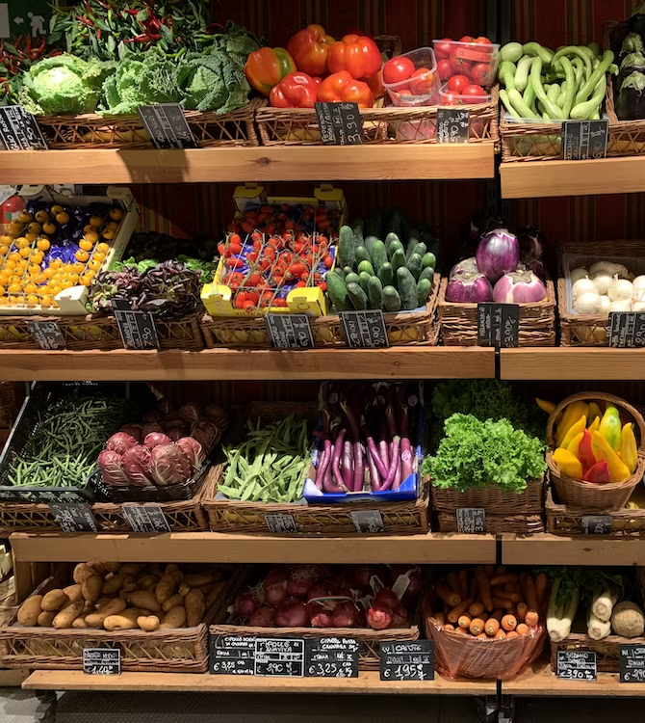
Start with your catalogue
Look at competitors Use your expertise Broad categories/Use cases Don’t overthink You can’t rank (today)
Francesco Baldini
info@betakrea.net

Slide 15
> Sub Product Listing Pages
Francesco Baldini
info@betakrea.net

Slide 16
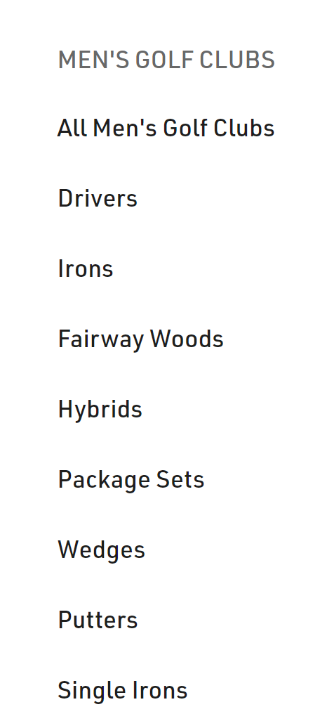
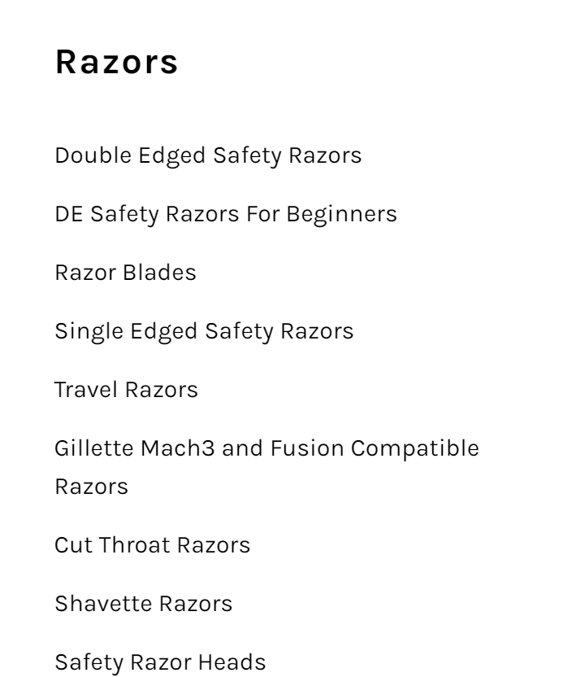
Sub PLP: Type
Type
Francesco Baldini
info@betakrea.net

Slide 17
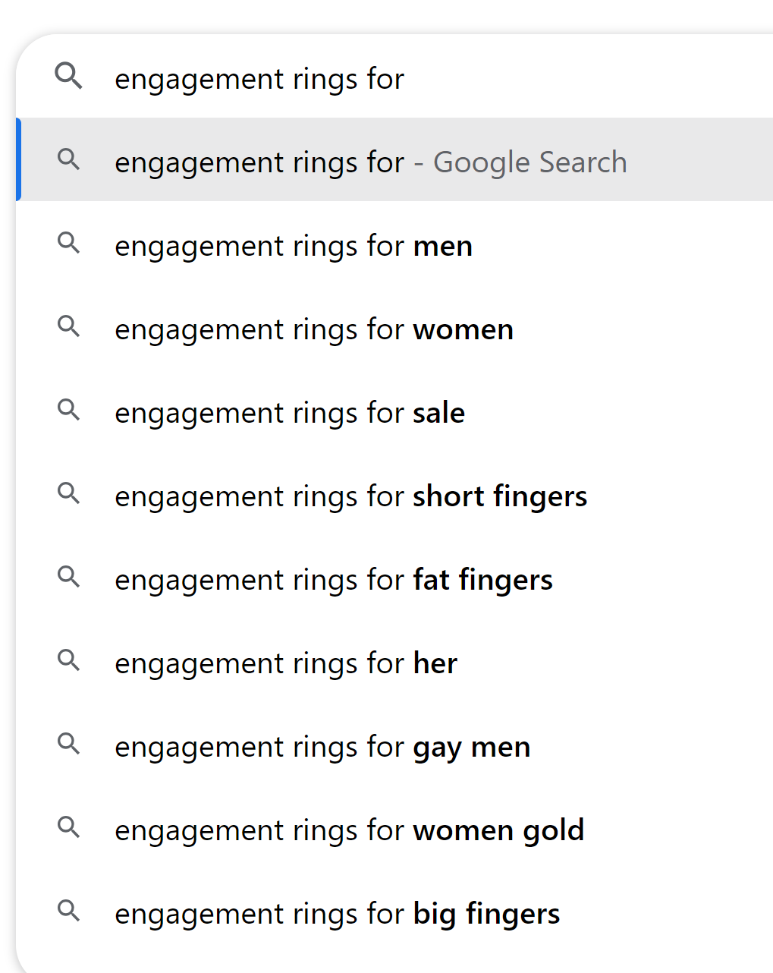
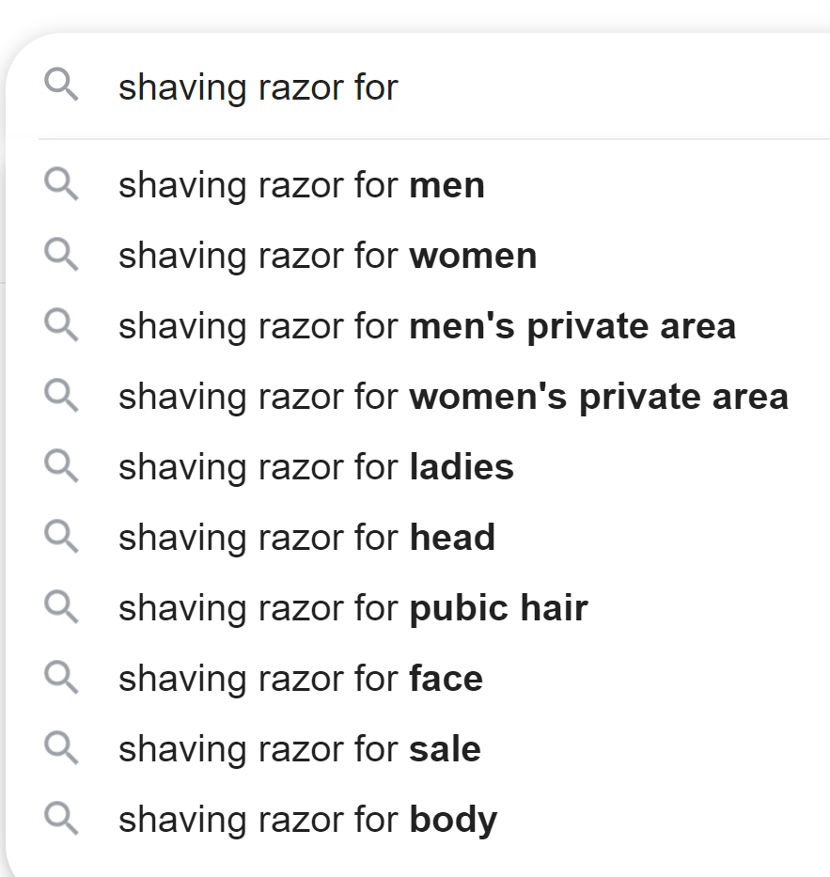
Sub PLP: Audience & Use Case
Audience
Use case
Francesco Baldini
info@betakrea.net

Slide 18
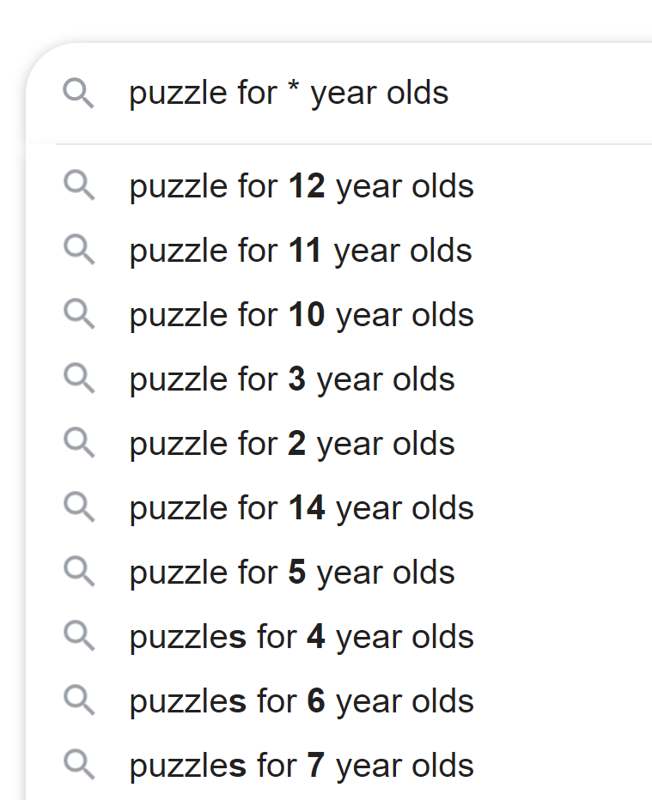
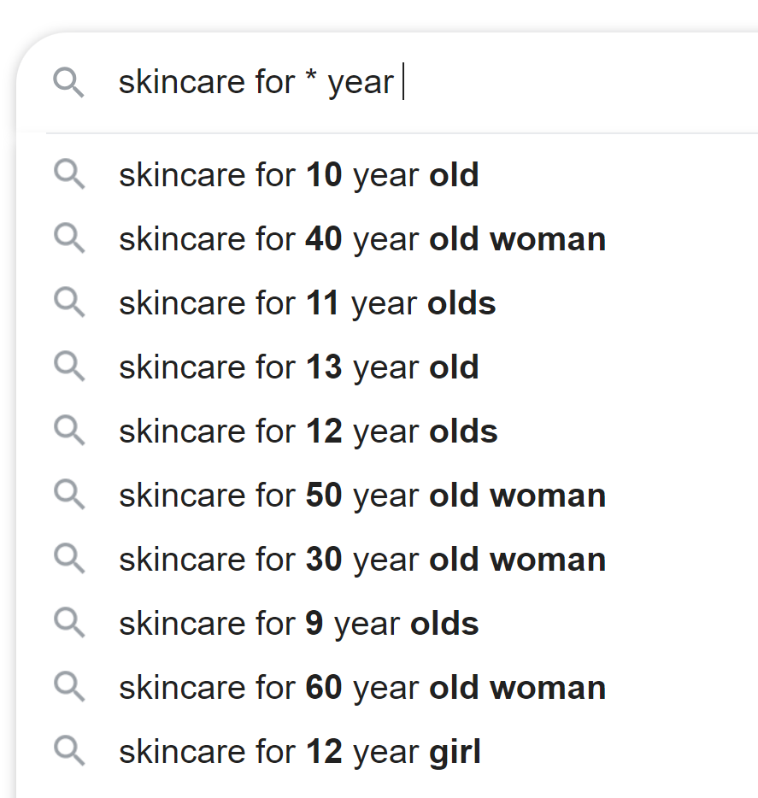
Sub PLP: Age
Age group
Francesco Baldini
info@betakrea.net

Slide 19
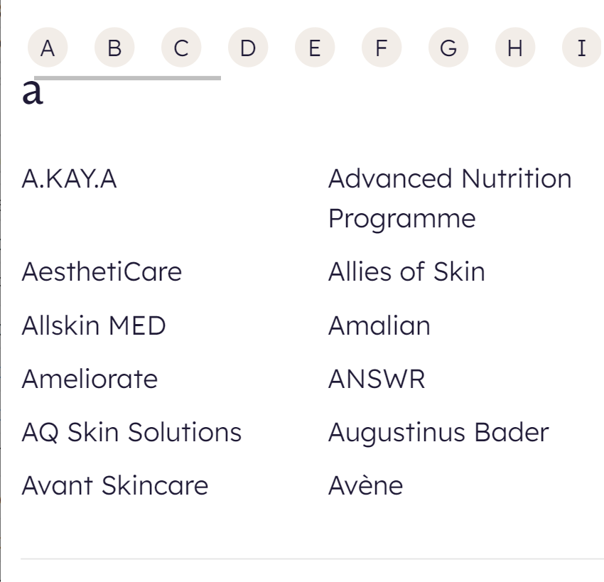
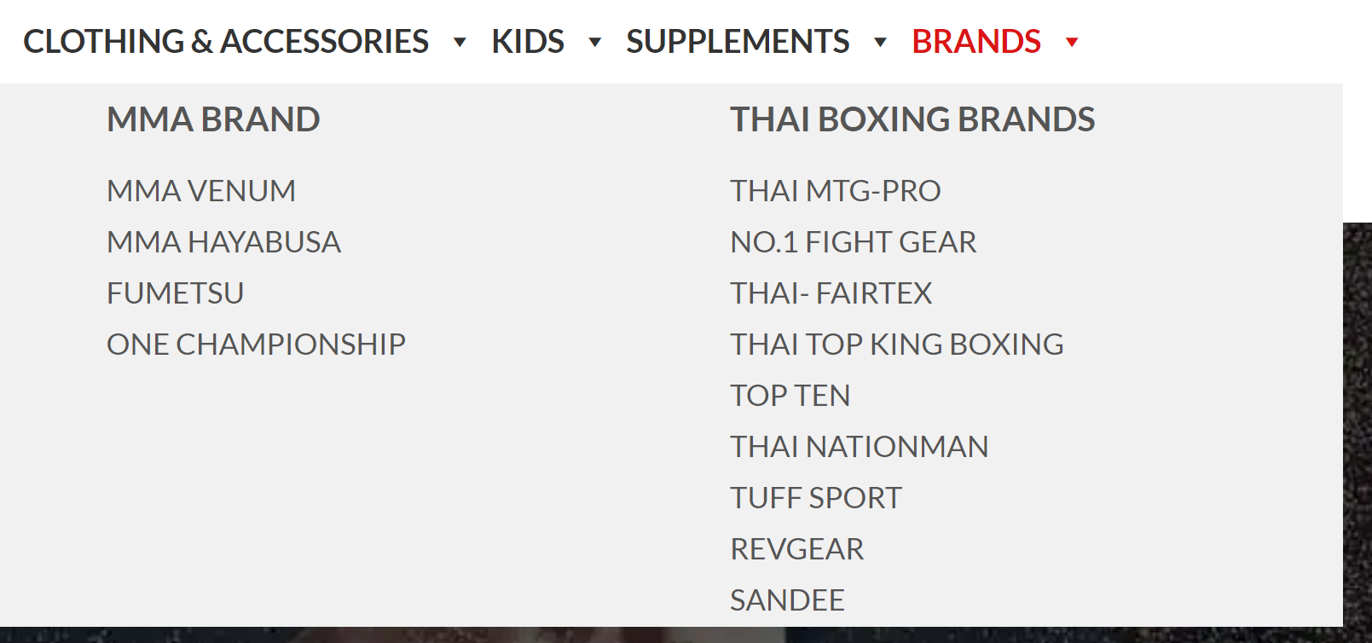
Sub PLP: Brands
Brands*
* When selling third party products
Francesco Baldini
info@betakrea.net

Slide 20
Sub PLP: Other
Focus on your audience
Francesco Baldini
info@betakrea.net

Slide 21
> Research & Ideas
Francesco Baldini
info@betakrea.net

Slide 22
Research: your data
Sales people
Customer services
Email
Francesco Baldini
info@betakrea.net

Slide 23
Research: Competitors (front)
Find big & small competitors specialised in your market category.
Francesco Baldini
info@betakrea.net

Slide 24
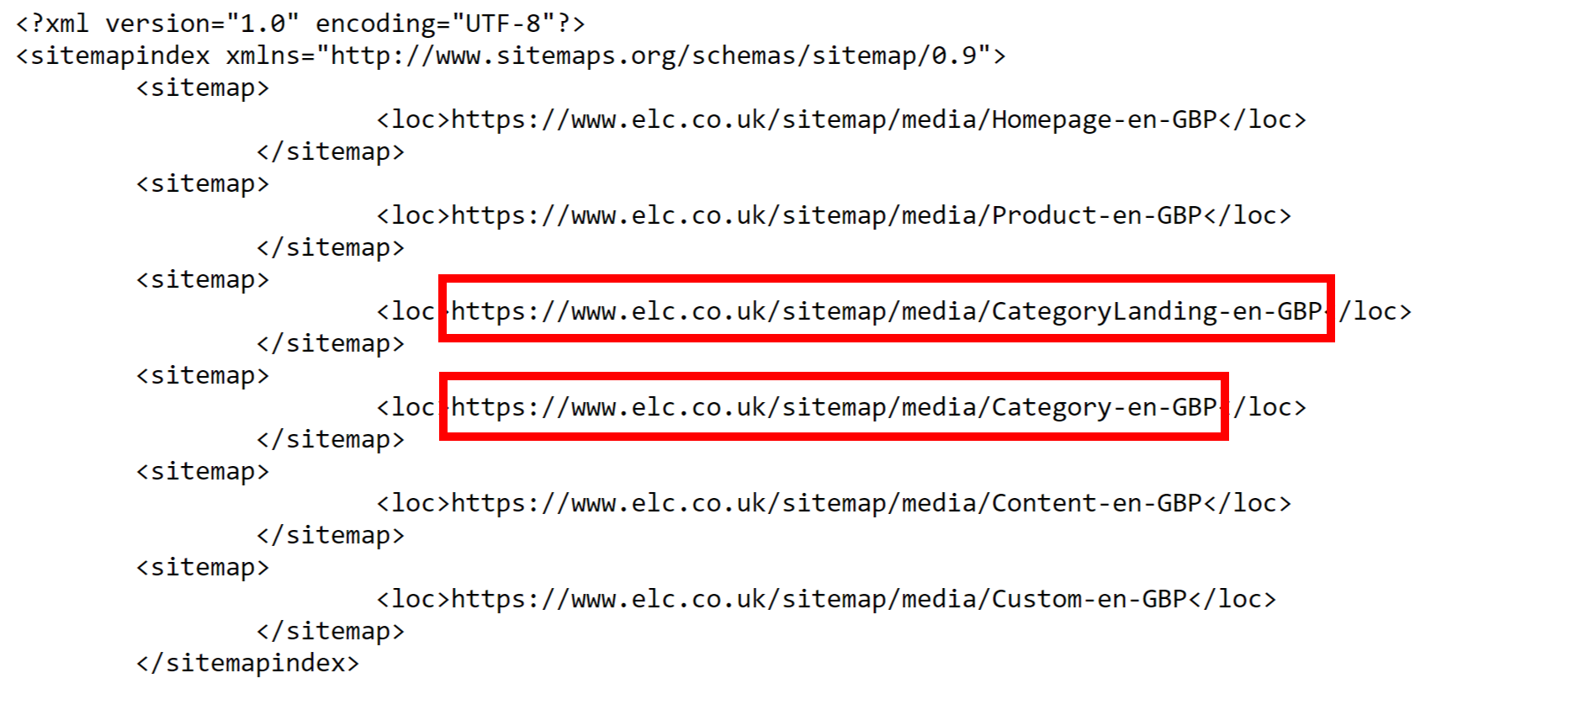
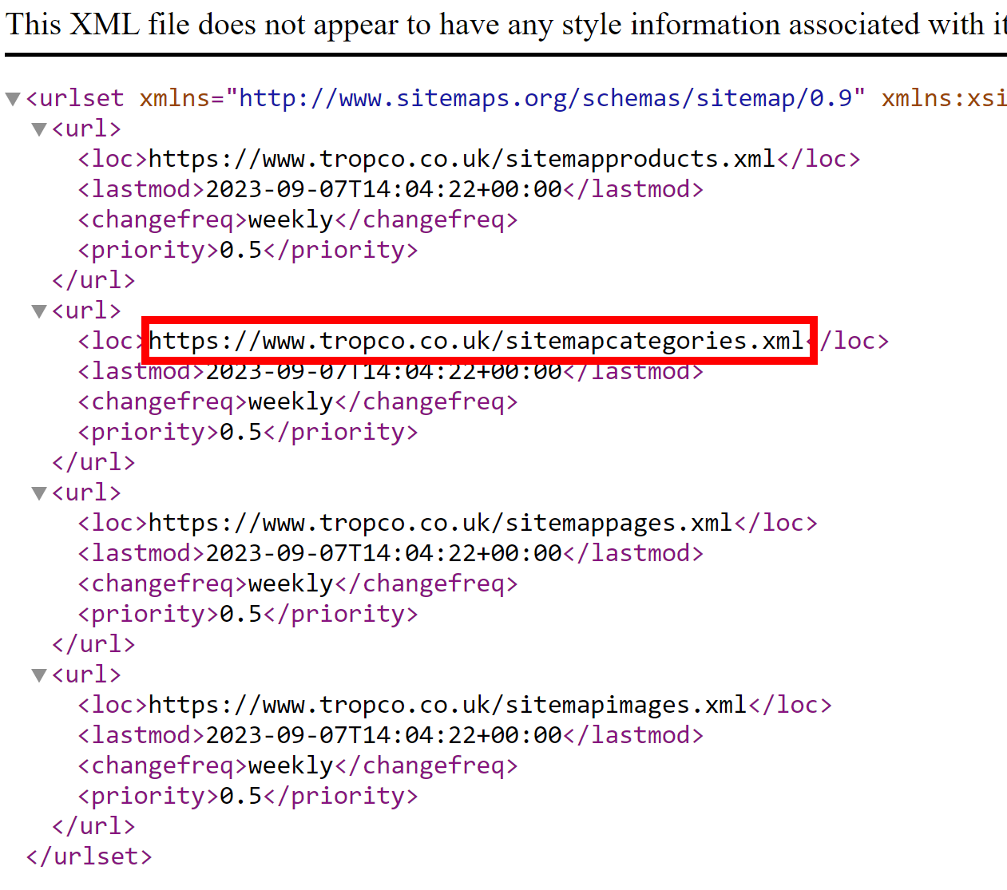
Research: Competitors (back)
Check their XML sitemap
Francesco Baldini
info@betakrea.net

Slide 25
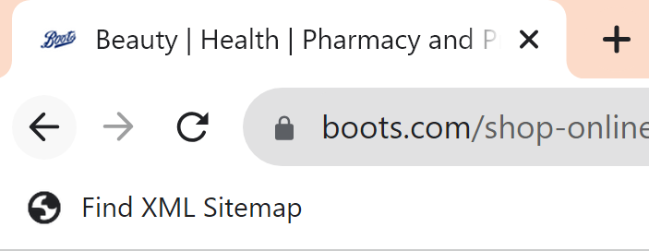
Research: Competitors (back)
Use my free Bookmarklet to speed up your research: https://www.betakrea.net/technical-seo/xml-sitemap-bookmarklet/
Francesco Baldini
info@betakrea.net

Slide 26
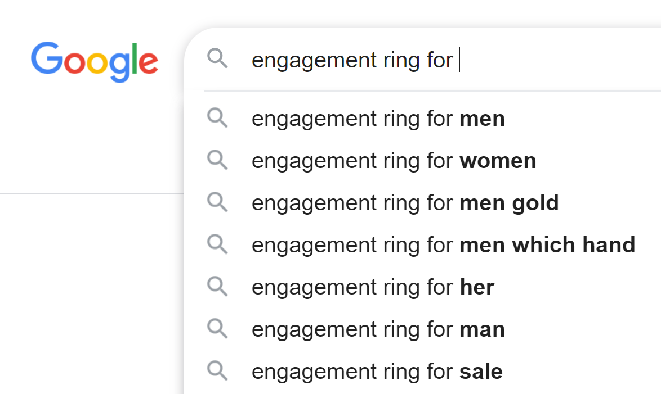
Research: Google suggestions #1
Francesco Baldini
info@betakrea.net

Slide 27
Research: Google suggestions #2
Francesco Baldini
info@betakrea.net

Slide 28
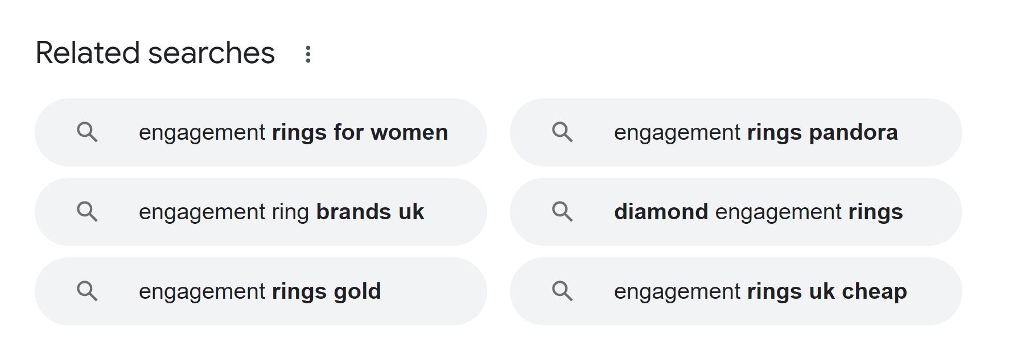
Research: Google suggestions #3
Francesco Baldini
info@betakrea.net

Slide 29
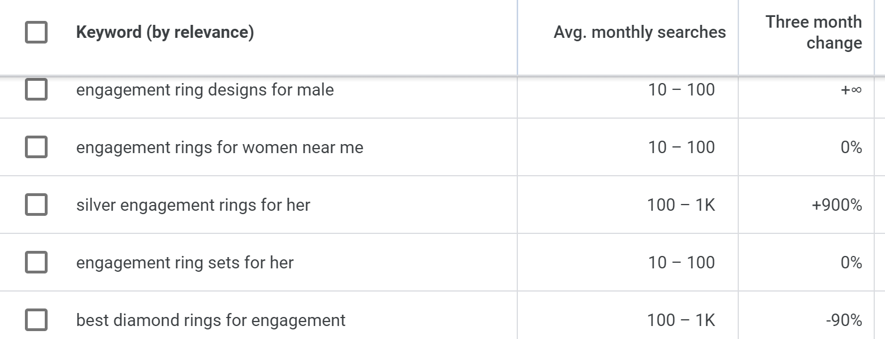
Research: Google Keyword Planner
Google Keyword Planner: https://ads.google.co.uk
Francesco Baldini
info@betakrea.net

Slide 30
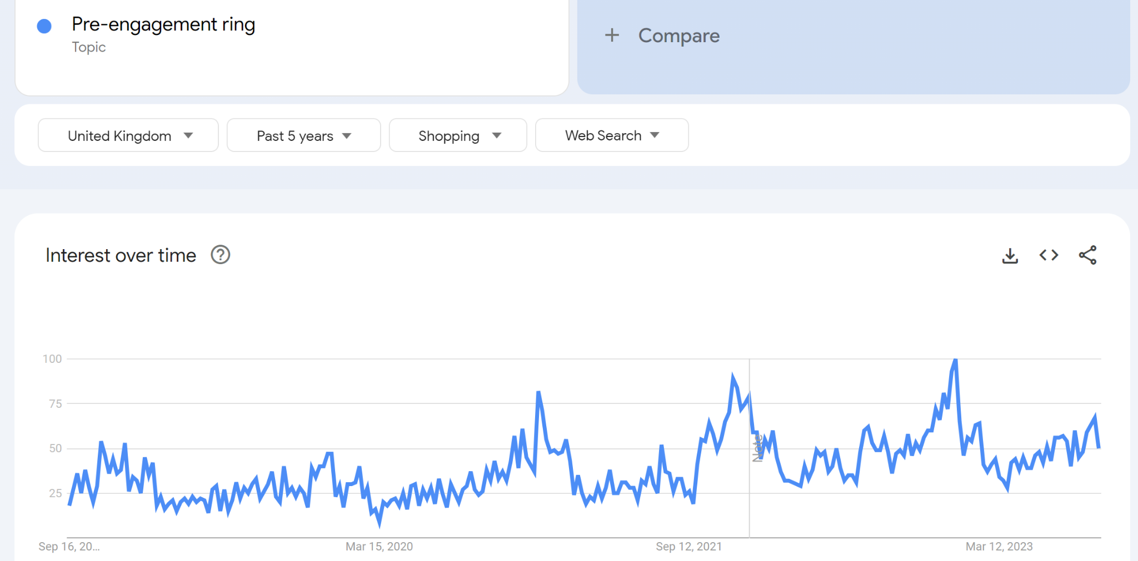
Research: Google Trends
Google Trends:
https://trends.google.co.uk/
Francesco Baldini
info@betakrea.net

Slide 31
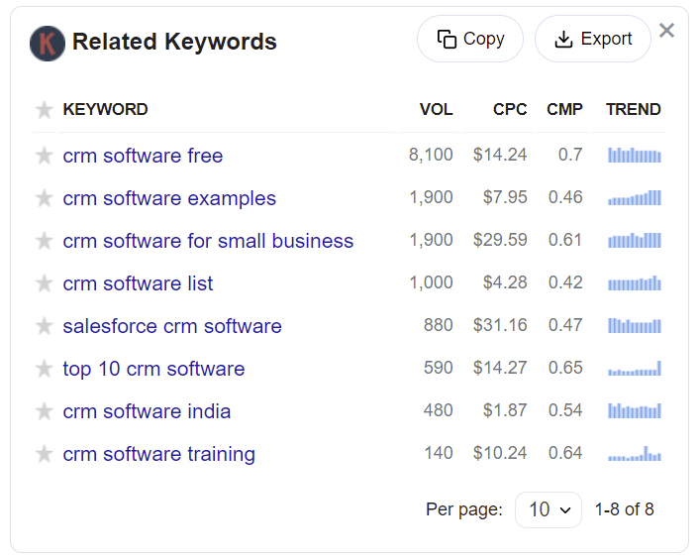
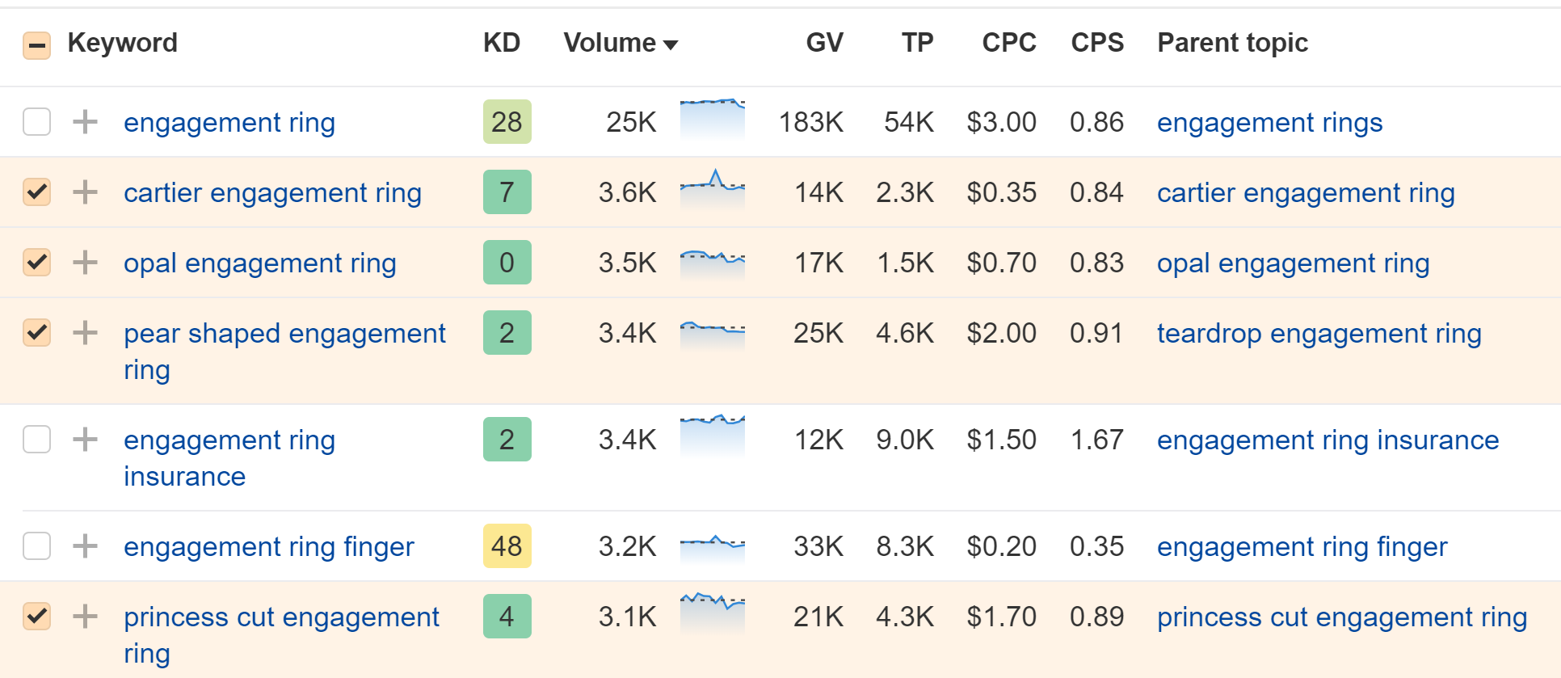
Research: SEO tools
https://ahrefs.com / https://keywordseverywhere.com/
Francesco Baldini
info@betakrea.net

Slide 32
Research: your data (again)
Sales people
Customer services
Email
Francesco Baldini
info@betakrea.net

Slide 33
You’re established
Francesco Baldini
info@betakrea.net

Slide 34
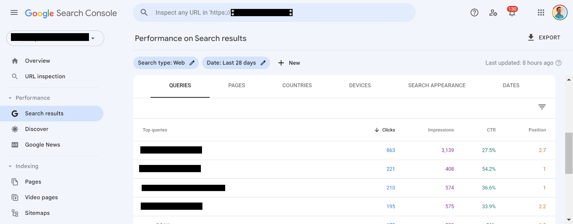
Your data, your goldmine
Francesco Baldini
info@betakrea.net

Slide 35
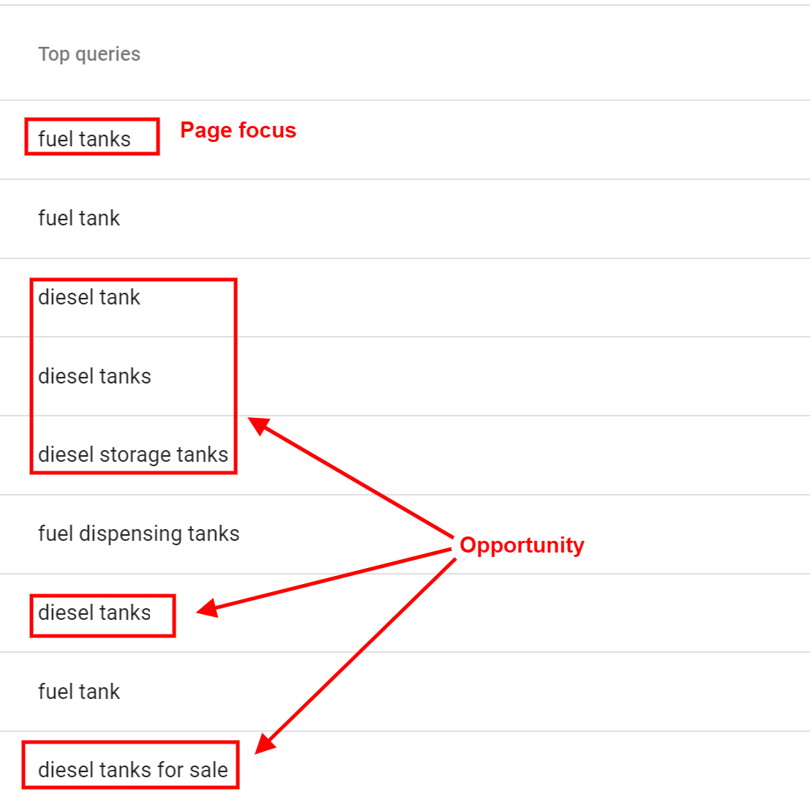
Google Search Console
Analyse your category pages. Spot opportunities from queries you are ranking for but not focusing on. Focus on top 10 product listing pages. Carry on on top 50 product listing pages.
Francesco Baldini
info@betakrea.net

Slide 36
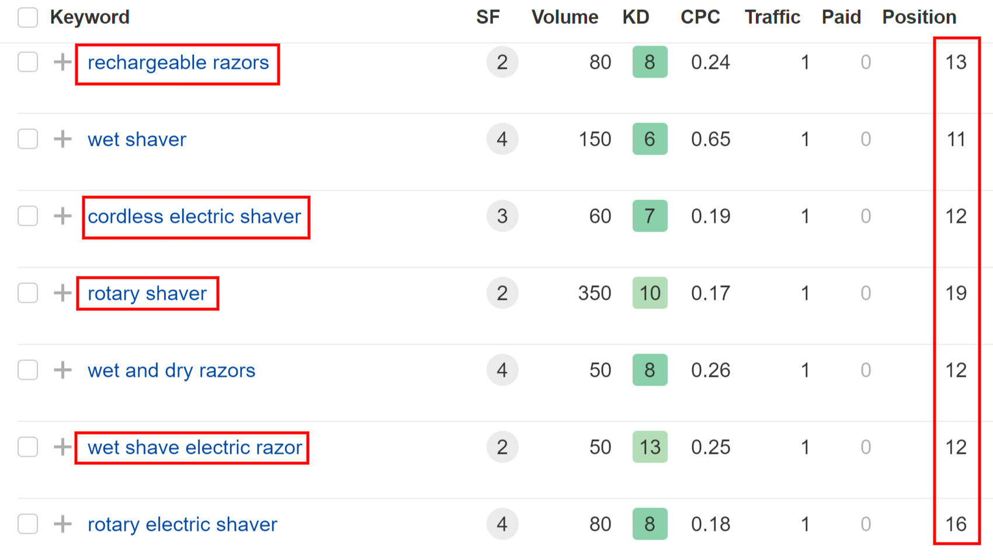
SEO tools
Analyse your category pages for queries ranking in lower position. Spot opportunities from queries you are ranking for but not focusing on. Focus on top 10 product listing pages. Carry on on top 50 product listing pages.
Francesco Baldini
info@betakrea.net

Slide 37
Your data (yes, again)
Sales people
Customer services
Email
Data Analytics Reviews
Francesco Baldini
info@betakrea.net

Slide 38
Invest in impactful tasks
Technical SEO: crawling & filters
On-Page optimisation: make pages digestible
Internal linking: hierarchy & connections
(Educational) Content: attract users
User Experience: make buying simple
Backlinks, Citations & Reviews: trust signals
Francesco Baldini
info@betakrea.net

Slide 39
Invest in your business by understanding the SEO basics. In 2023.
Francesco Baldini
info@betakrea.net

Slide 40
Thank You
Francesco Baldini
info@betakrea.net

Slide 41
Francesco Baldini Freelance SEO Consultant
info@betakrea.net
https://www.betakrea.net
linkedin.com/in/francescobaldini/ twitter.com/betakrea
Francesco Baldini
info@betakrea.net

