Slide 1
Betting 100% Online In A Luxury Market

Slide 2
Our History
Opened in 1946
Luxury pen specialists
Oldest pen retailer in the UK
20 stores including 4 in London
15 concessions
5 stores in Airports
200 staff members

Slide 3
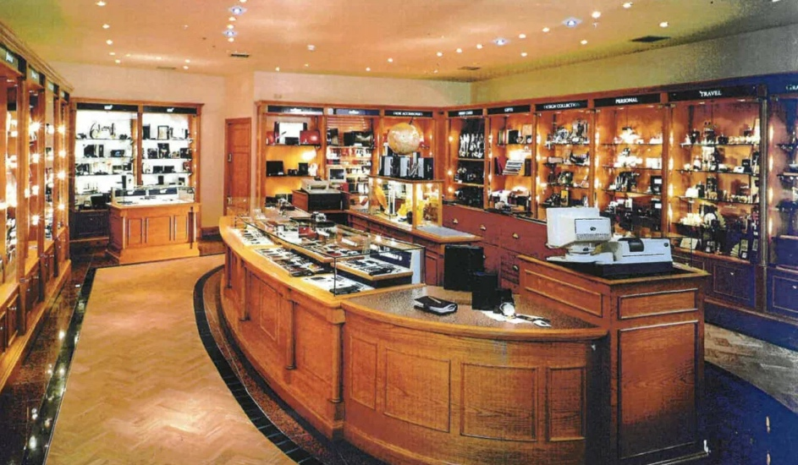
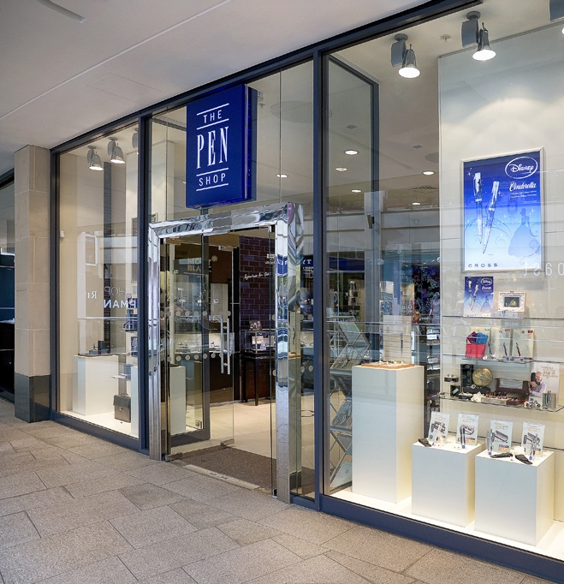
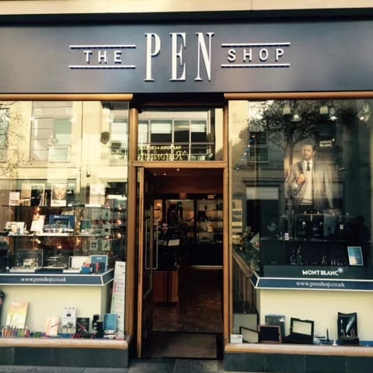
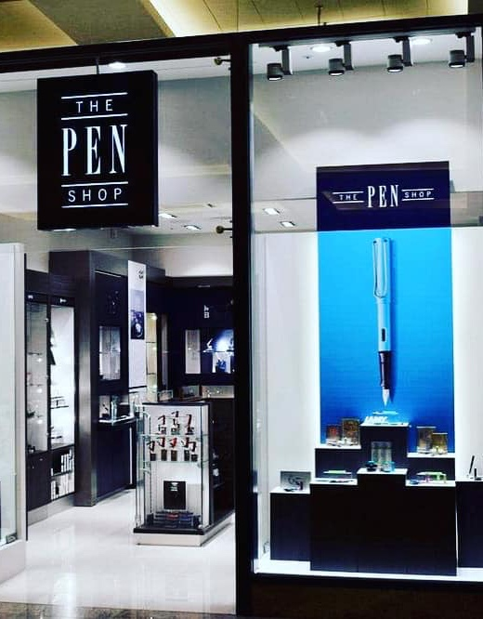
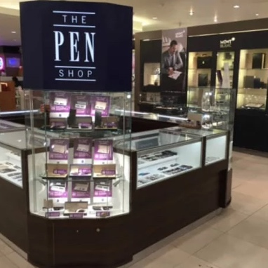
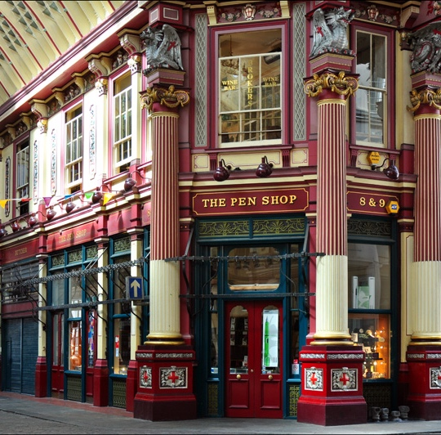
Our Stores

Slide 4
How Has Consumer Behavior Changed?
Online shopping sales have more than tripled in the last 10 years
After COVID, ecommerce sales surged and while many have returned to store shopping, 43% of consumers now buy products online rather than go back to stores.
22% of consumers now buy fashion products online as returning products has been made easier
17,125 stores closed last year

Slide 5
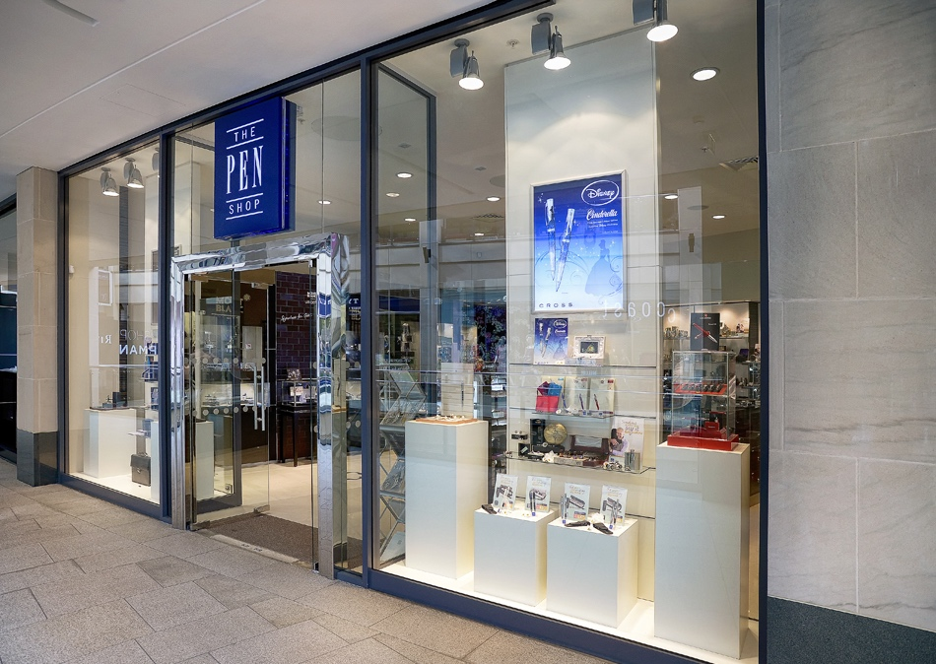
Why We Started Closing Down The Stores
Increased rent (38% increase in London)
Increased rates (10% in ten years)
Technology changes made pens more niche
Buying behaviour showed an increasing shift towards online shopping
The most recent closures saved over £150,000 a year in rent

Slide 6
Challenges we have faced with closing the stores and how we overcame it
Customers want to see/hold high value products before purchasing
Certain suppliers only allow retailers with stores
Customers sometimes want to talk to people directly
Perception that the company is failing if it closes down the stores
Improved imagery with graphic designer
Improved marketing on specific brand to increase sales for the brand
Avoided the use of chat bots and used actual people
Increase brand awareness by increasing presence in different markets, to different demographics.

Slide 7
How Closing The Stores Has Benefitted The Pen Shop
Considerably lower costs
Rent
Stock
Rates
Wages
Cost effective expansion
Increased customer reach
Round the clock sales
Ability to grow in other countries much quicker
Greater profit margins
Lower risk
Problem solving became much easier when everything is centralized

Slide 8
How our fulfillment strategy has changed?
Previous
Current
Large warehouse for own brand products
Suppliers sent stock directly to stores
Large fulfillment team
Small warehouse
Dropship integration with stock management system
Small fulfillment team
Efficient system allowing same day dispatch up to 3:30pm
Much more accurate stock control

Slide 9
What Is Next For The Pen Shop?
Branching out into international markets
The return of our ‘own brand’ products
Selling on multiple channels
Becoming market leader on personalized pens
Relaunch The Pen Shop Pen Amnesty Charity

Slide 10
Thank You For Listening
Any Questions?

