Slide 1
From Fighting with Google Over £400K/mo`

Slide 2
A Journey from Passion to Ecommerce Success
From a childhood love for gadgets to the creation of DroiX

Slide 3
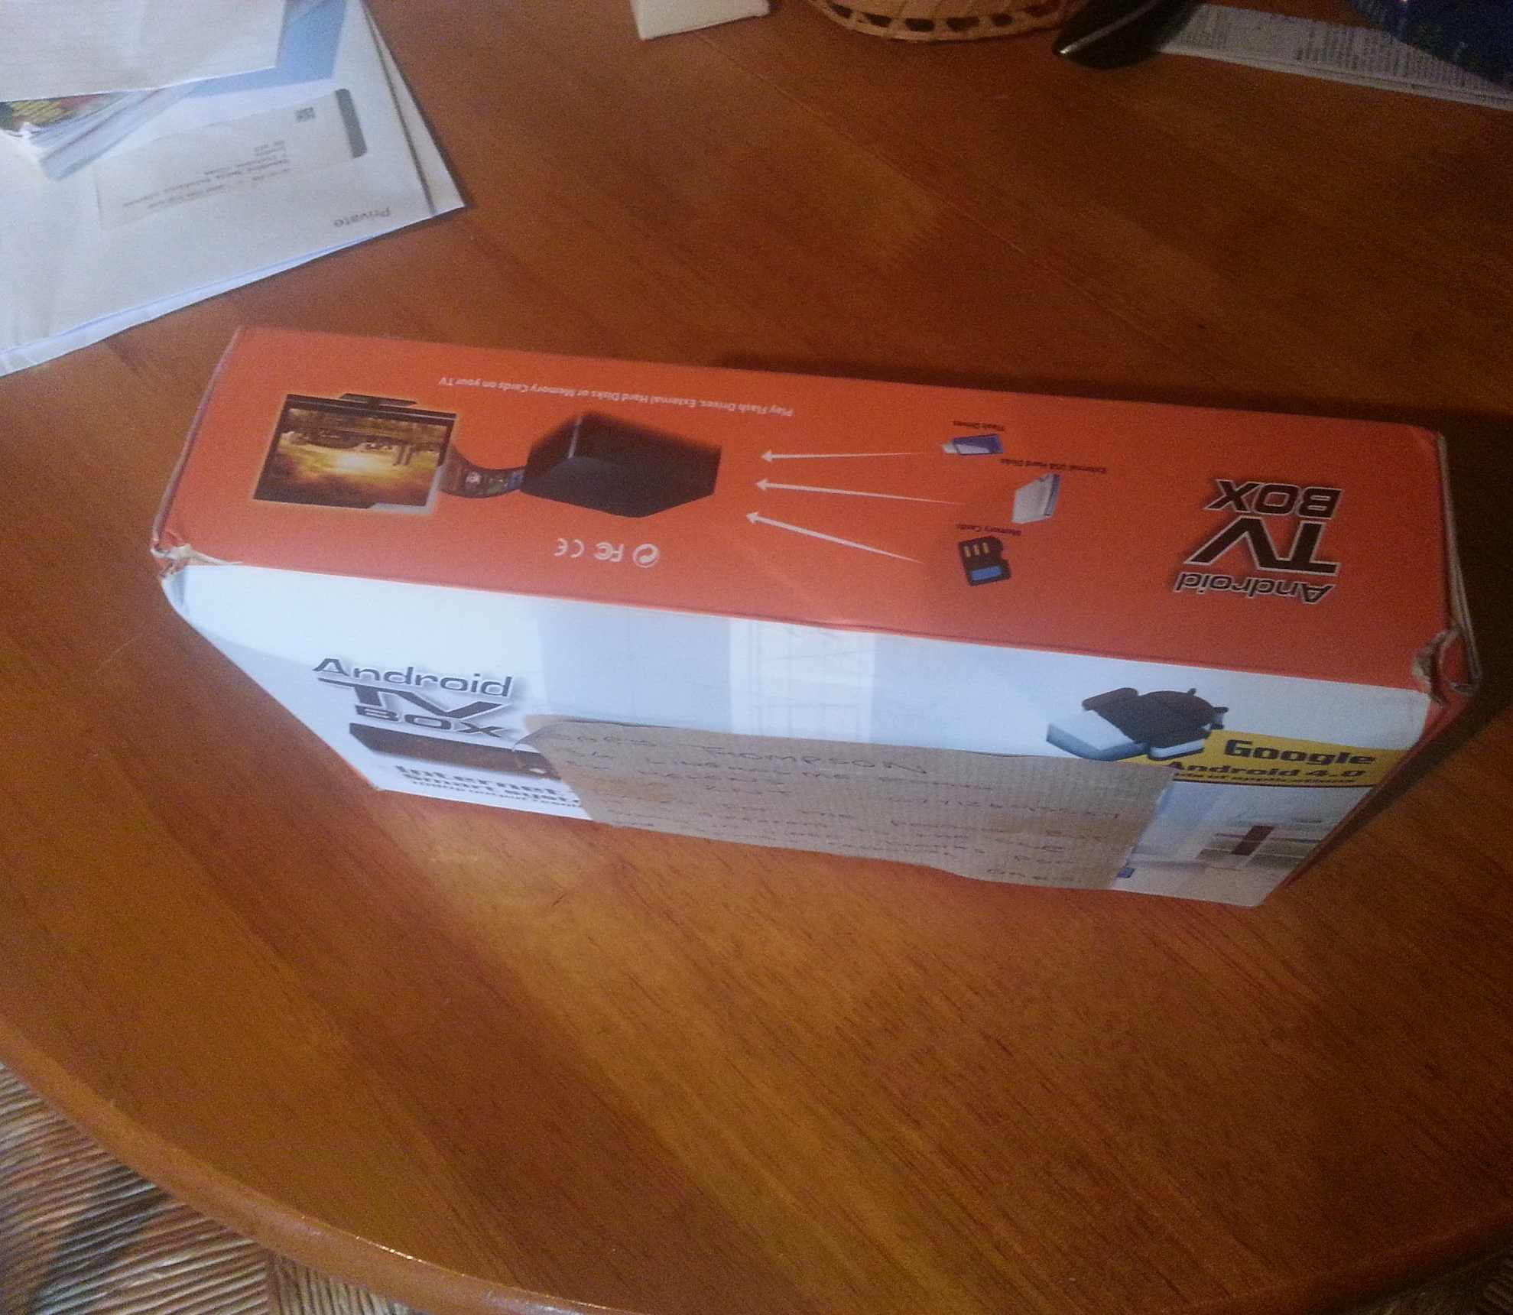
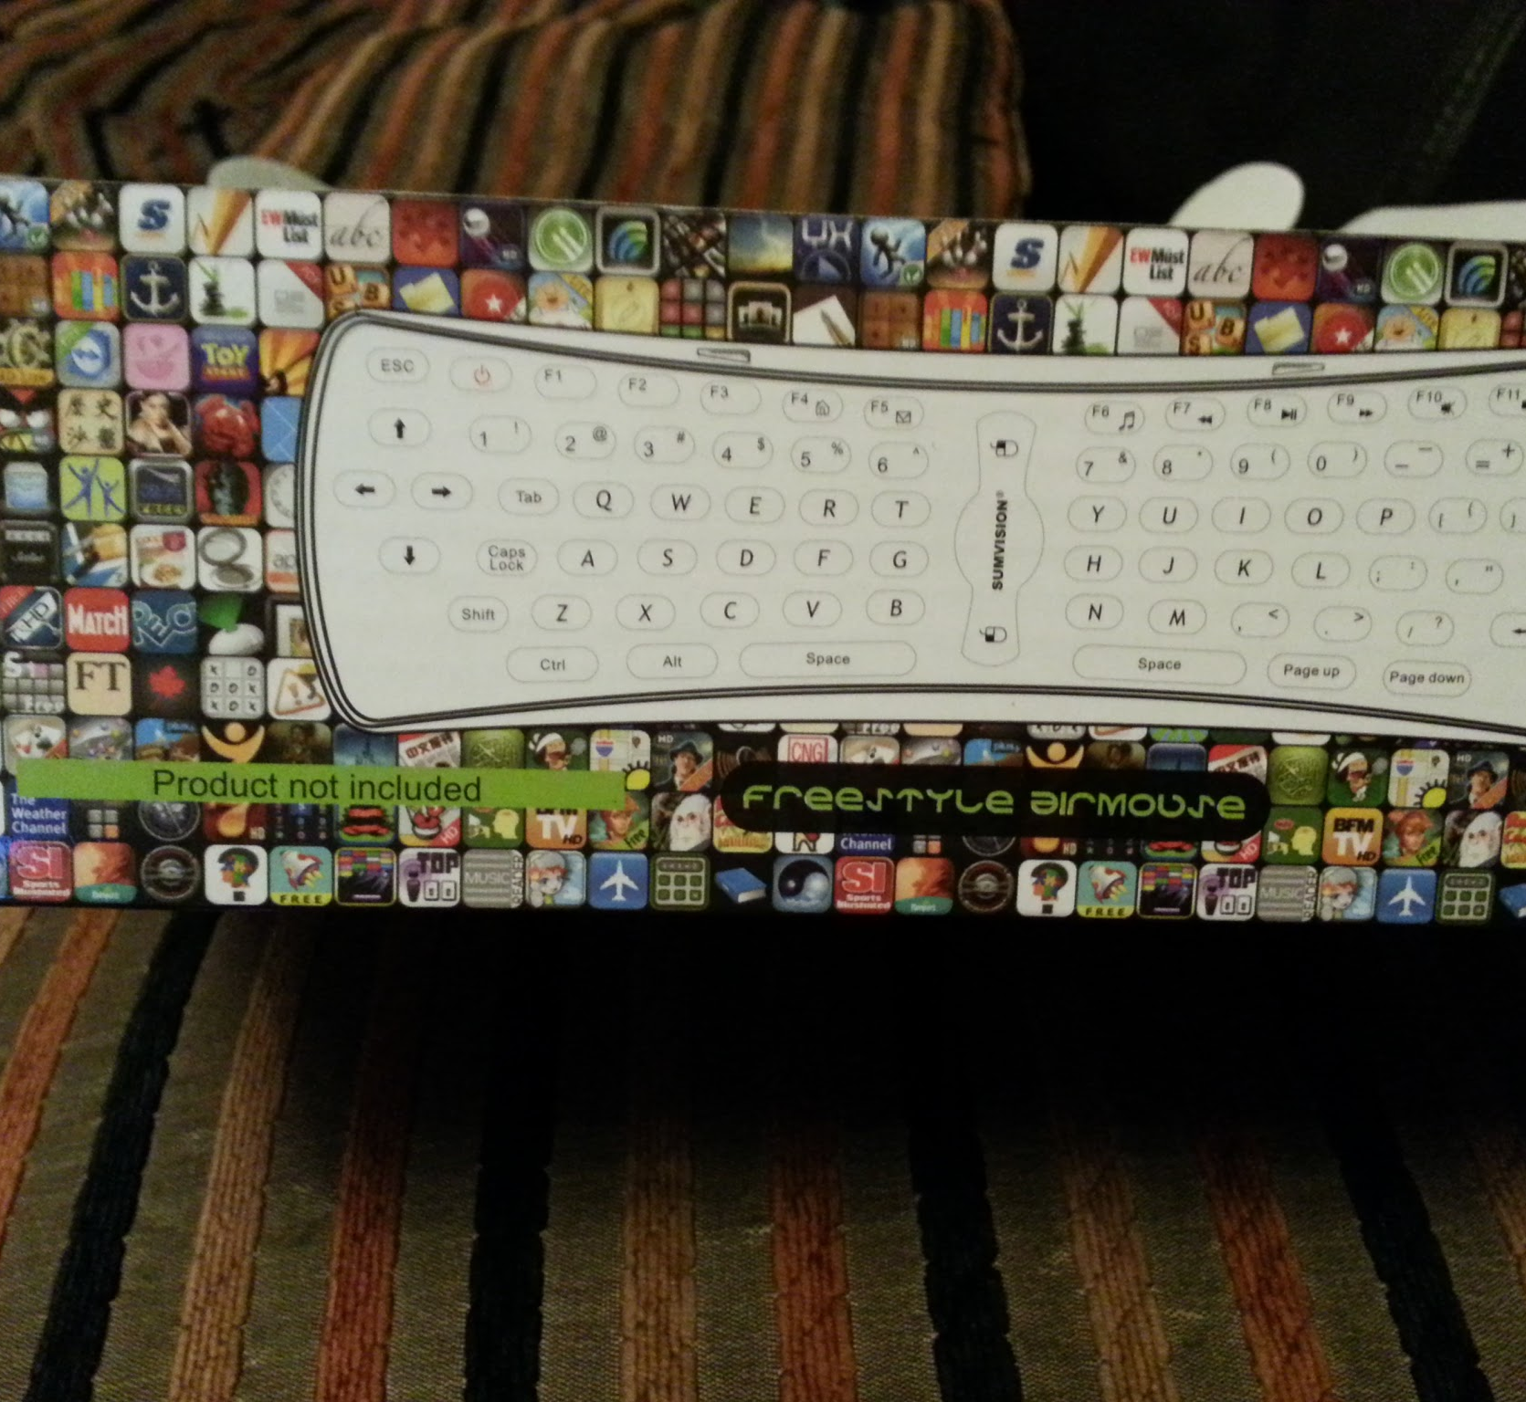
Spotting an Opportunity
Searched for a media player in 2012.
Discovered Android Box.
Recognized a gap in the UK market.

Slide 4
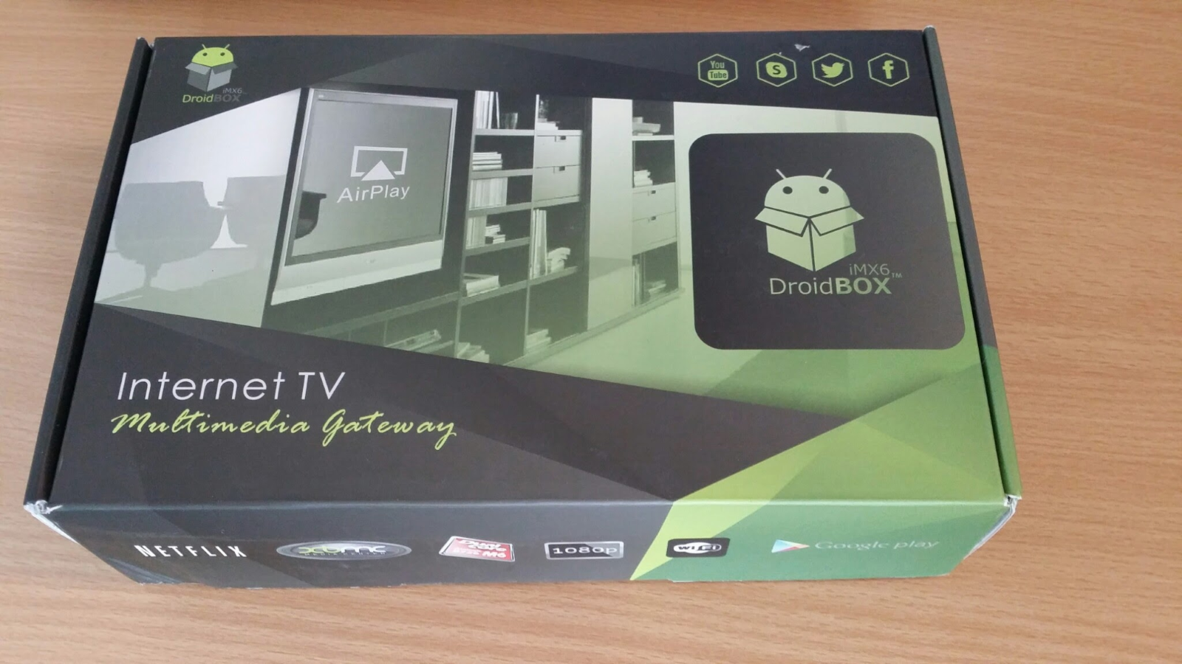
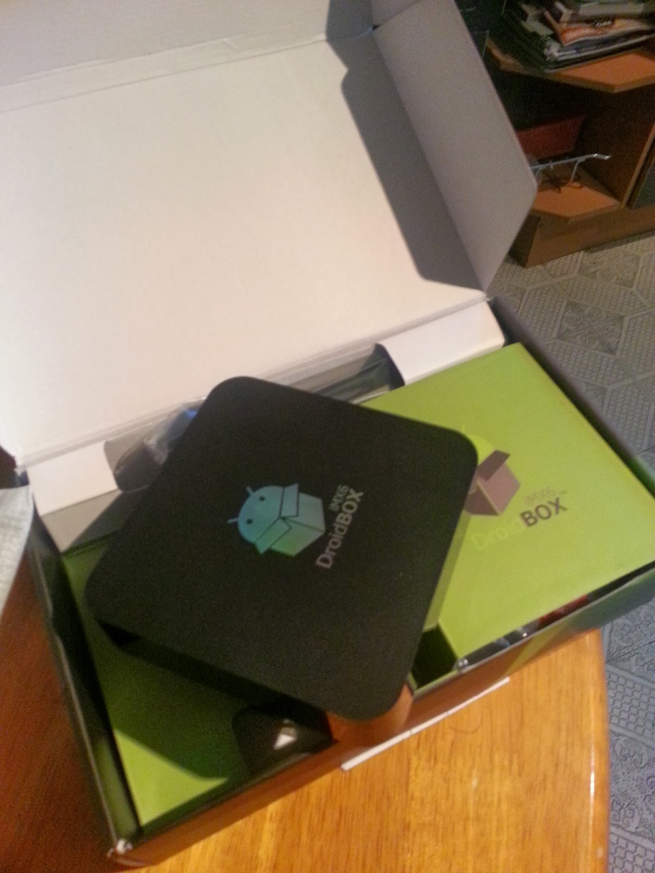
Taking the First Step
Started selling on eBay in 2012.
Realized importance of branding by 2013.
Registered the DroidBOX trademark and domain.

Slide 5
Embracing Amazon FBA
Introduction to Amazon FBA.
Shifted from manual shipping via Royal Mail.
Discovered the ease of Linnworks for order management.

Slide 6
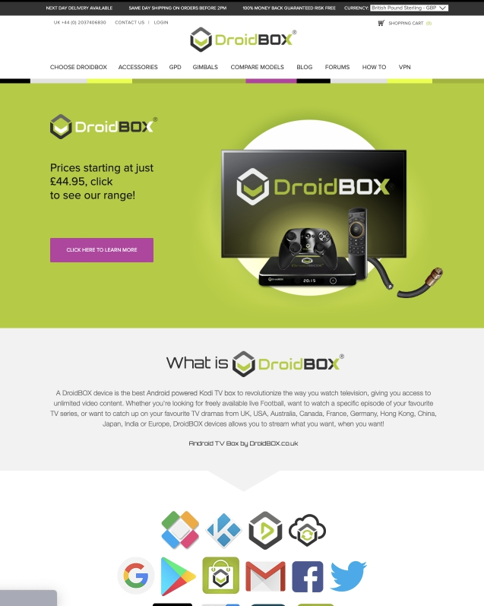
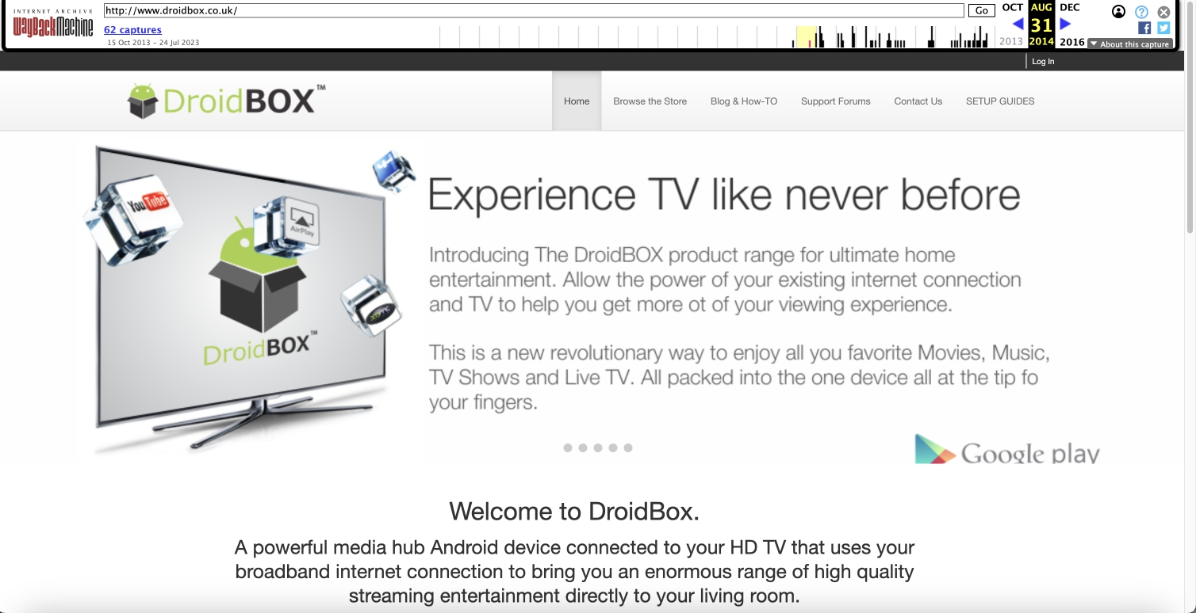
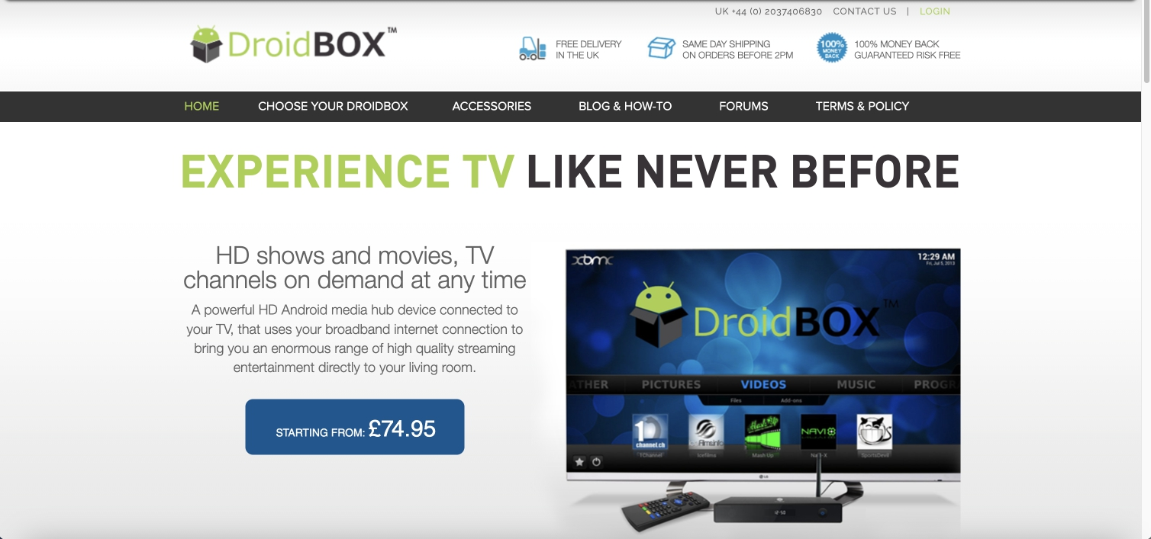
Commitment to the Vision
Left full-time job in January 2014.
Recognized the potential of an E-commerce website in 2015.
Partnered with Magecloud for Magento 1.9 website.

Slide 7
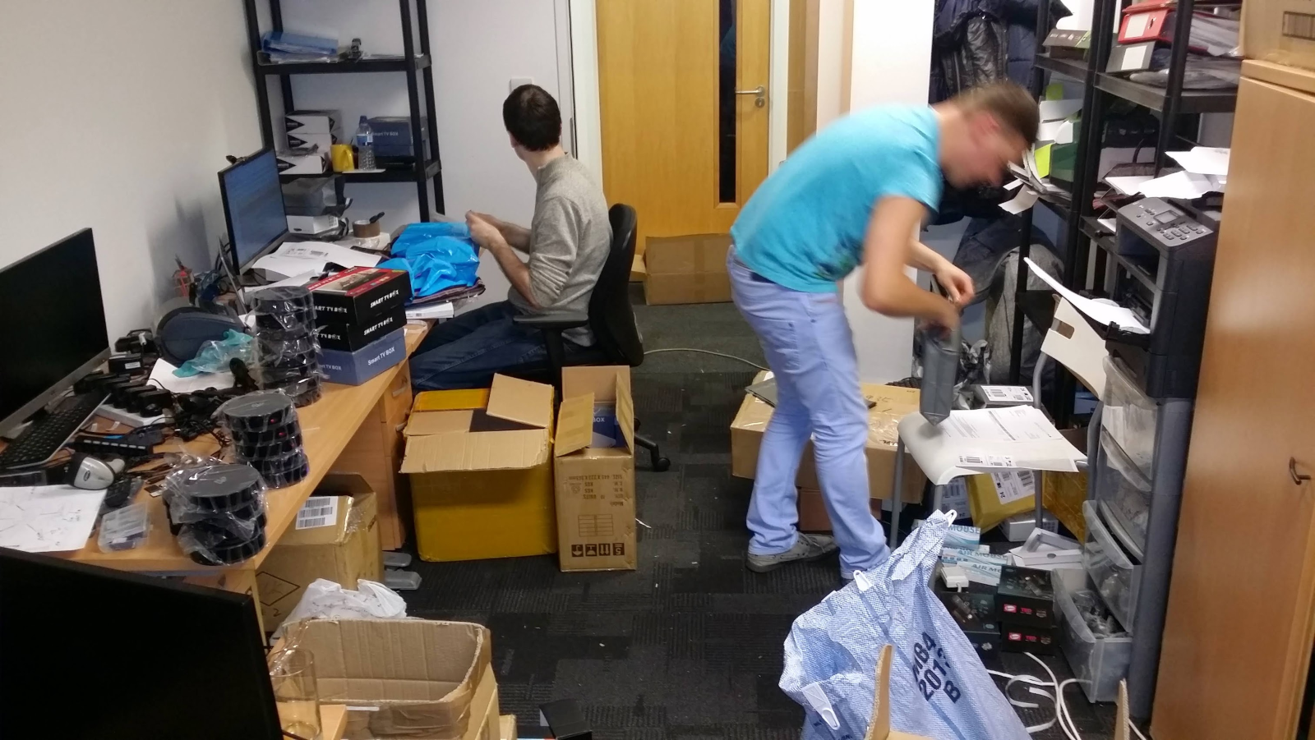
Navigating the Ecommerce Waves
Moved to a bigger office in 2015.
Diversified products post-Brexit 2016.
Google's objection to "DroidBOX" brand in 2016.
Increased turnover by 25-30% in EU markets & FBA.

Slide 8
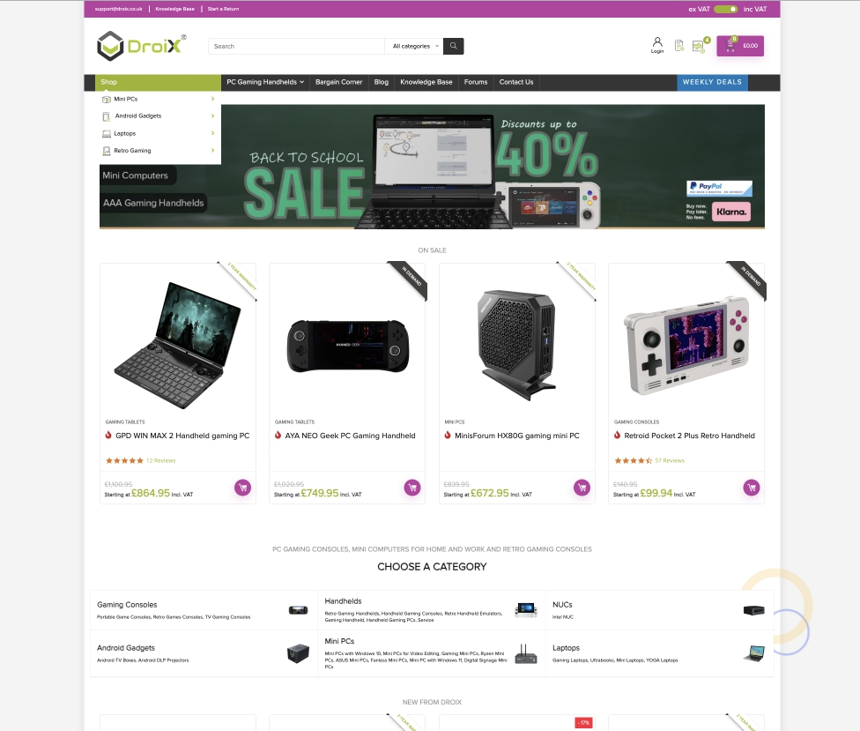
A New Identity A Global Vision
Expanded to Amazon USA (2017-2019).
Rebranded to DroiX after 3 years of litigation.
Introduced DroiX Global (DroiX.net) in 2019-2023.

Slide 9
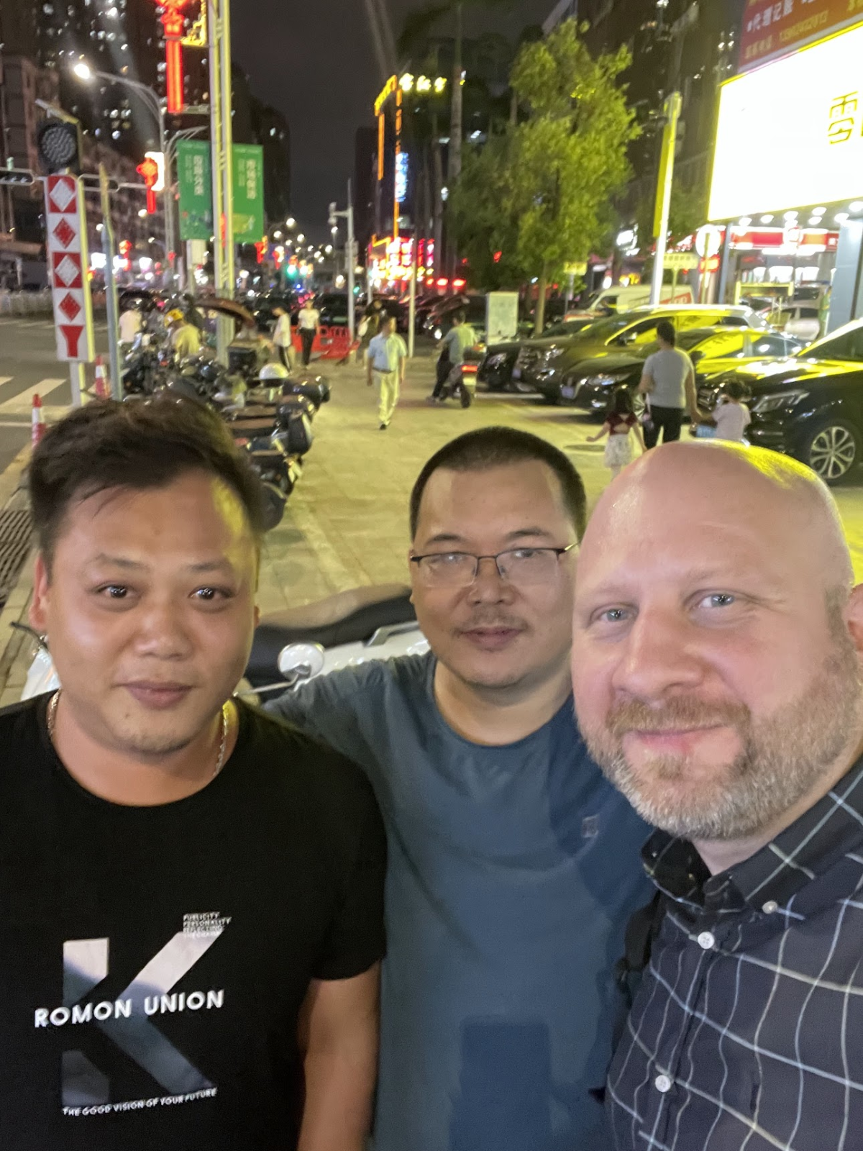
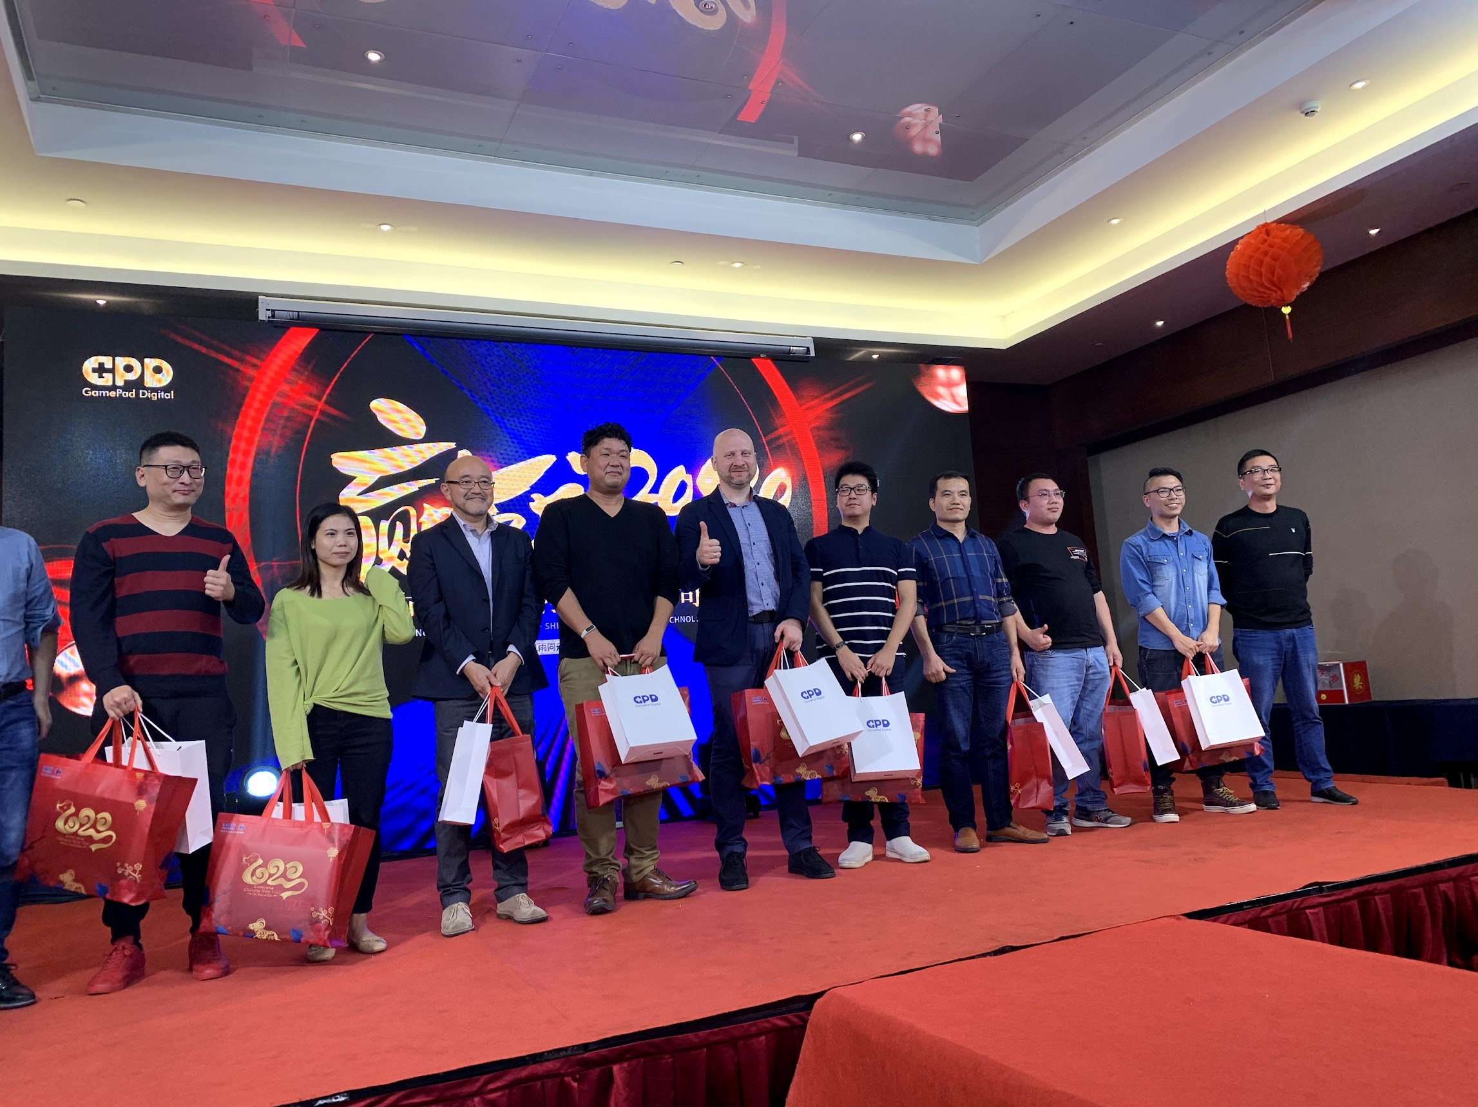
Importance of Relationships
Importance of personal relations with suppliers.
Benefits: Better deals, extended warranties, priority support.

Slide 10
The Present Snapshot
Amazon, eBay, and DroiX platforms.
Over 100 active SKUs.
Presence on major social platforms.
In-house team structure.

Slide 11
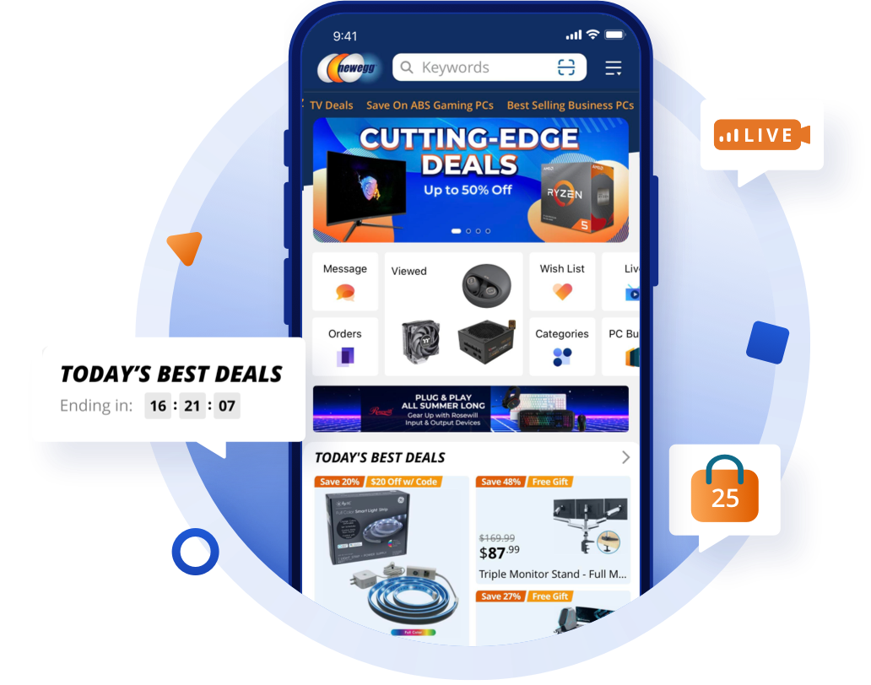
The Road Ahead
Strengthen video reviews and social presence.
Expanding into more Marketplaces
eBay USA
eBay Europe
Walmart
Newegg

Slide 12
From One to Many
s
10 Years of journey encapsulated
The importance of adaptation, relationships and vision in Ecommerce

Slide 13
Selling / Marketing / Future
Our Selling Platforms
Choosing the right one
A Product’s journey
Marketing & Selling Services

Slide 14
Making the Right Decision
In-house customisation
In-house design
AI Assistant for Development
Flexibility
Maintenance
Scalability
Documentation

Slide 15
Going the Woo Commerce way
Magento to WooCommerce
Why WooCommerce?
Developing WooCommerce
PROs and CONs
Plugins
Customisable
Documentation
No Transaction Fees
Plugins
Customisable
Security
Stability

Slide 16
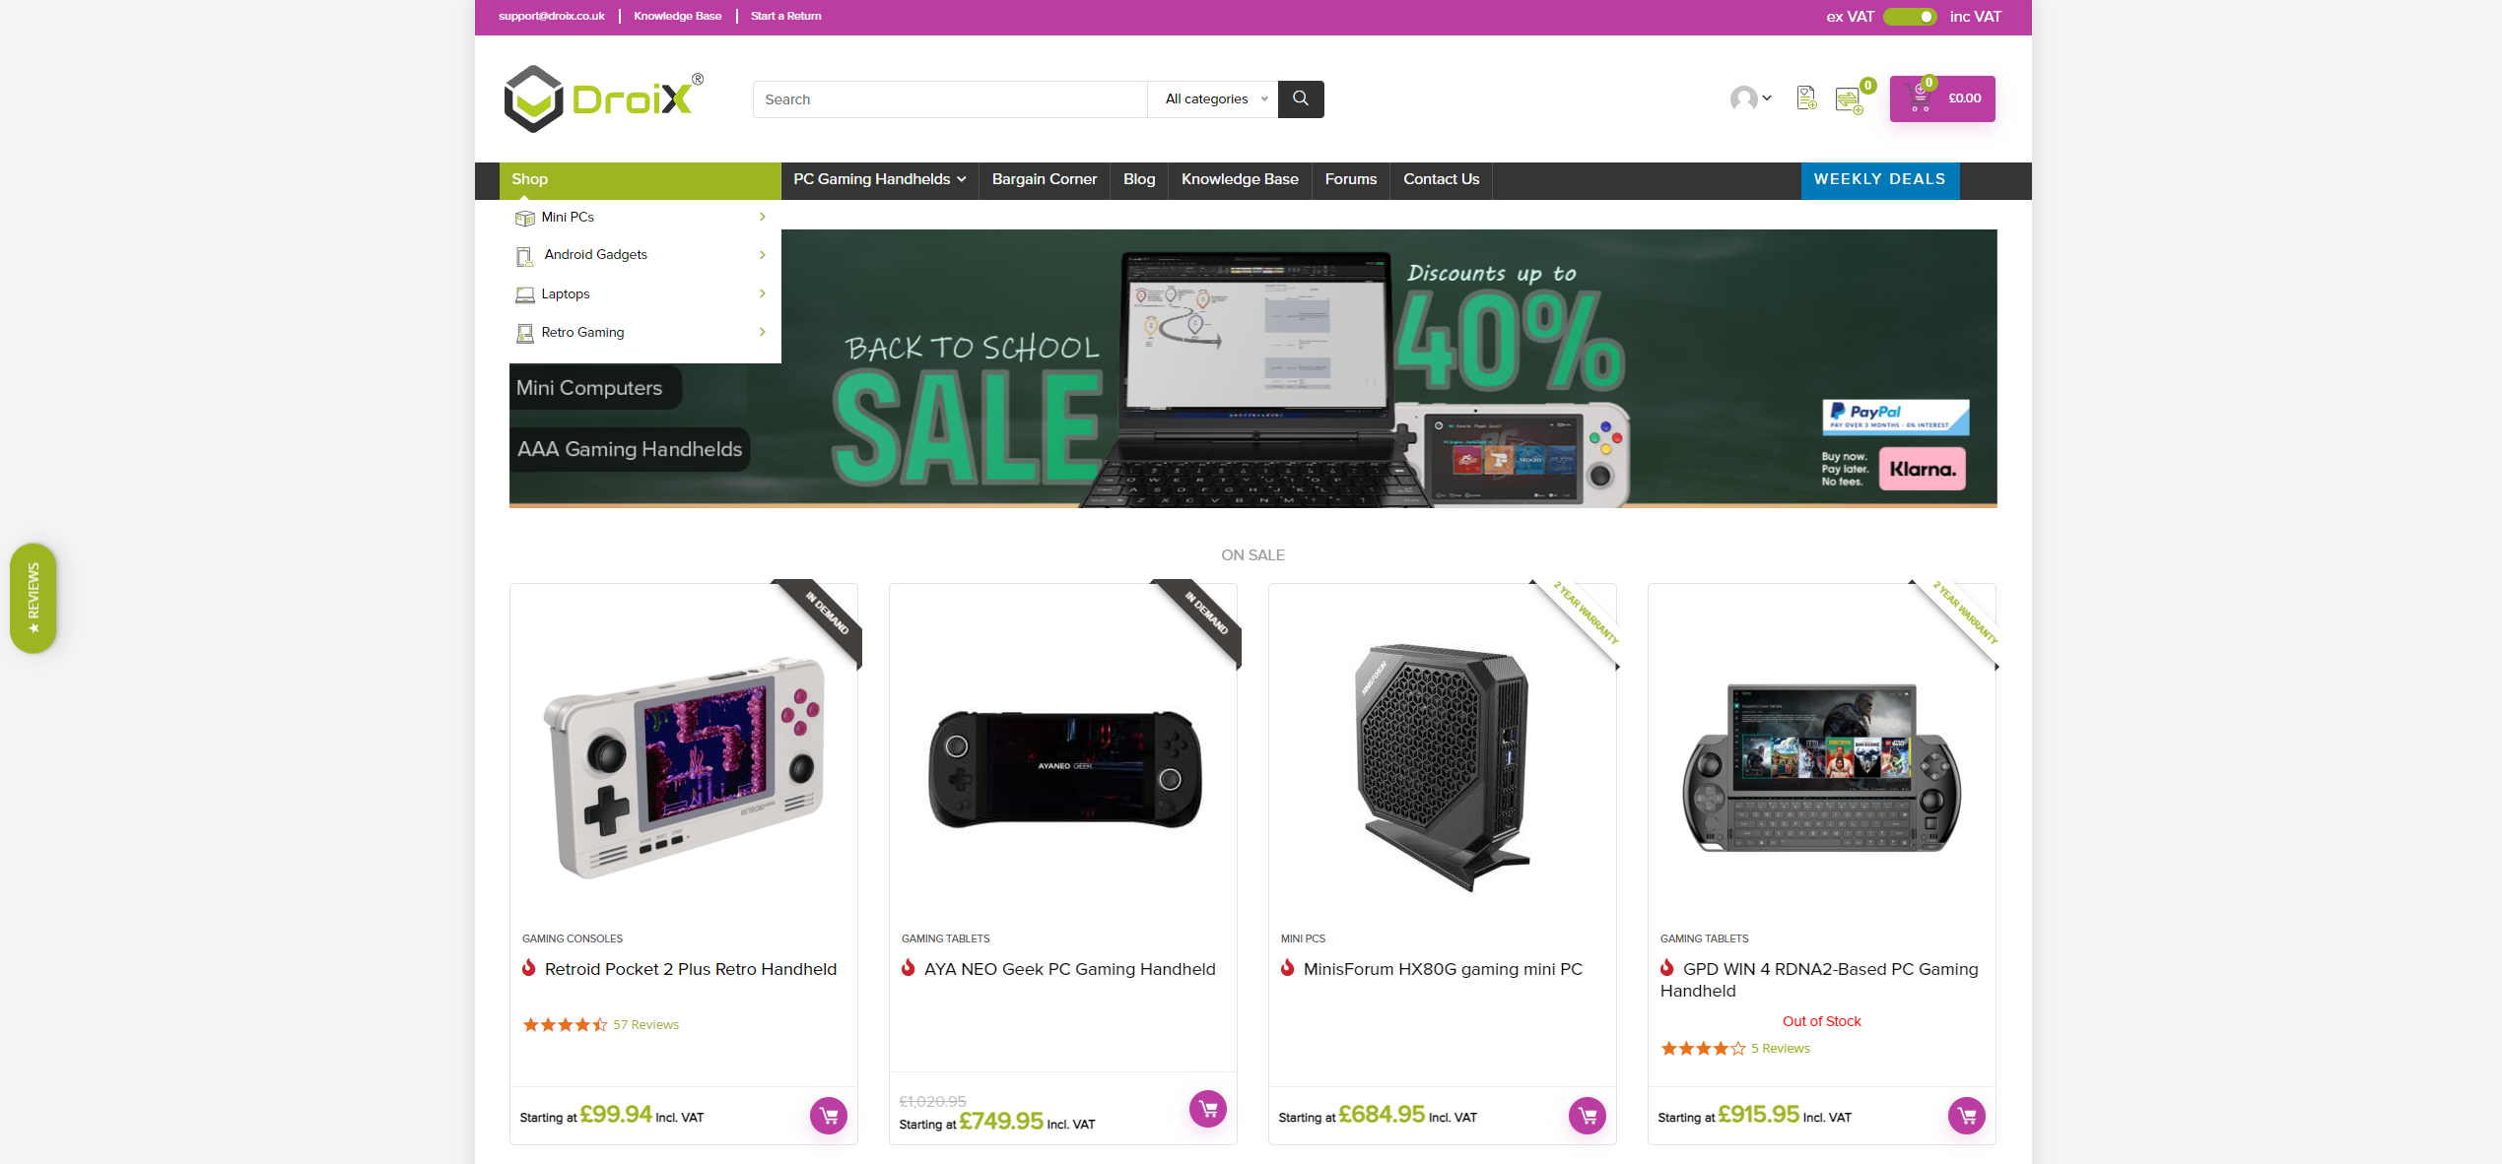
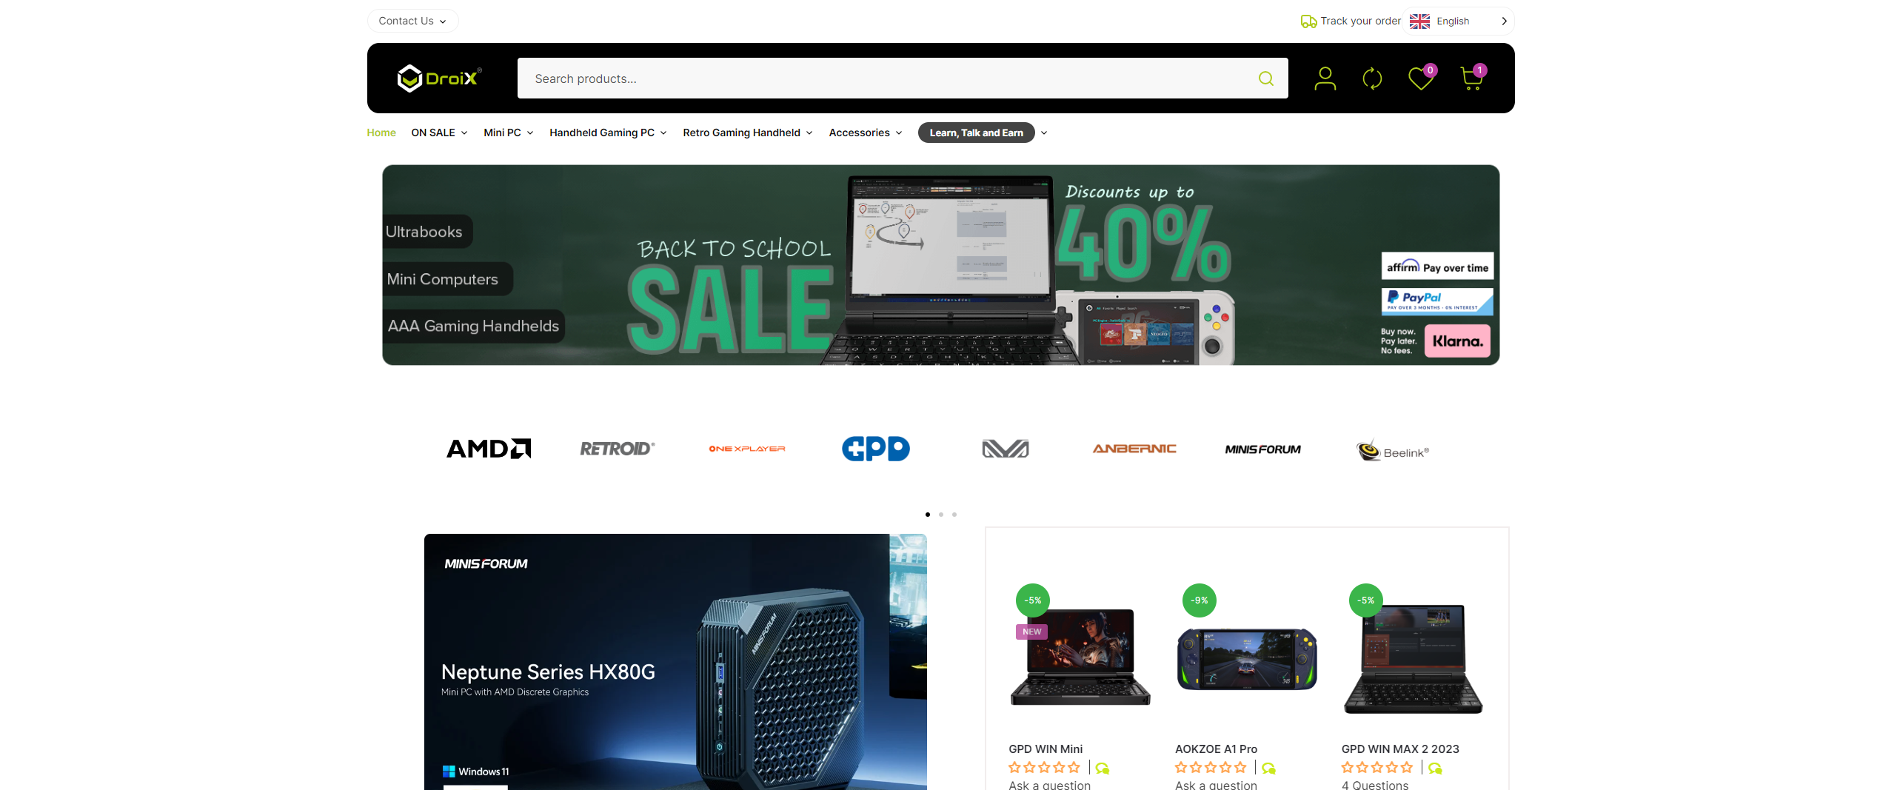
Going Live
DroiX.co.uk for UK Customers
DroiX.net for International Customers

Slide 17
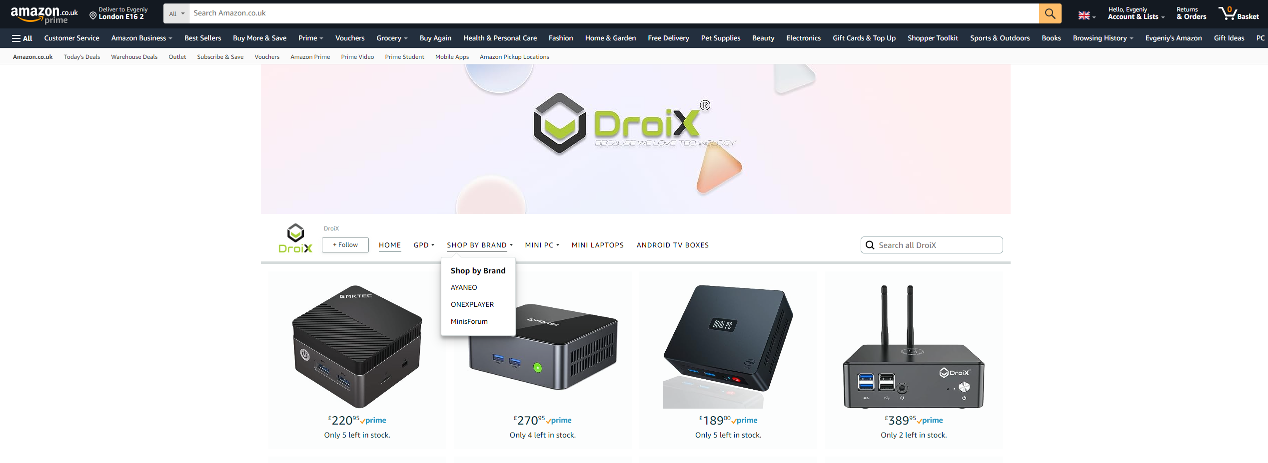
A “must-have” Amazon
Access to over 2 billion visits
Fulfillment by Amazon
Brand Expansion
Extra Sales Revenue

Slide 18
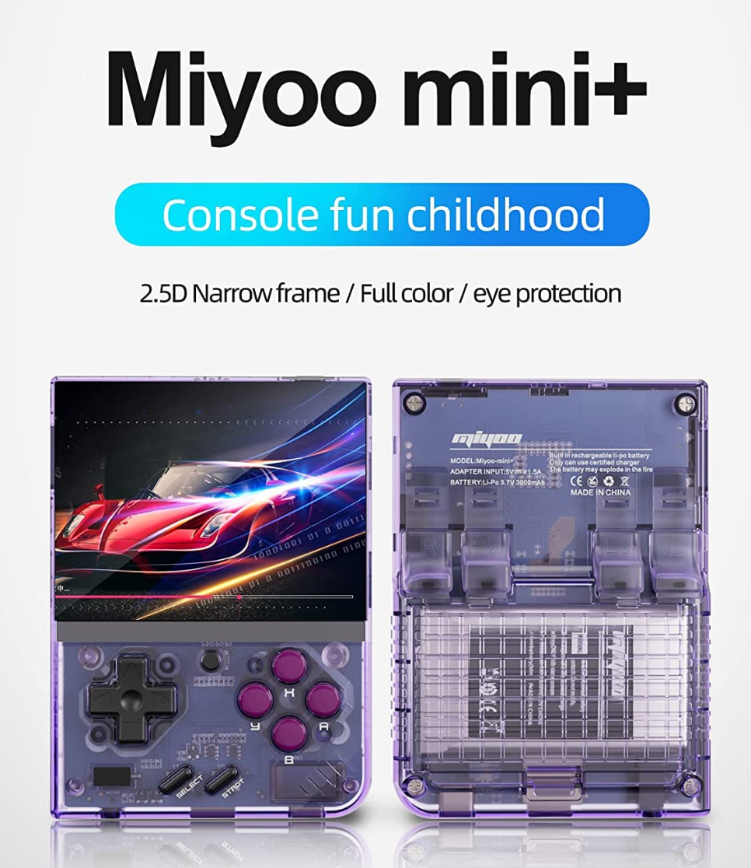
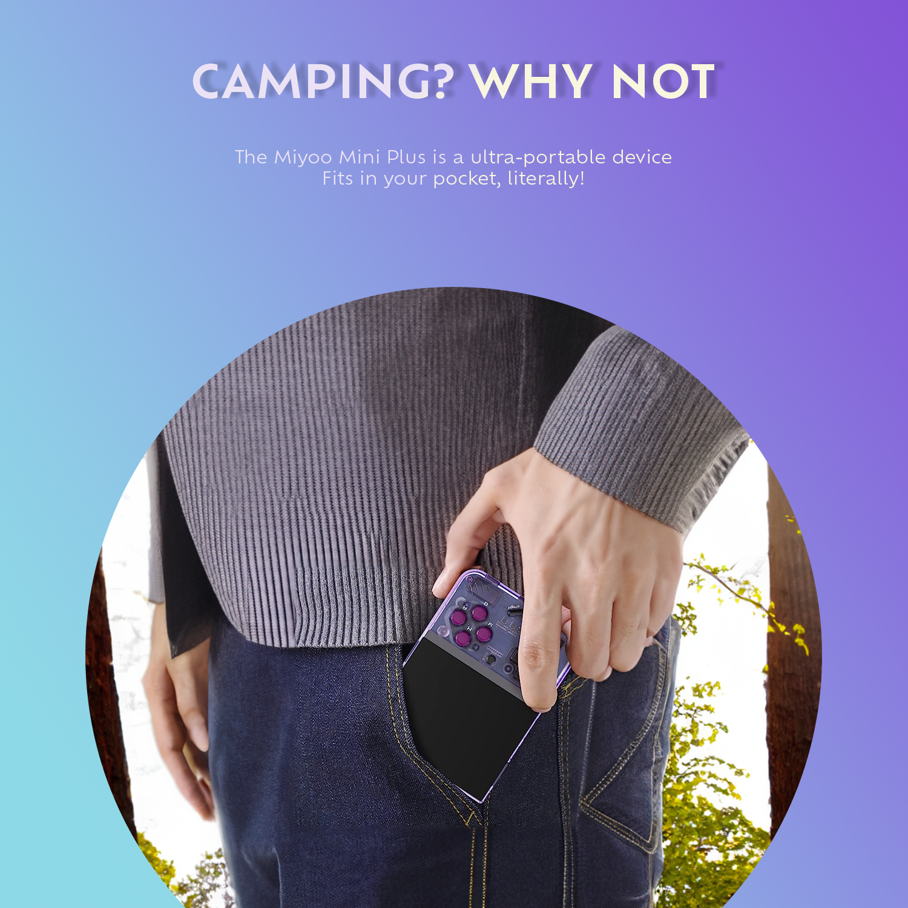
Shine a light on your product
Marketing The Product: Ensure visibility and awareness.
Target Demographic: Original materials often miss the mark.
Importance of Good Grammar: Bad spelling can increase website bounce rate by 85%.
DIY Approach: Craft your own appealing product images.
Highlight Positives: Showcase the product's best features.
Control Presentation: Images should allow customers to visualize owning the product.
Bonus: Unique images boost SEO.

Slide 19
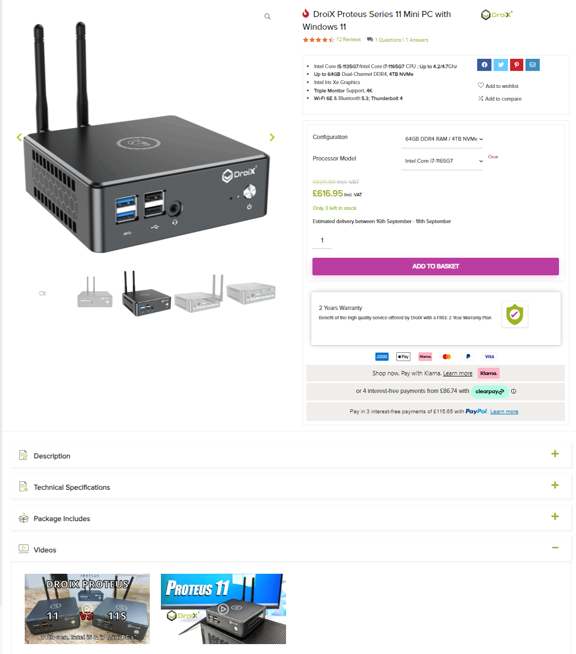
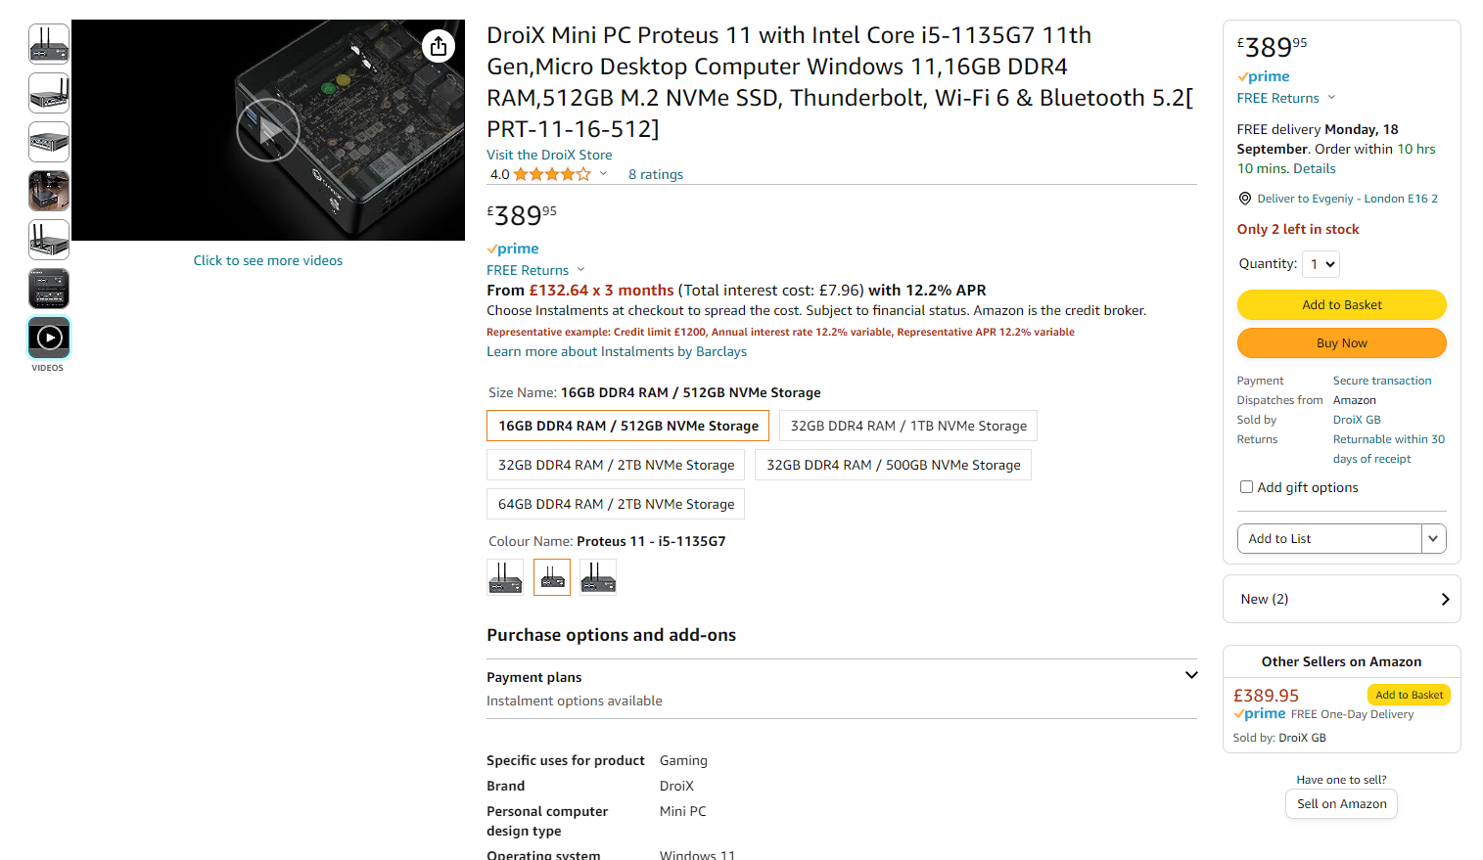
Using all the Tools
1st or 3rd Party

Slide 20
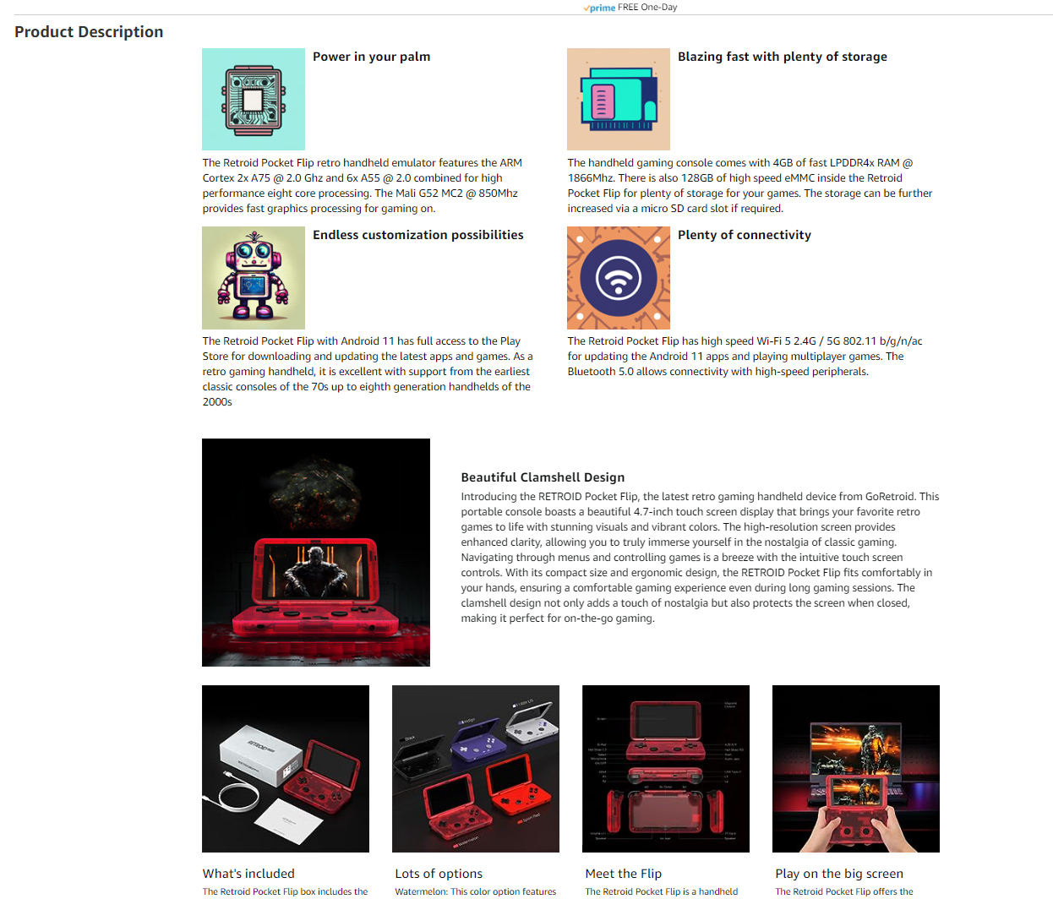
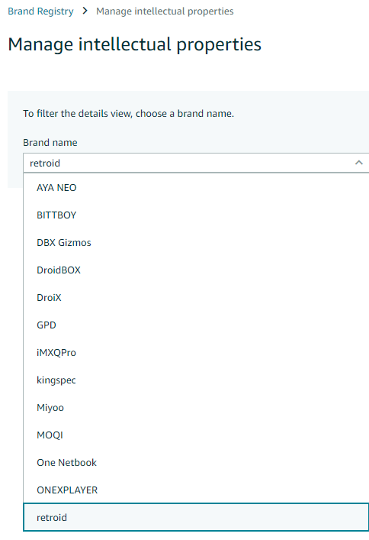
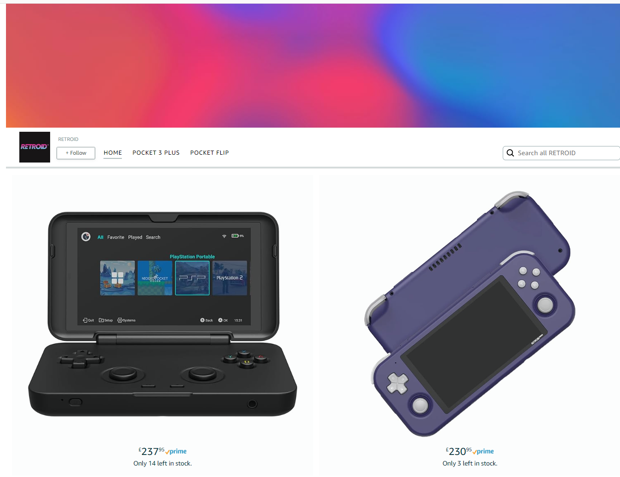
Amazon Brand Registry
Sponsored Brand Ads
EBC Content
Stores
Videos

Slide 21
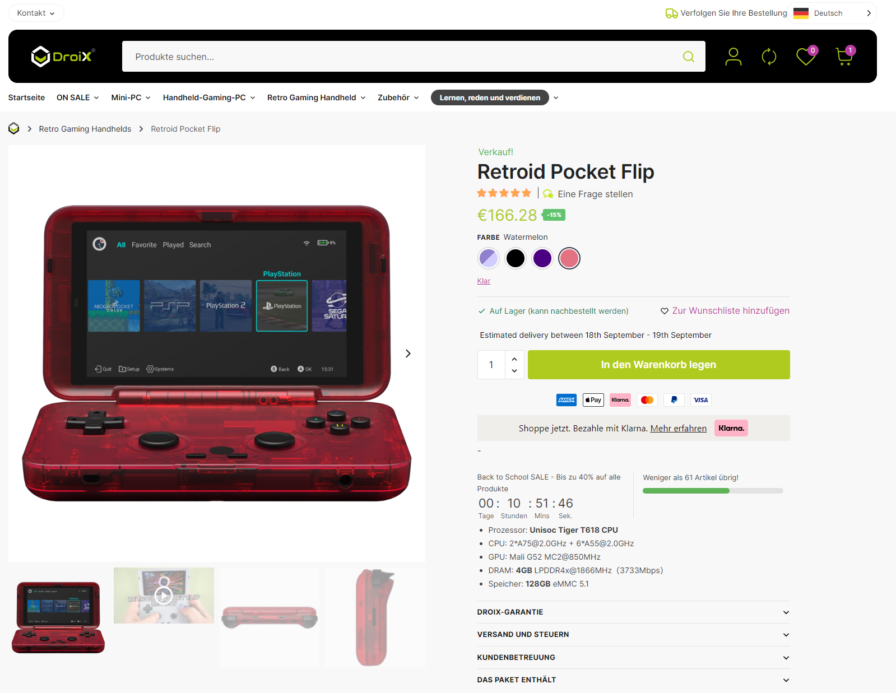
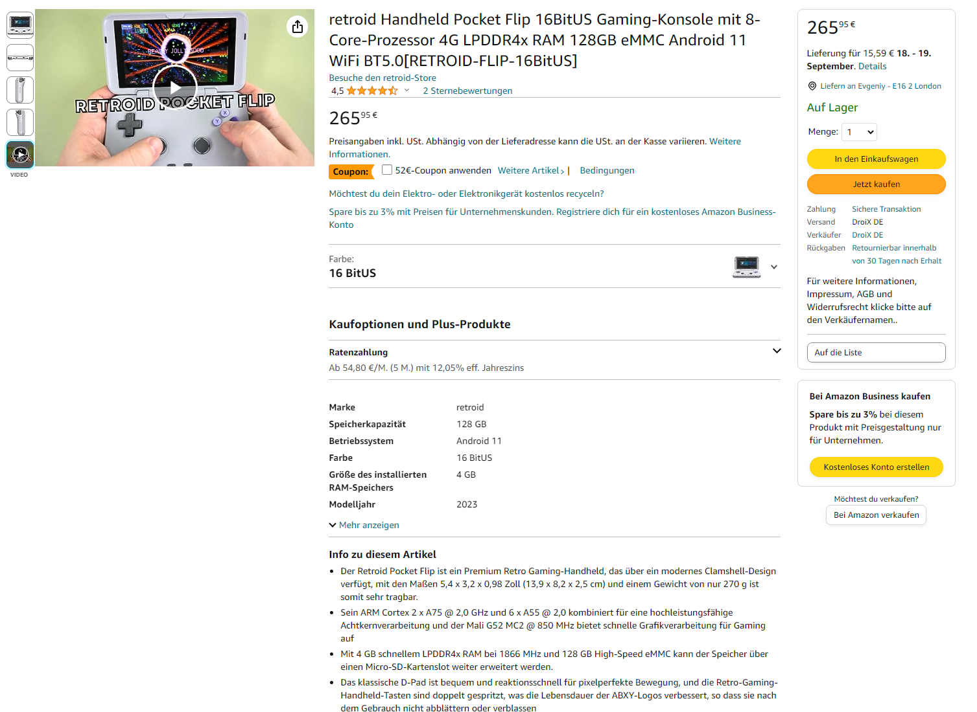
Multi-Language Content
Listings, Ads, Videos

Slide 22
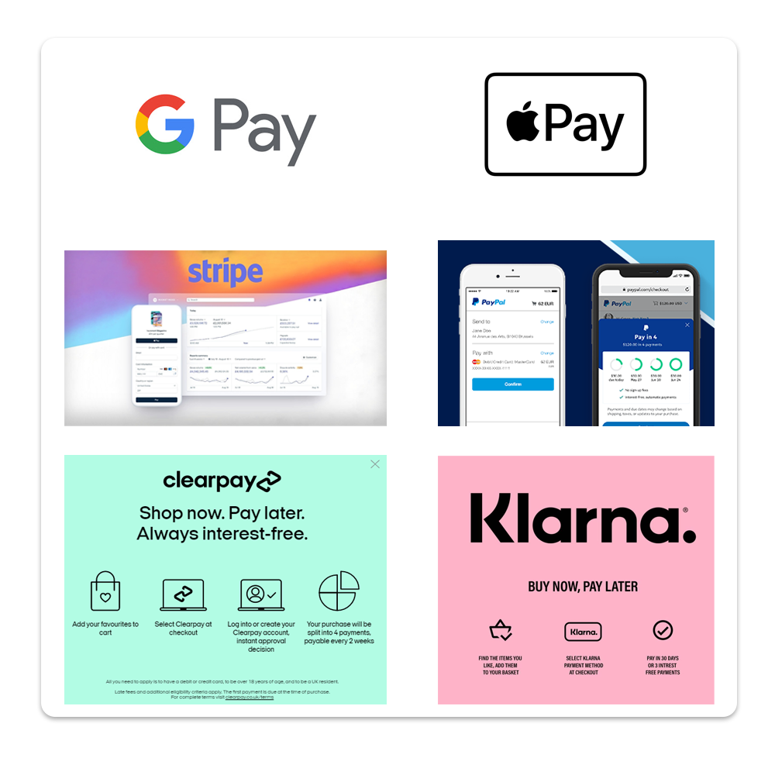
Payments Selling Fees
Payment Methods
First Party Fees
Payment Processor Fees
Amazon Selling Fees

Slide 23
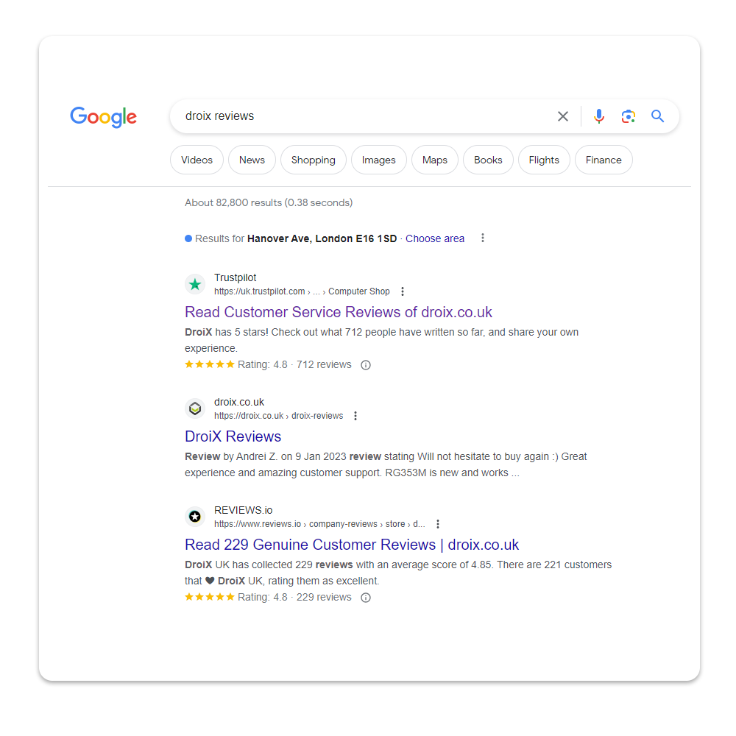
Brand Strength
Review Aggregators
Google MyBusiness
Influencers
Customers

Slide 24
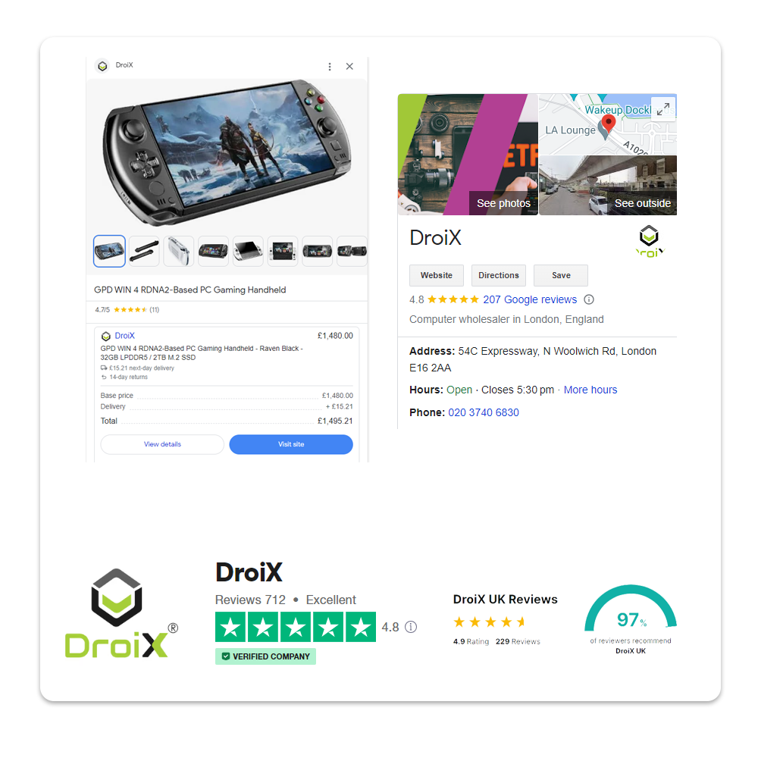
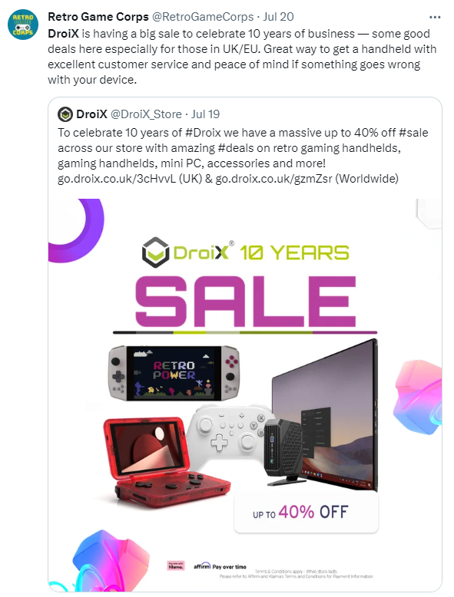
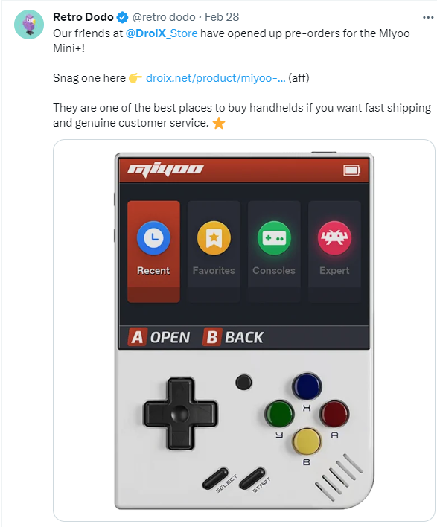
Community Voice
Word to Mouth / Perception of Brand

Slide 25
Customer service
Options for contacting DroiX
e-mail, phone, live chat, contact form
Knowledge base
Customer support software
Zendesk
SupportSync
3 dedicated people for customer support – reply time < 24h
One dealing 12 hours per day with Zendesk & Live chat
One person dealing with customer returns & technical support
One person answering the phone line and handling logistics related issues

Slide 26
Customer support software
Integrates all communication options to the customers
Integrates Channel Reply messaging from our marketplaces including Amazon, eBay, Walmart
Rich in features but can get pricey
Average number of tickets per month is around 2000
Most common questions from customers - use of macros
Where is my order?
When will it ship?
I want to cancel my order.
Will I need to pay import taxes?

Slide 27
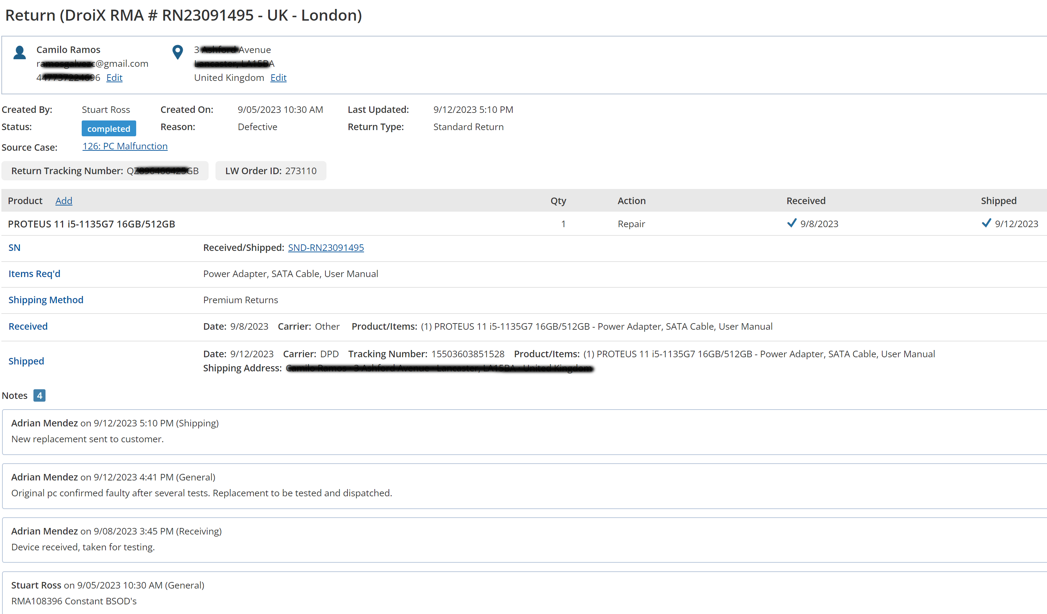
Customer return software
Streamlines the process
Provides an automated frontend system for customers to track the progress of their return
Provides reports with statistics

Slide 28
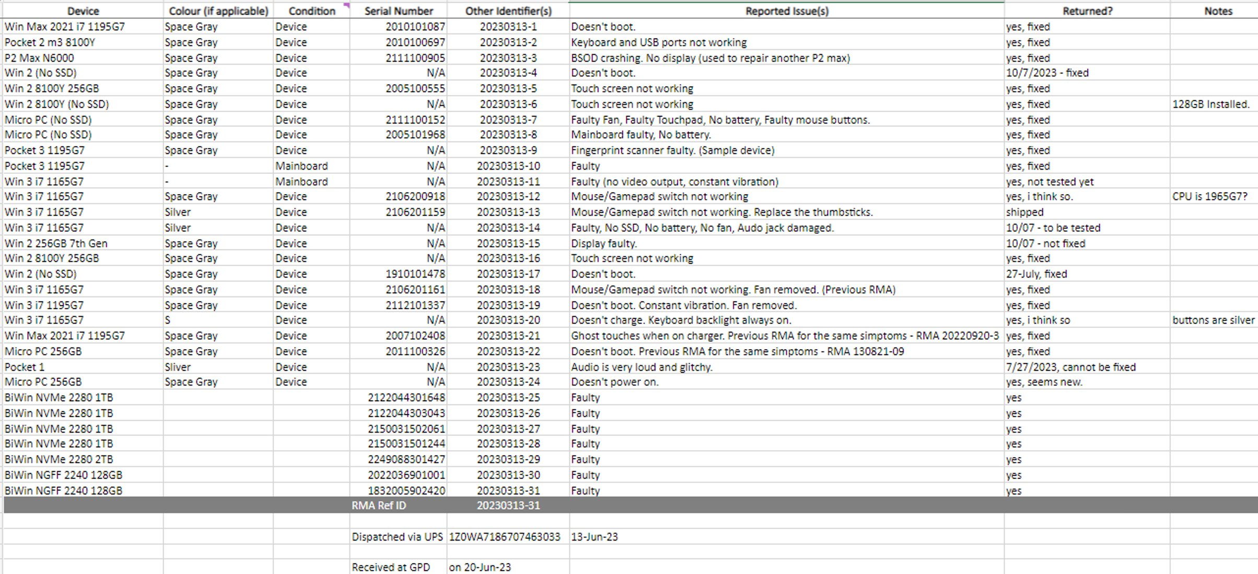
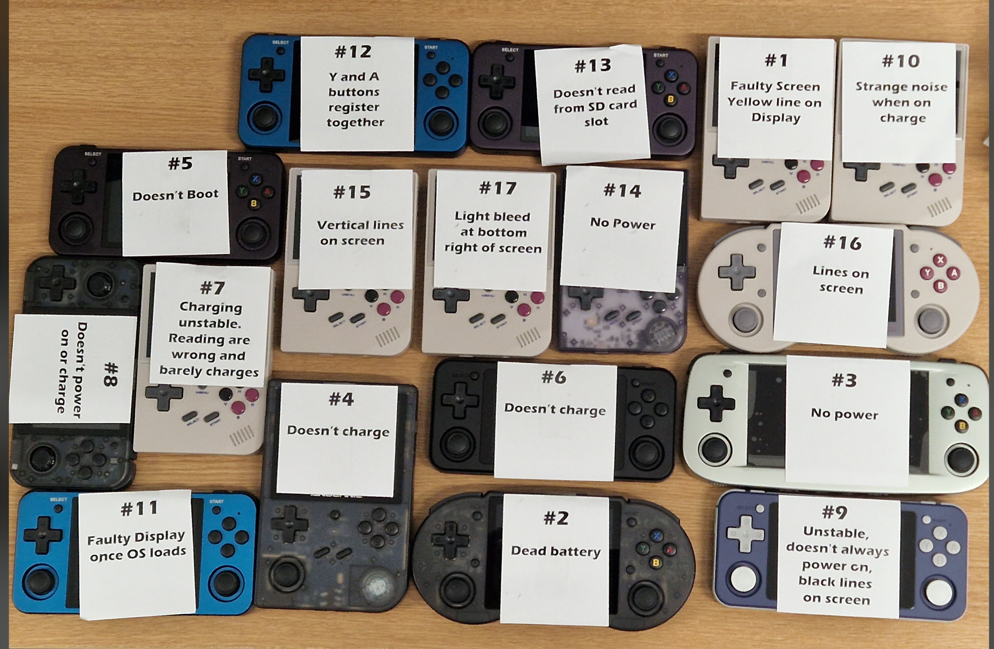
Chinese suppliers providing RMA

Slide 29
Logistics
Fulfilling orders to customers – delivery and local collection
Lost for 2023 – more than 30 parcels.
Global Mail (Deutsche Post) lost more than 20 and after we claimed they informed us the parcels were destroyed due to hazmat
How to protect Choose your shipping partners carefully
Insure your parcels
Other issues (damaged, delayed, missing items, disputed deliveries)
Collection issues with DPD
Missed collections – delayed orders
Non scanned parcels – lost, unable to claim

Slide 30
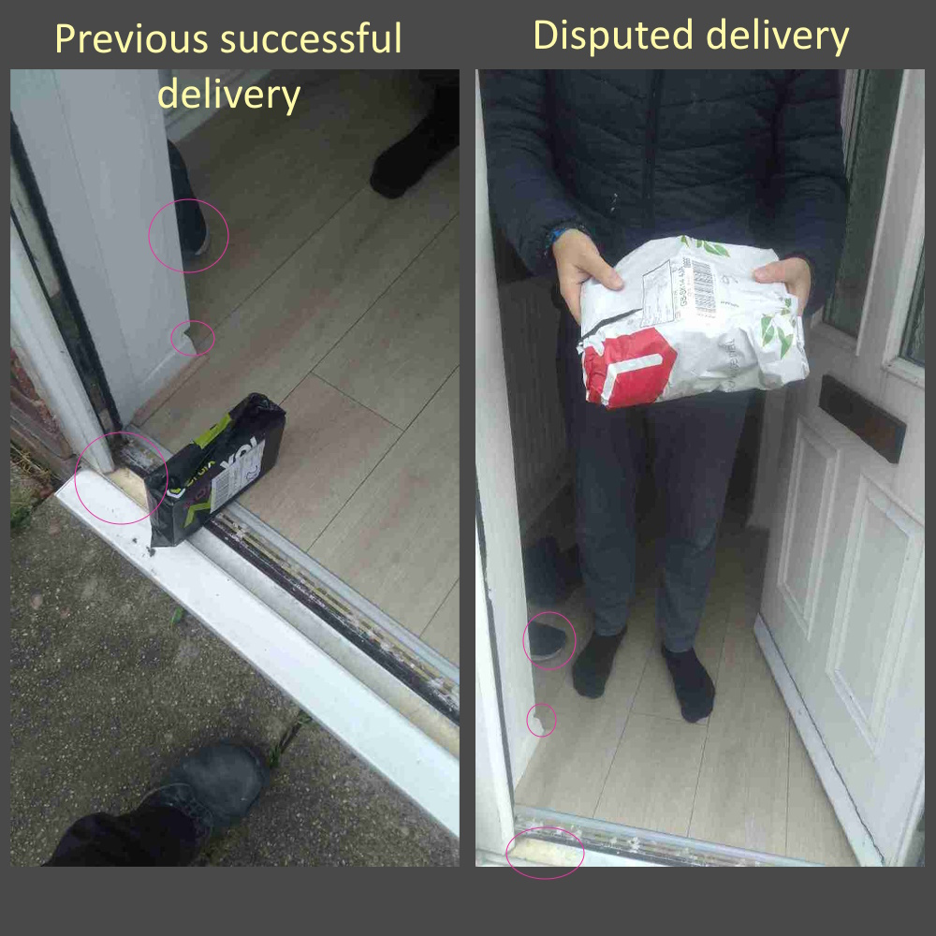
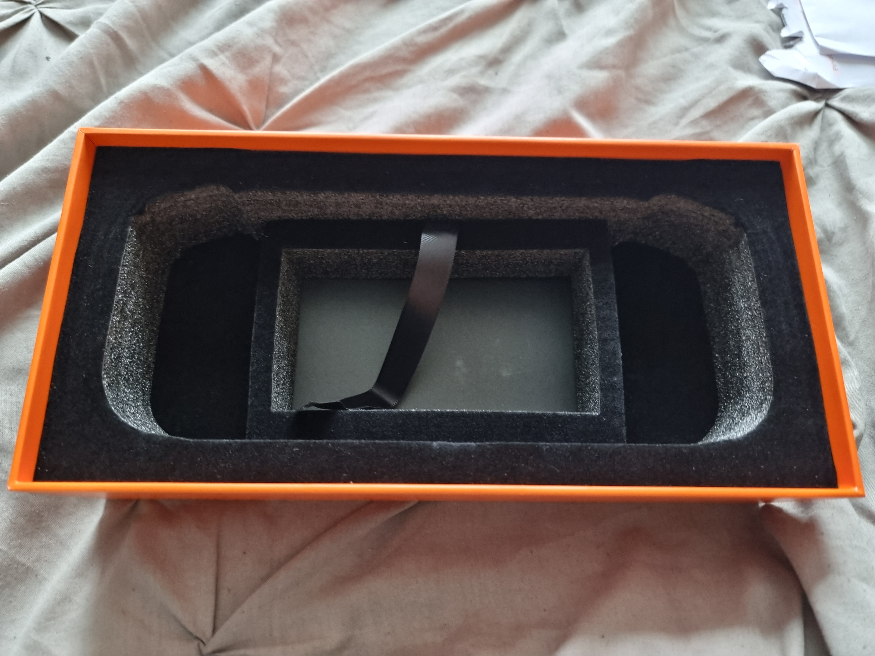
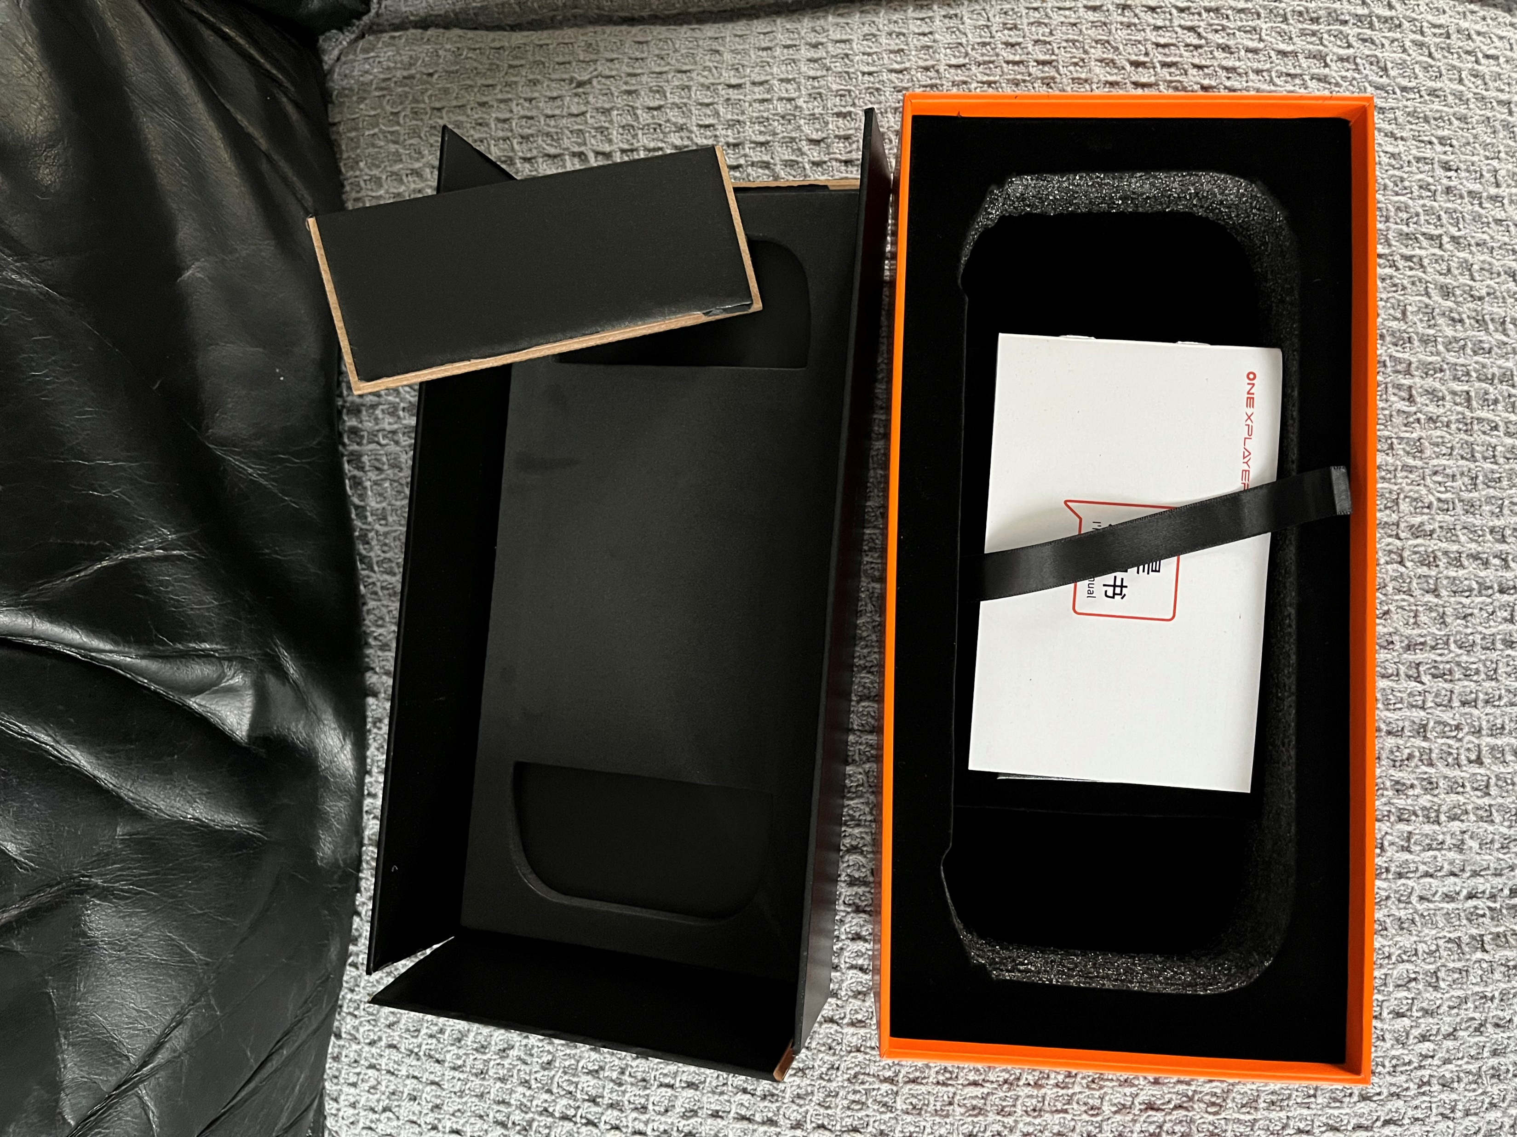
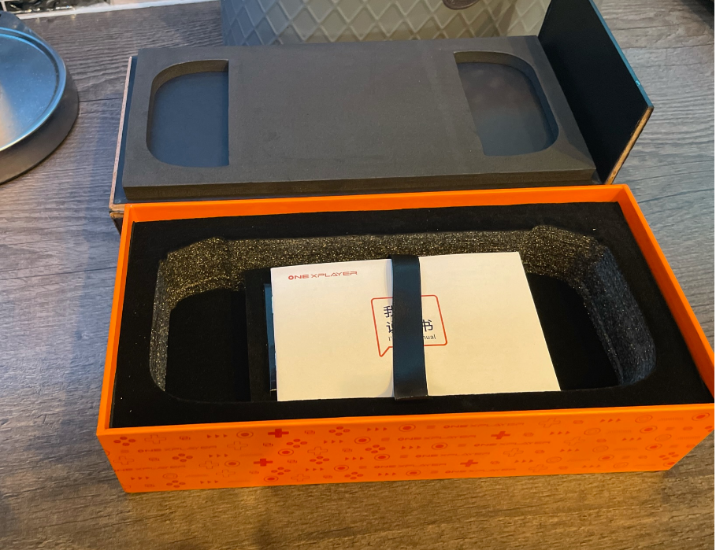
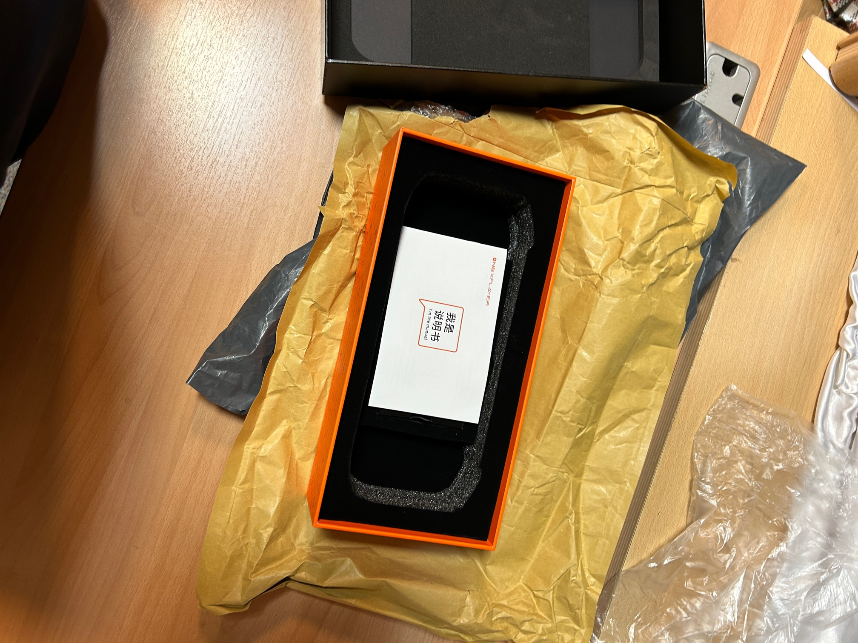
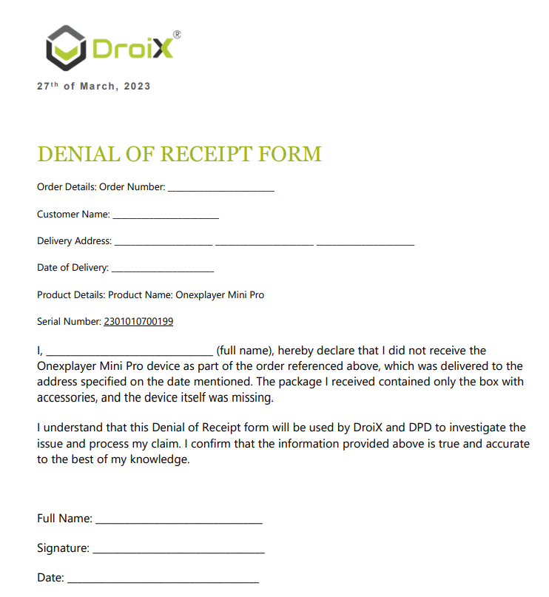
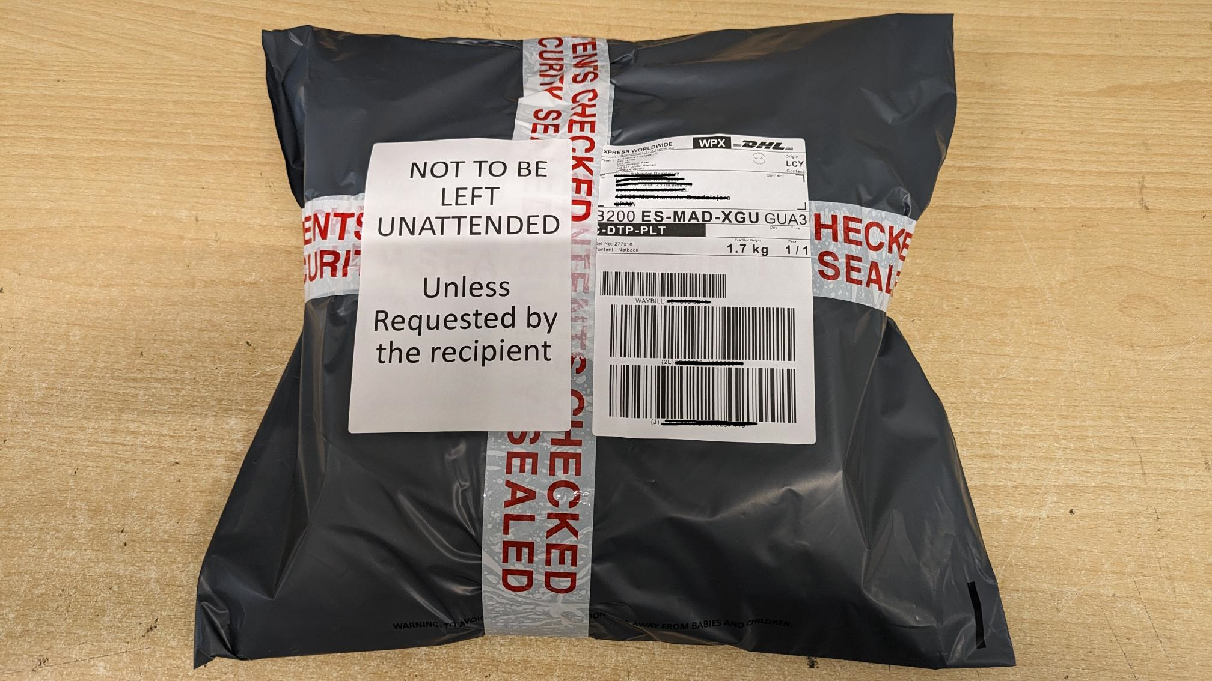
Scams
Disputed deliveries
Ways to protect

Slide 31
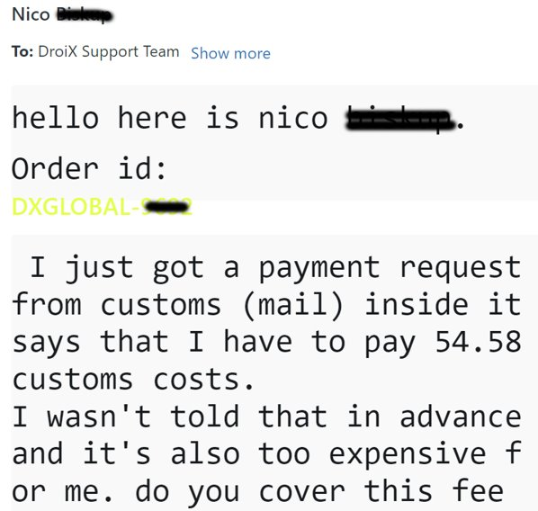
Logistics - BREXIT
Implementing shipping services to adjust to the change – DDP, IOSS
Issues with customers from EU
“Will I need to pay import taxes?”

Slide 32
Social Media
We use all the main social media platforms for customers to contact us with any queries.
We also use these platforms to promote our store and engage with customers.

Slide 33
Not all social media works for us
What works
YouTube
Twitter/X
Blogs
What doesn’t work
Instagram
TikTok
Mixed Success
Facebook

Slide 34
Why does it not work for us?
It can take a lot of time to create content specific for a social media platform
You must consistently post new content to be relevant (several posts a day on Twitter for example)
Low engagement on platforms such as Instagram and TikTok (time spent versus results)

Slide 35
Loomly
Create & schedule posts
Reuse content to post to multiple social media platforms
Read & reply to comments and messages in one place

Slide 36
A different approach
Identifying niche platforms such as Reddit & Discord servers run by fans, manufacturers etc
Finding many unchallenged comments regarding DroiX

Slide 37
A different approach
Answer queries
Engage in conversations. Do not to self-promote unless it’s a direct question to the business
Build reputation and trust with users of the platform

Slide 38
Word of mouth
Free advertising
People talking about and recommending your brand
Builds legitimacy for your business

Slide 39
Blogs
Blogs generate 60% of our organic traffic
Keep the content varied, not just pushing your customers to buy a product
Our goal is for people to return as a source of news and information

Slide 40
ChatGPT
You do not need to be a writer to create content
Creates informative content for you
SEO optimised
Saves a lot of time compared to writing from scratch

Slide 41
ChatGPT
You do not need to be a writer to create content
Creates informative content for you
SEO optimised
Saves a lot of time compared to writing from scratch

Slide 42
Translations
Use AI to translate your blogs content to multiple languages
Services such as WPML for WordPress make this very easy
It brings in visitors searching in their native language to your blog

Slide 43
Looking to the future
AI video translations of voice overs for product reviews on localised stores such as Amazon France, Germany, Spain and Italy
Considering to reuse the content for localised YouTube channels

Slide 44
Summary
Identify what social media platforms work best for you, concentrate on the ones that do
Explore different avenues; fan sites, forums, Reddit, Discord etc.
Do not only push your products. Engage on social media to build your brand and reputation
Use services such as ChatGPT, Loomly, WPML & TranslateVideo to help create content more efficiently

