Slide 1
How to make your brand uniquely ‘you’

Slide 2
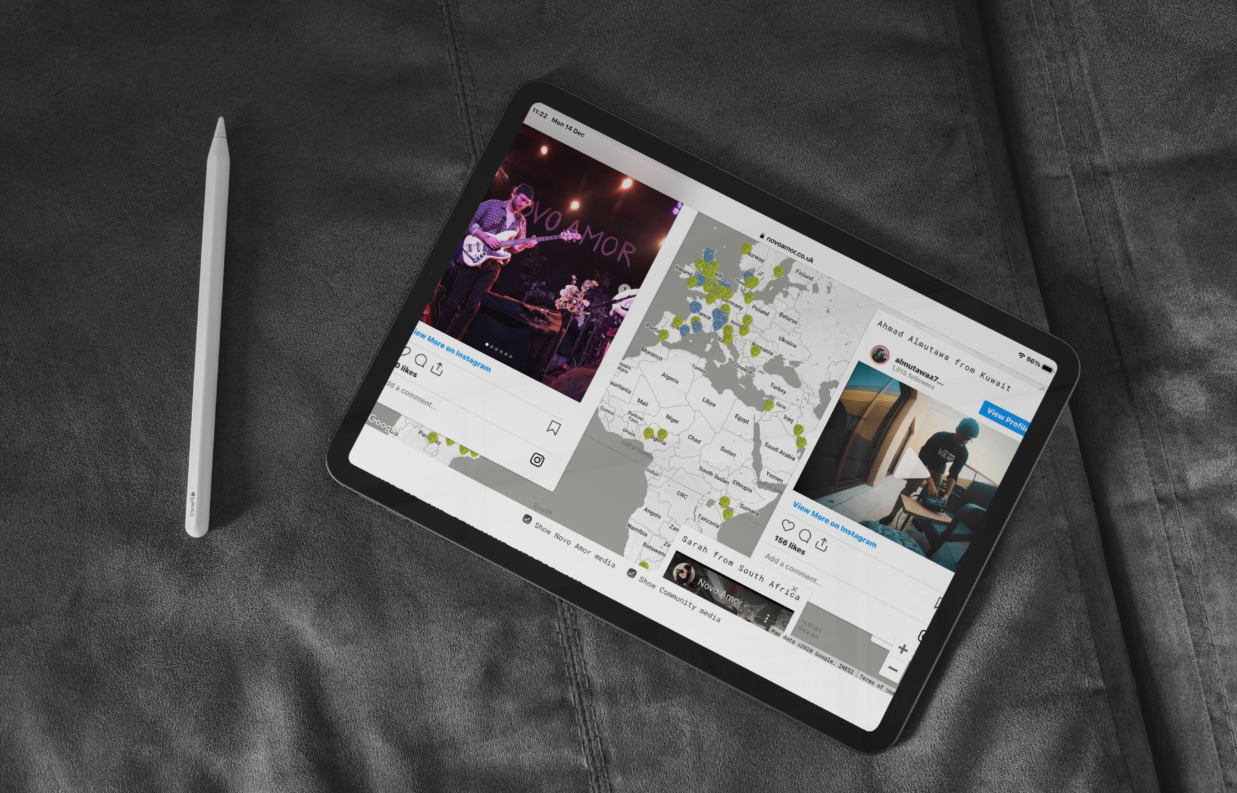
We create award winning campaigns, identities and digital experiences

Slide 3
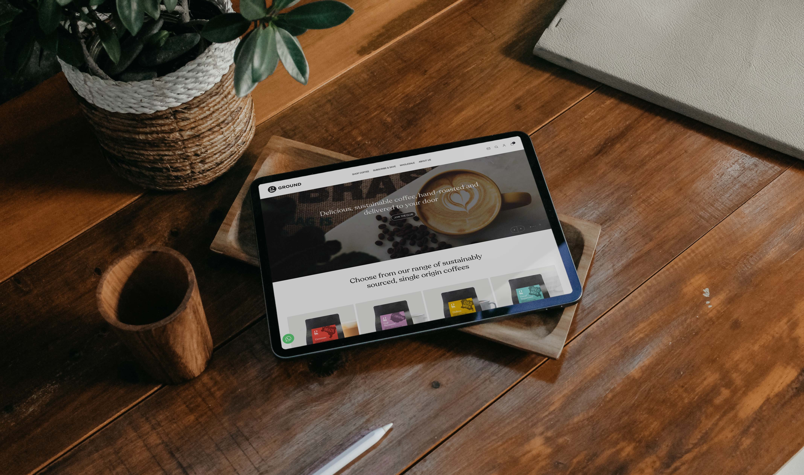

Slide 4
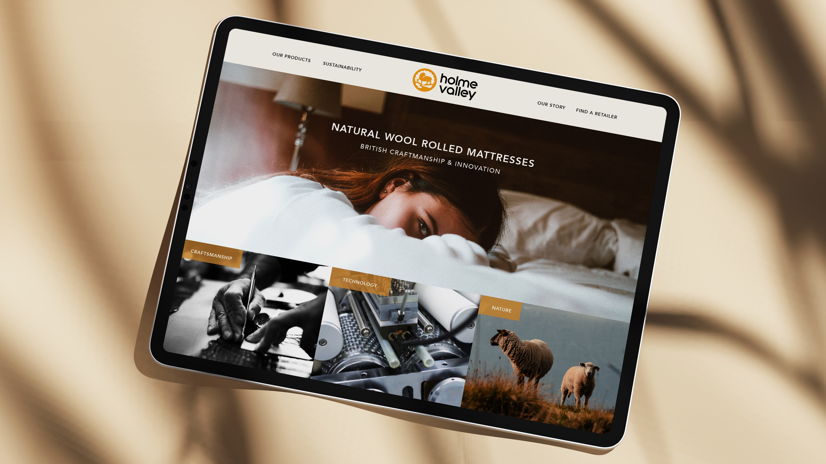

Slide 5
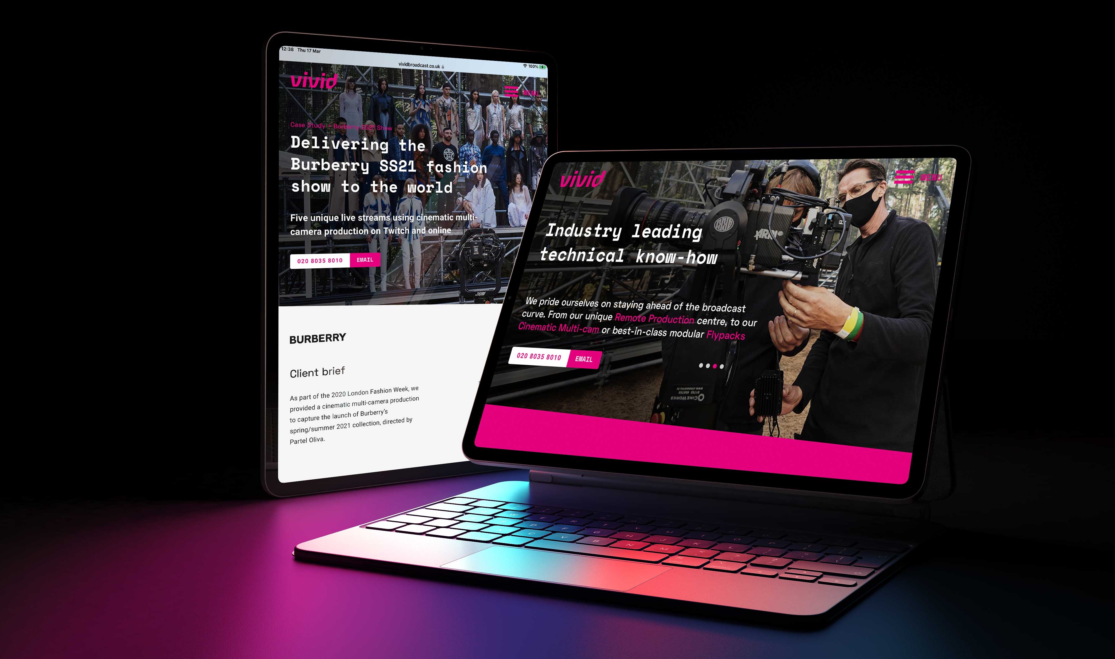

Slide 6
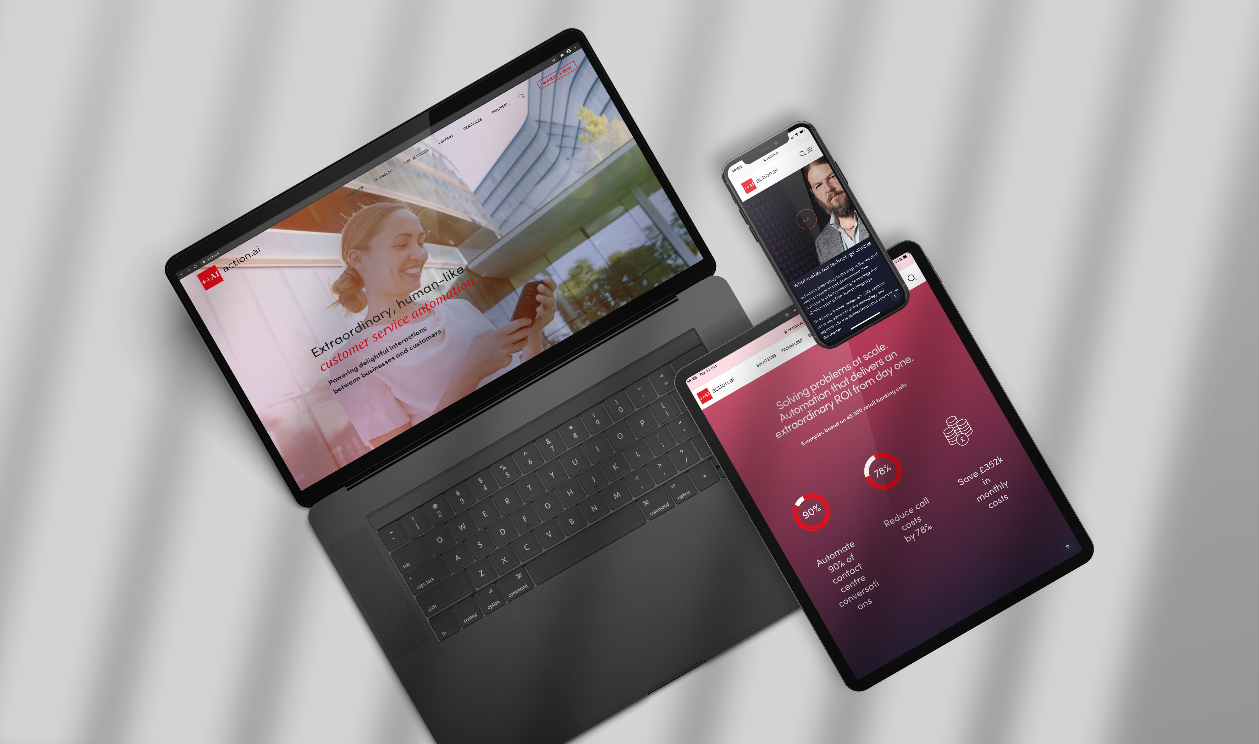

Slide 7
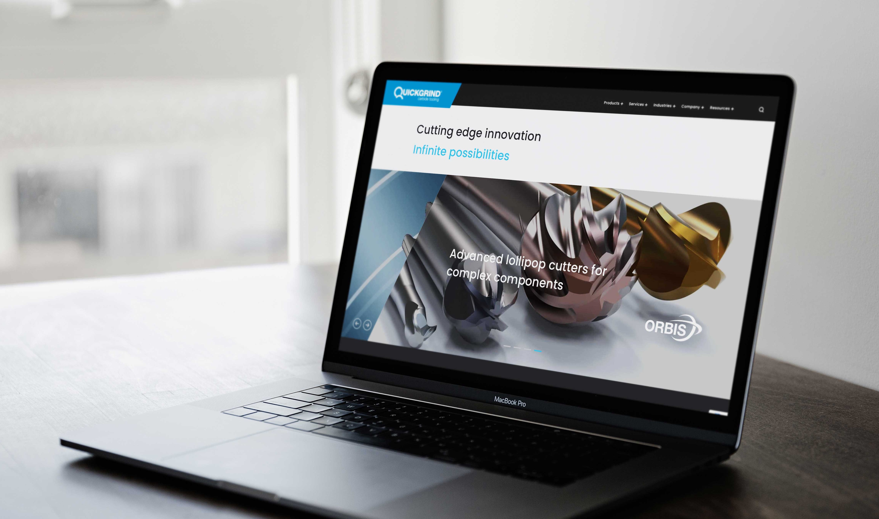

Slide 8
Notes:
Who are we

Slide 9
The funnel problem
Long term
Tomorrow’s customers
Brand building: Emotional connection
Short term
Today’s customers
Sales activation: Rational connection
Loyal customers
Notes:
Everyone is fighting in short term = price, features, PPC etc = expensive (discounting, bid price PPC etc). Cost per acquisition is high.
Long term is slow burn but drives growth and profit

Slide 10
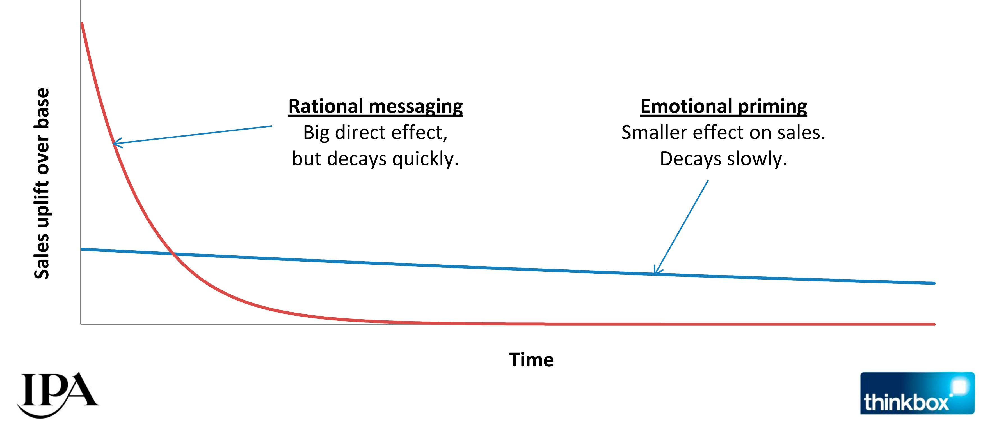
Effect of rational vs emotional messaging
Notes:
Institute of practitioners in advertising report. Single engagement

Slide 11
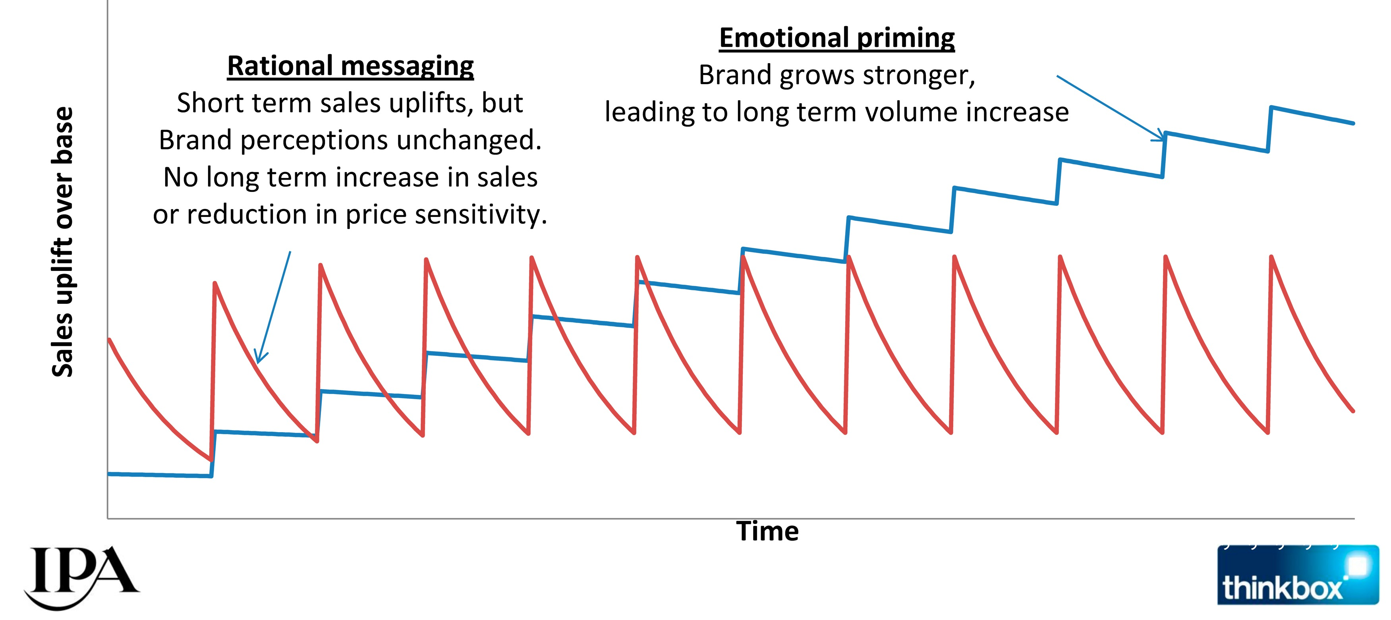
Multiple marketing engagements

Slide 12
Uniquely ‘you’=
+
Rational
Emotional

Slide 13
Unique brand = stand out from the crowd

Slide 14
What is your ‘brand’?
Your brand is not your logo.
Your brand is how people ‘feel’ about you having seen, read, swiped or watched your content. It is unique. You are unique.

Slide 15
How to uncover your brand
Notes:
Brand essence = core motivation
Disney = magical / Volvo = Safe

Slide 16
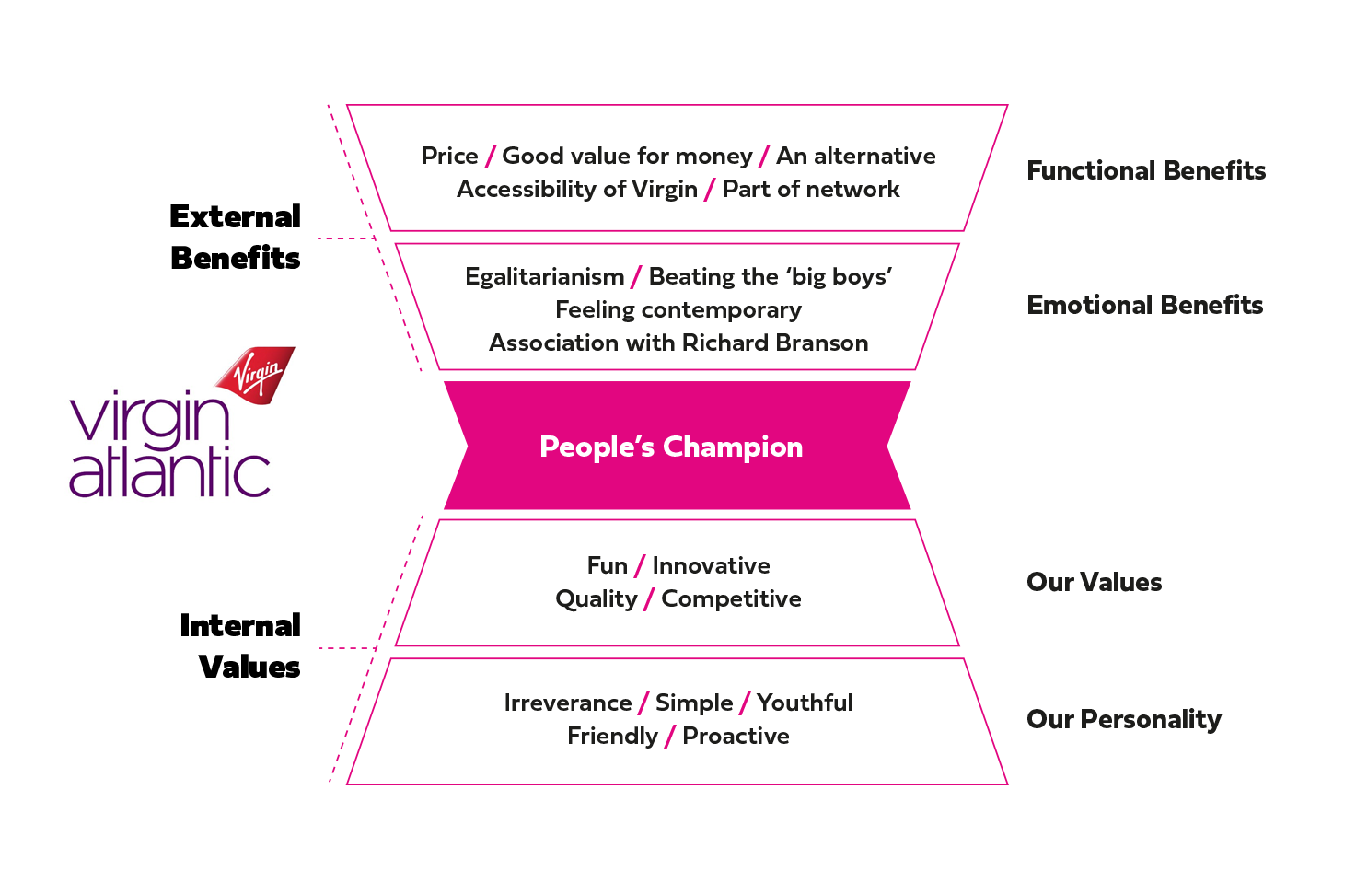

Slide 17
Questionnaire
Notes:
Providing this in electronic form enables individuals to be candid and honest in their responses which is critical to the success of the process.
Once we have collated and analysed the results we will present back a working document where we have completed with the results and consensus from the questions asked.

Slide 18
Psychometric brand test
Notes:
Providing this in electronic form enables individuals to be candid and honest in their responses which is critical to the success of the process.
Once we have collated and analysed the results we will present back a working document where we have completed with the results and consensus from the questions asked.

Slide 19
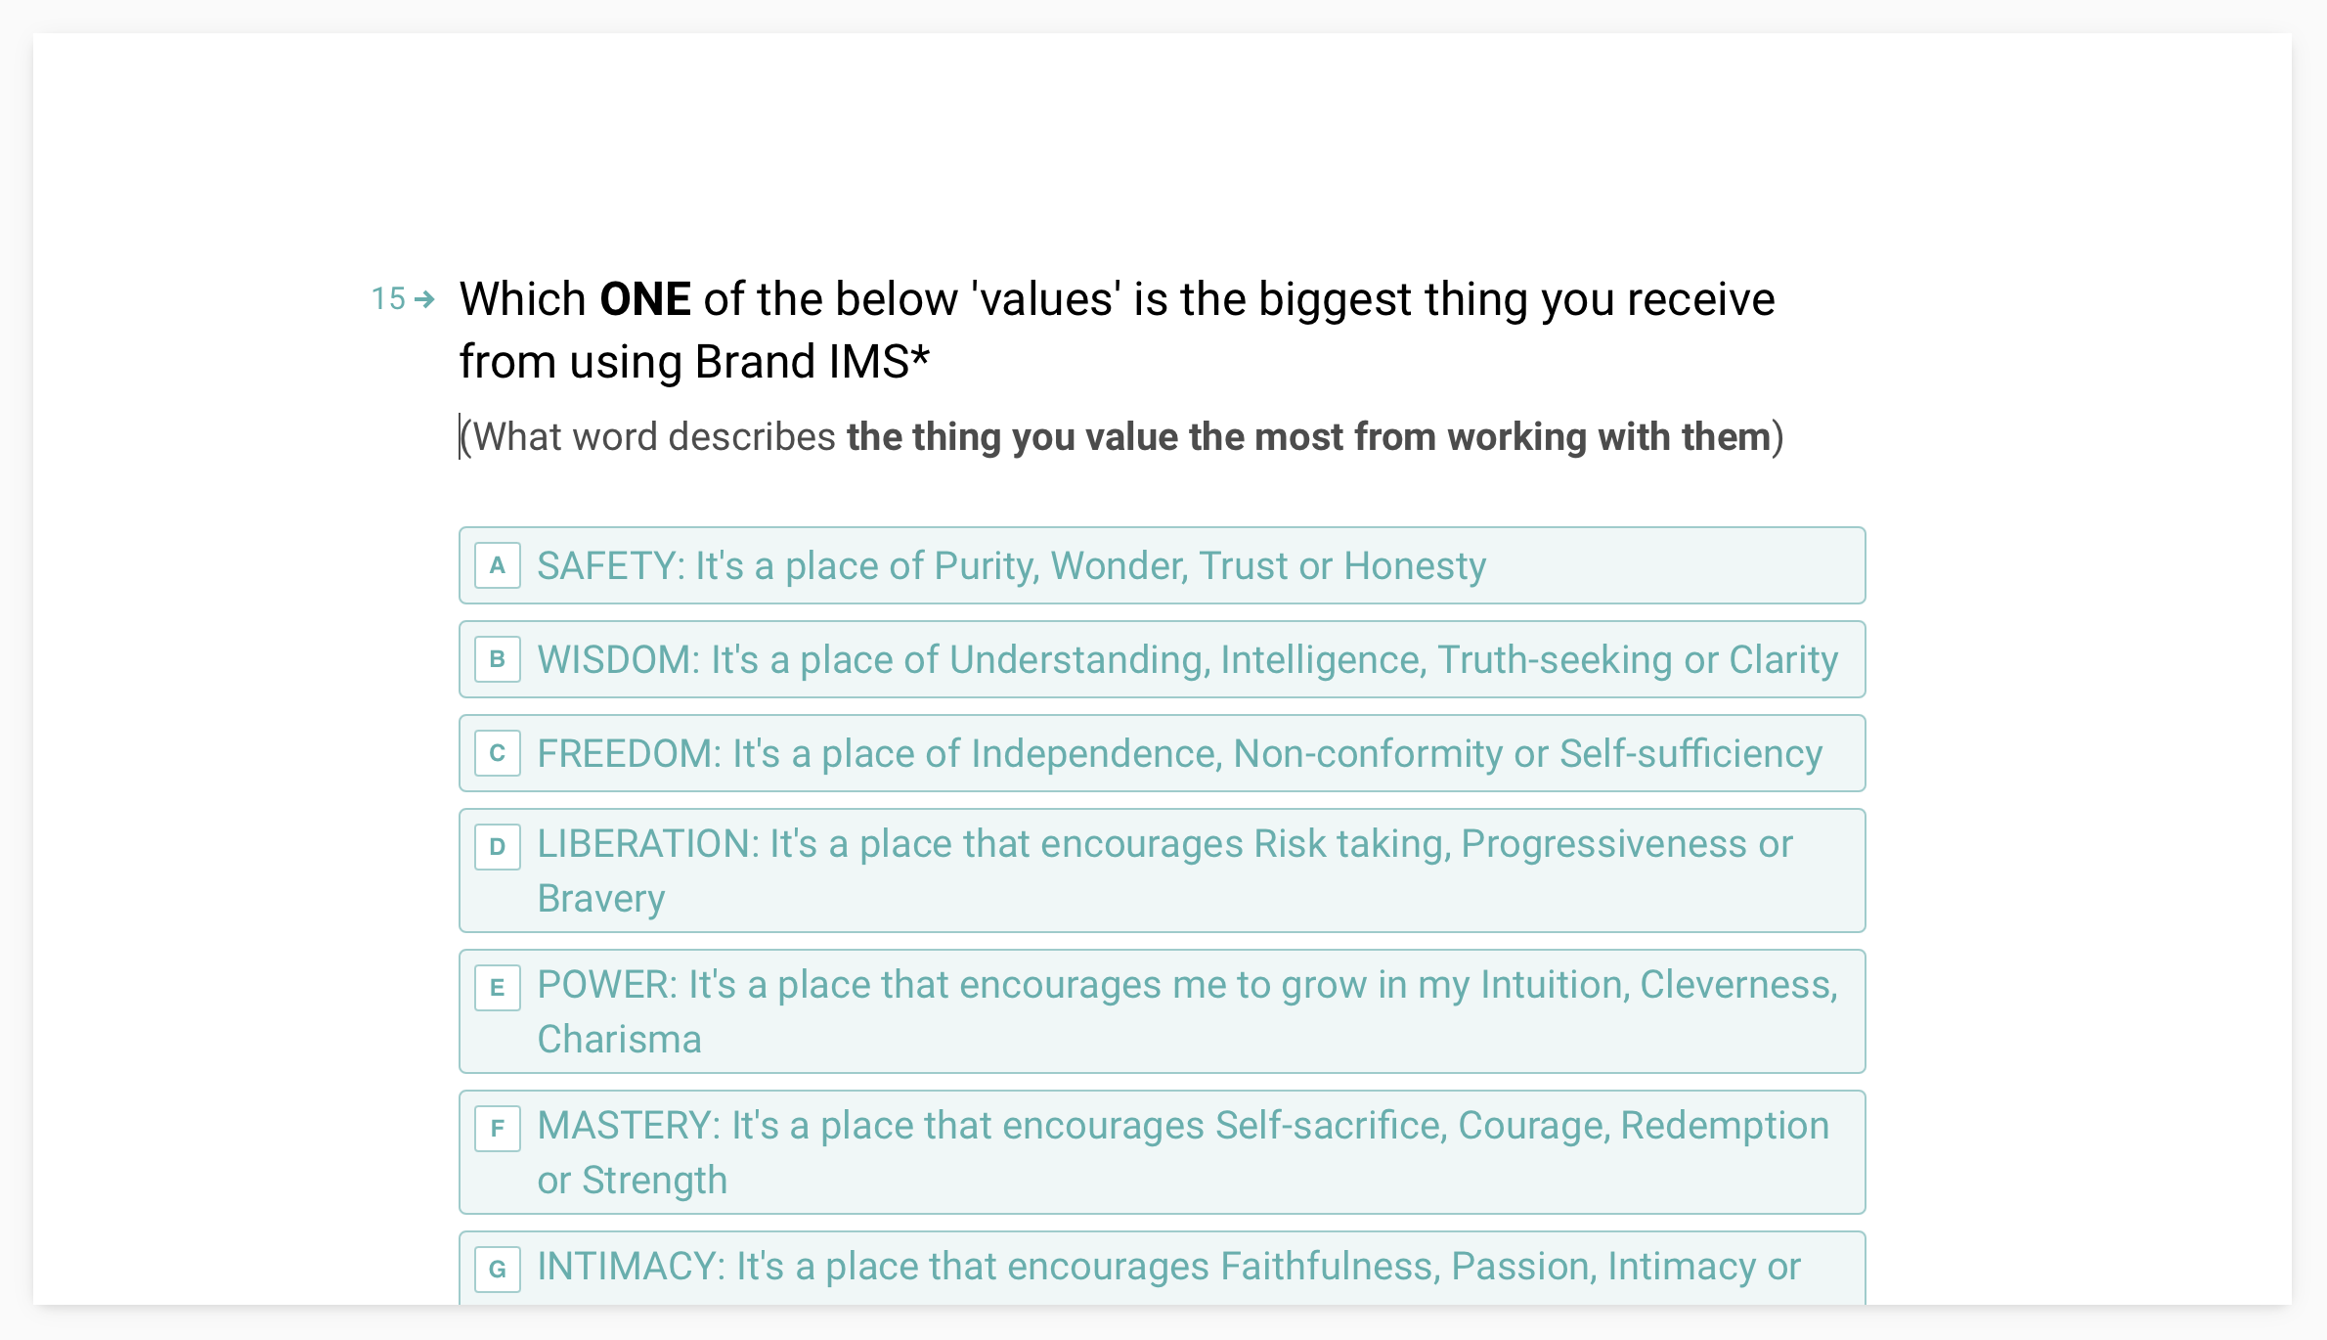
Psychometric brand test
Notes:
Candid and honest in their responses which is critical to the success of the process.

Slide 20
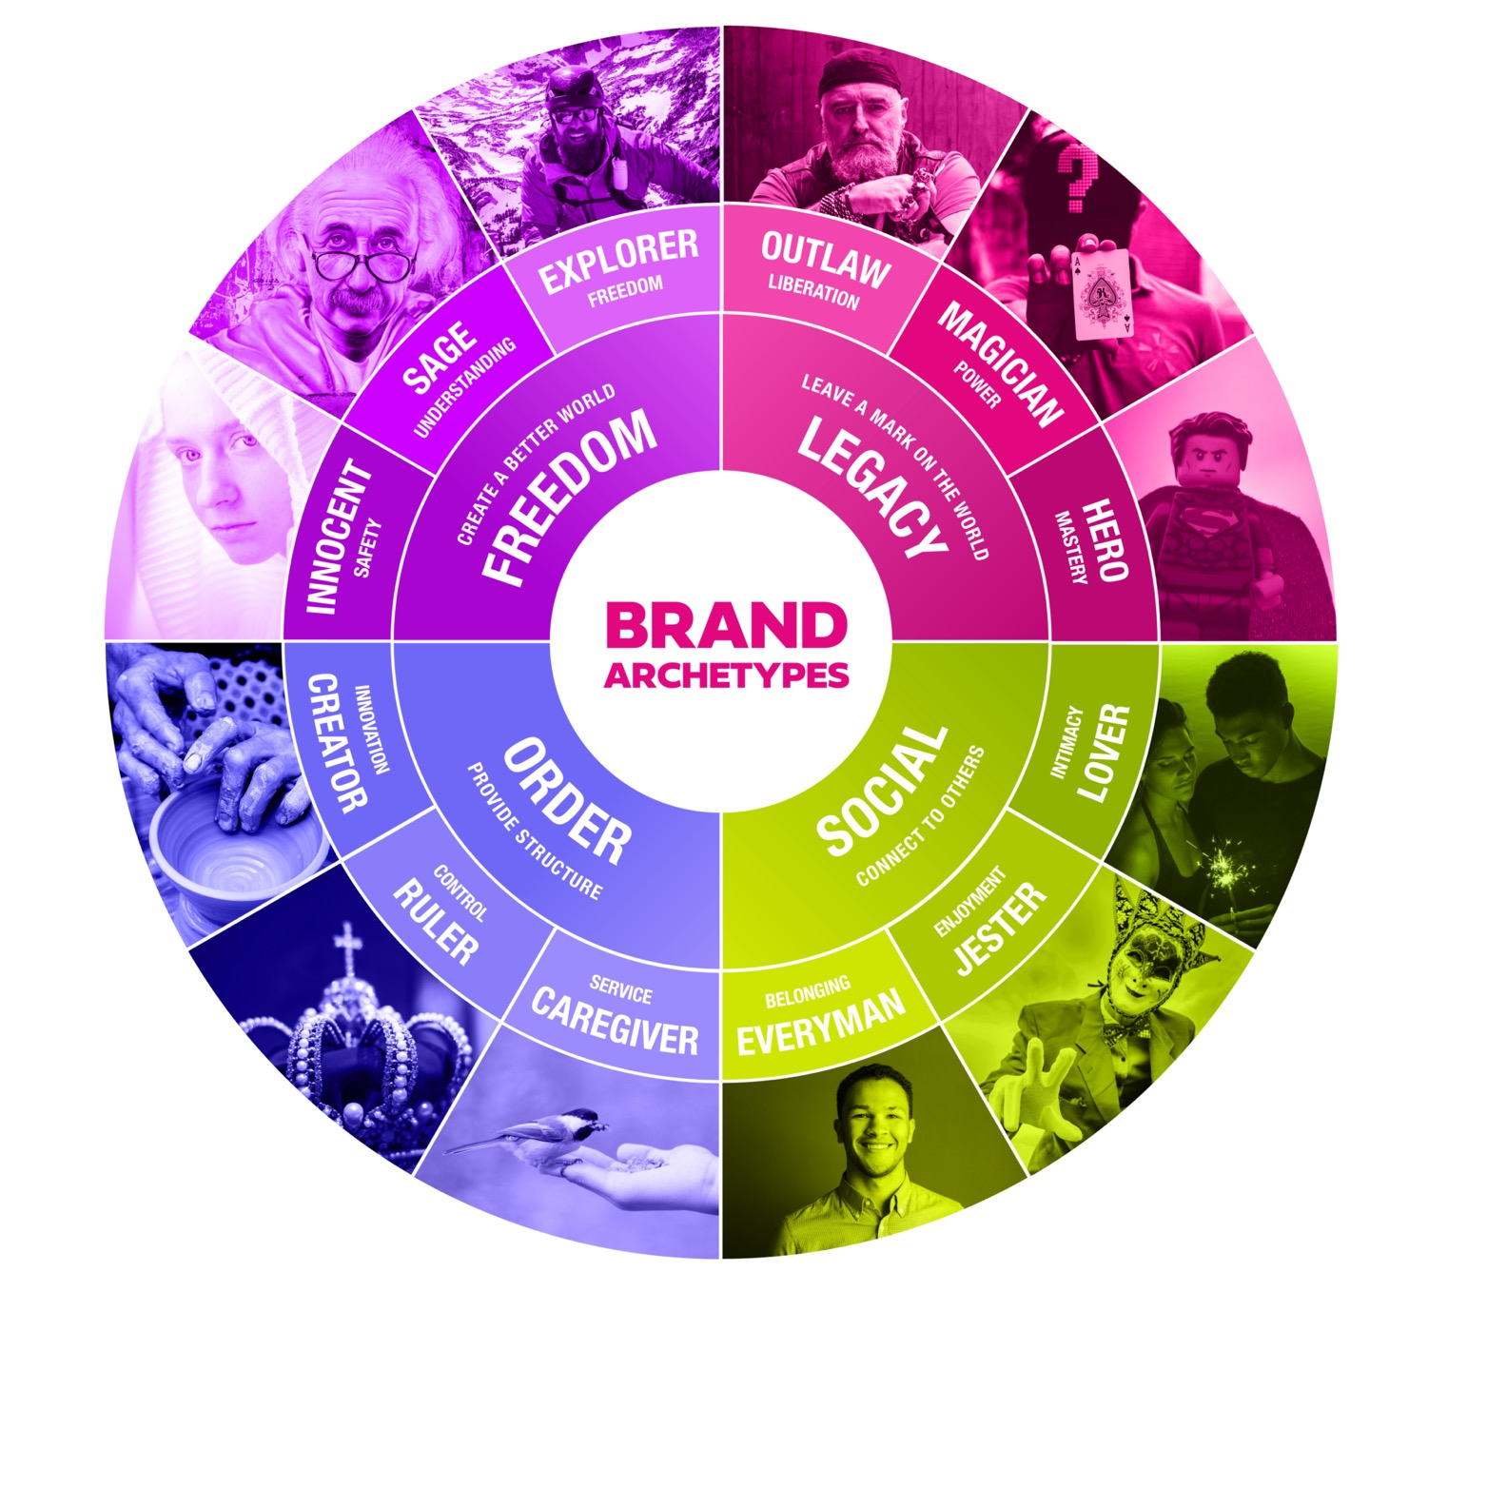
Brand archetype
Notes:
The first test relates to the Carl Jung ‘personality archetype wheel’. Spectrum of powerful character values/traits that helped us to identify where you sit on the archetype wheel.
Answers helped us to identify what your brand values and personality and trust cues are. Primary and secondary archetype.
Magician: Disney, Tesla, Lurpak Outlaw: Harley, Marmite, Bewdog Regular guy: Gap, Ford, Lynx
Opposites test
Our ‘opposites test’ forces responders to take a clear stance on the brand personality. Ensure your brand is focused and stands out.

Slide 21
Brand essence
Notes:
Test 1: Brand Essence Territory test
By Jennifer Aaker – American social psychologist and professor of marketing at the Stanford Graduate School of Business. It is a cognitive framework for understanding which core dimension your brand sits within which will drive how customers will relate to your brand.

Slide 22
`
Brand essence
Your Brand Essence is “the core characteristic that defines and drives your organisation – the motivation behind everything you do”
Not a ‘strapline’ but will inform one (if needed)
Happiness
Belong Anywhere
Notes:
Test 1: Brand Essence Territory test
By Jennifer Aaker – American social psychologist and professor of marketing at the Stanford Graduate School of Business. It is a cognitive framework for understanding which core dimension your brand sits within which will drive how customers will relate to your brand.

Slide 23
`
Brand essence
Your Brand Essence is “the core characteristic that defines and drives your organisation – the motivation behind everything you do”
Not a ‘strapline’ but will inform one (if needed)
SAFE
PROGRESS THROUGH TECHNOLOGY
Notes:
Test 1: Brand Essence Territory test
By Jennifer Aaker – American social psychologist and professor of marketing at the Stanford Graduate School of Business. It is a cognitive framework for understanding which core dimension your brand sits within which will drive how customers will relate to your brand.

Slide 24
Brand essence
Test 1: Brand Essence Territory test
Notes:
Test 1: Brand Essence Territory test
By Jennifer Aaker – American social psychologist and professor of marketing at the Stanford Graduate School of Business. It is a cognitive framework for understanding which core dimension your brand sits within which will drive how customers will relate to your brand.

Slide 25
Brand essence
Test 2: Find your enemy

Slide 26
Example
500+ coffee roasters in the UK
No brand definition
Tired management
Notes:
B2C

Slide 27
Experienced
Founder / team / own roastery / track record
Appealing to everyone
Range / training / all hot beverages
Convenient
Subscription / one stop shop
Example
Functional Benefits
External Benefits
Premium coffee /people I can count on
Approachable
Team & brand attitude A brand I can stay with for the long run
Easy
Coffee next day Barista training White label
Emotional Benefits
Brand Essence (SINCERE COMPETENCE)
Enriching Everyone
Life & Vitality
Inclusiveness - Belonging Everyone’s invited
Our Values
Authenticity
Internal Values
Passionate & Dedicated
Authentic Down to earth & approachable
Our Personality
Connected & Inclusive
Notes:
B2C

Slide 28
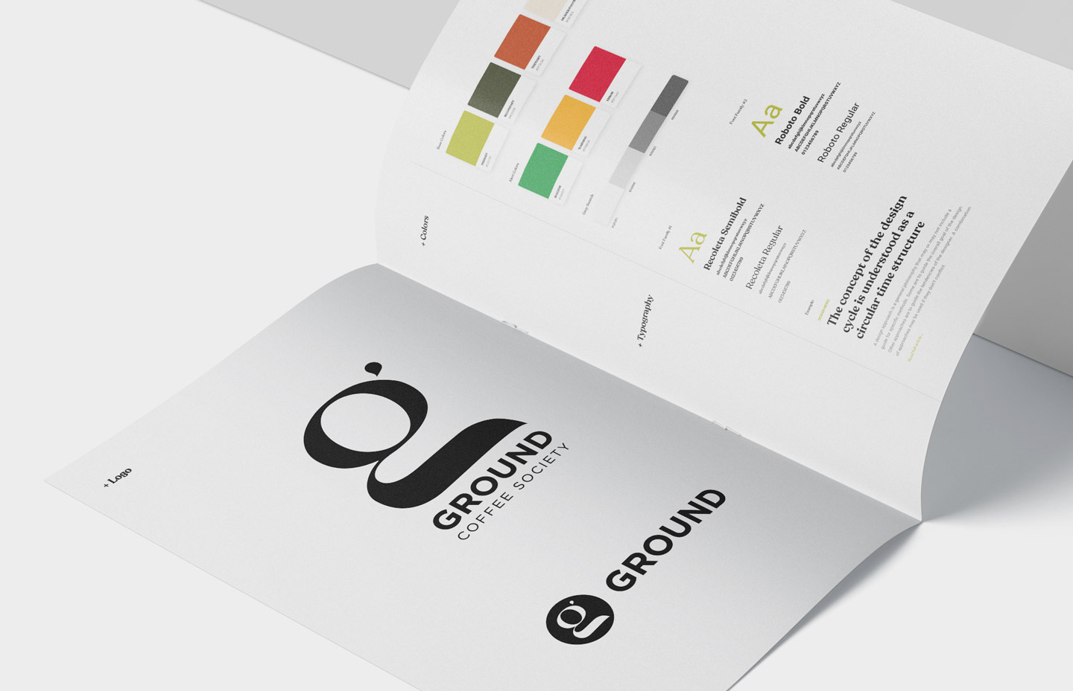
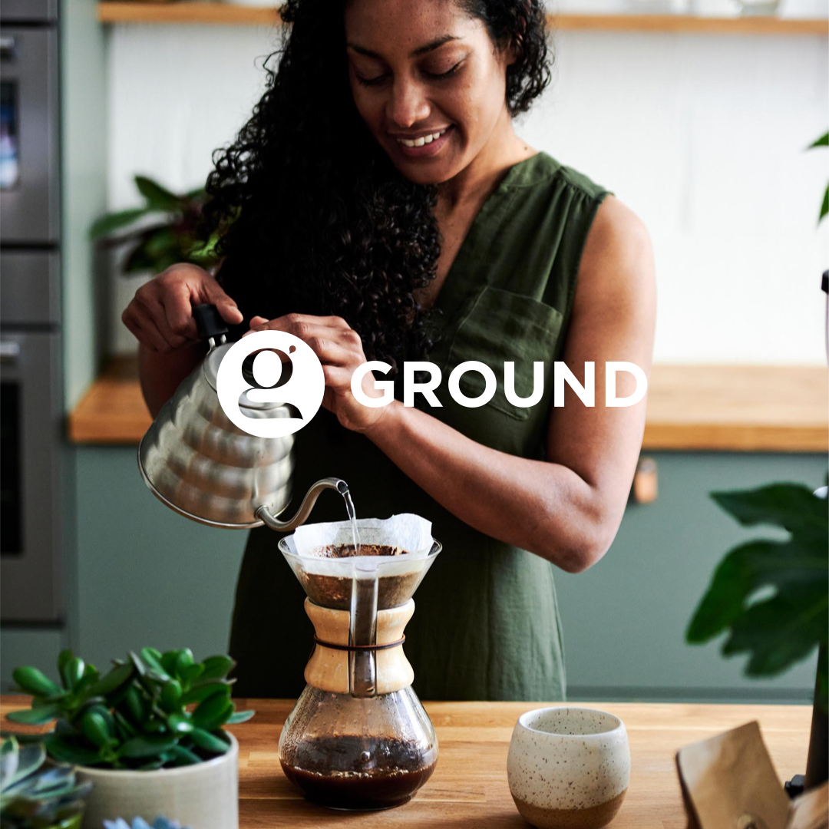

Slide 29
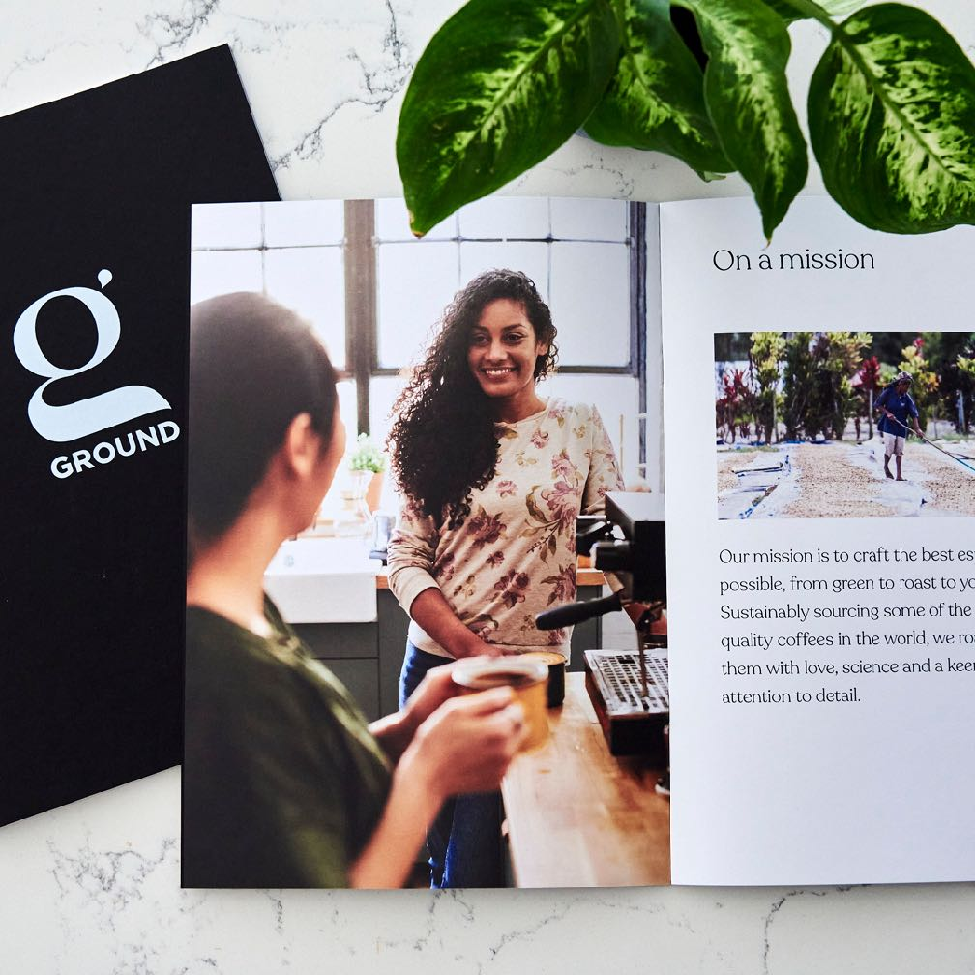
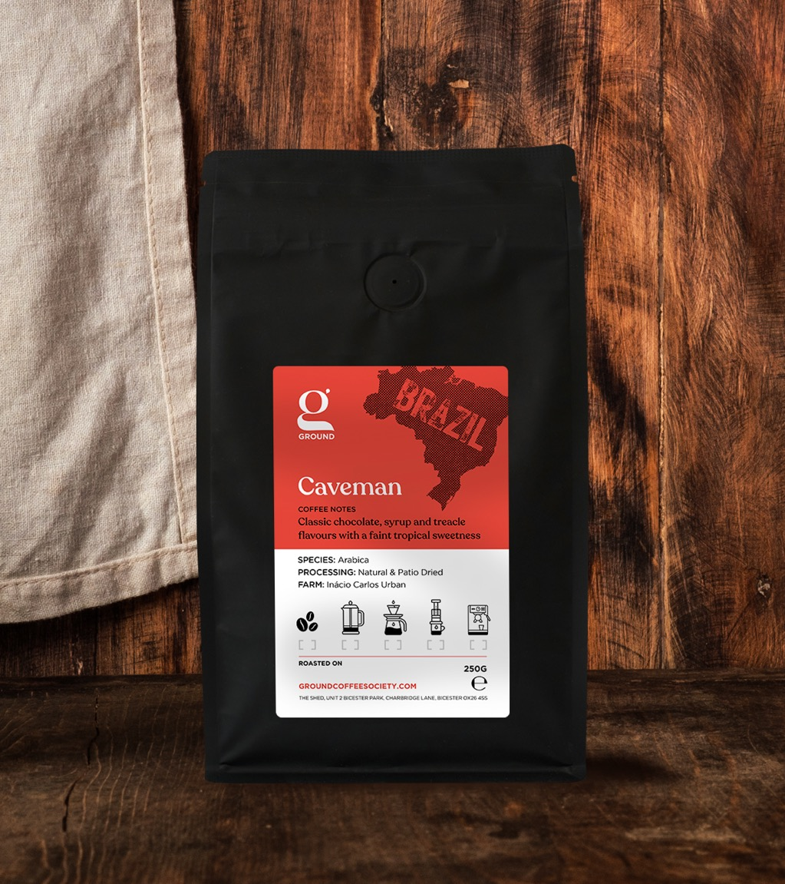
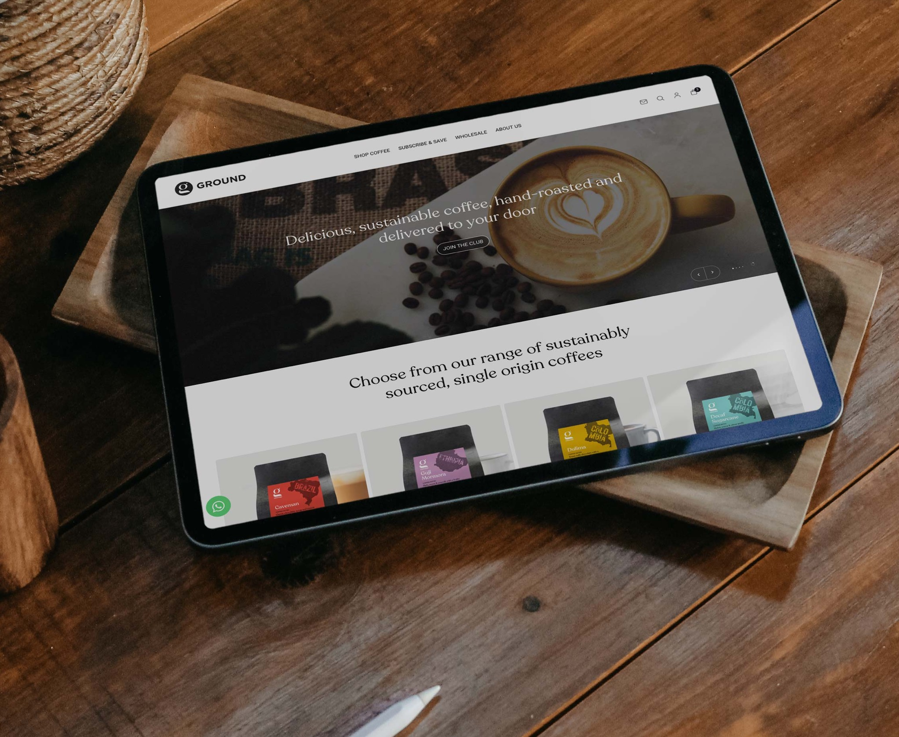
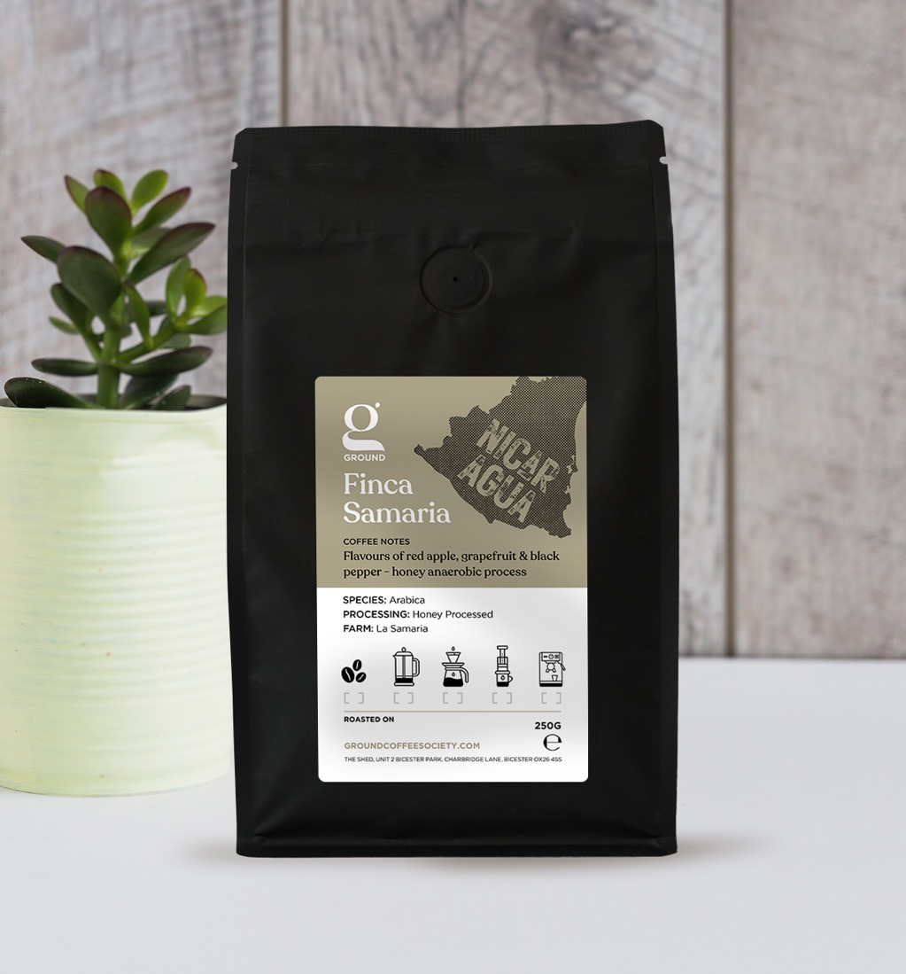
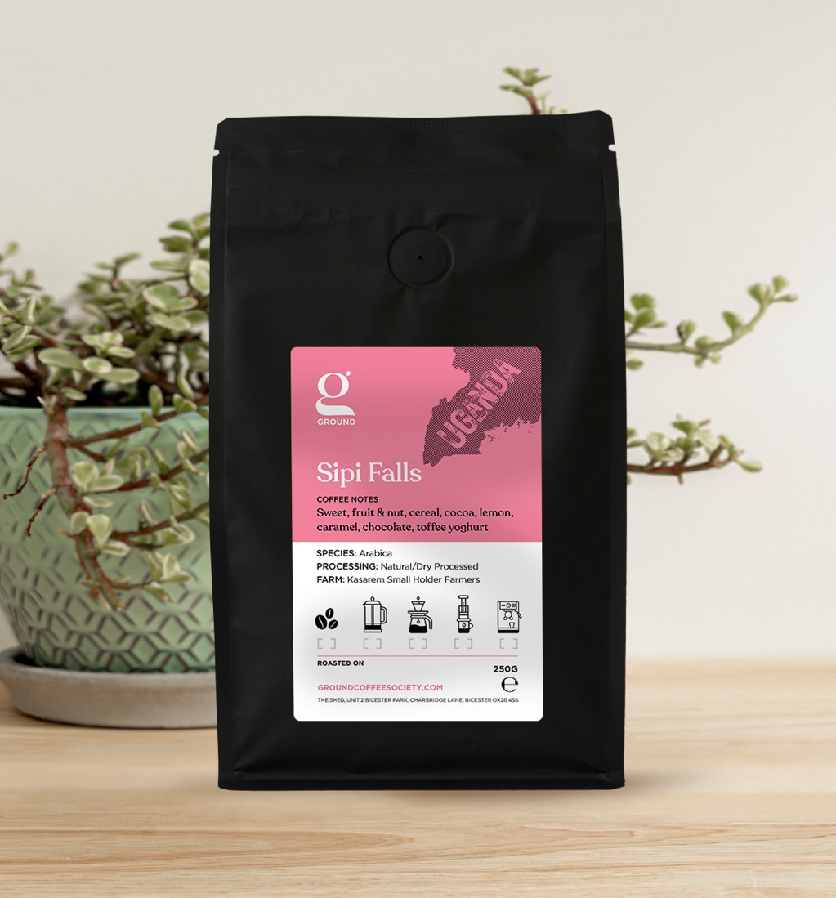
Notes:
Informed all comms

Slide 30
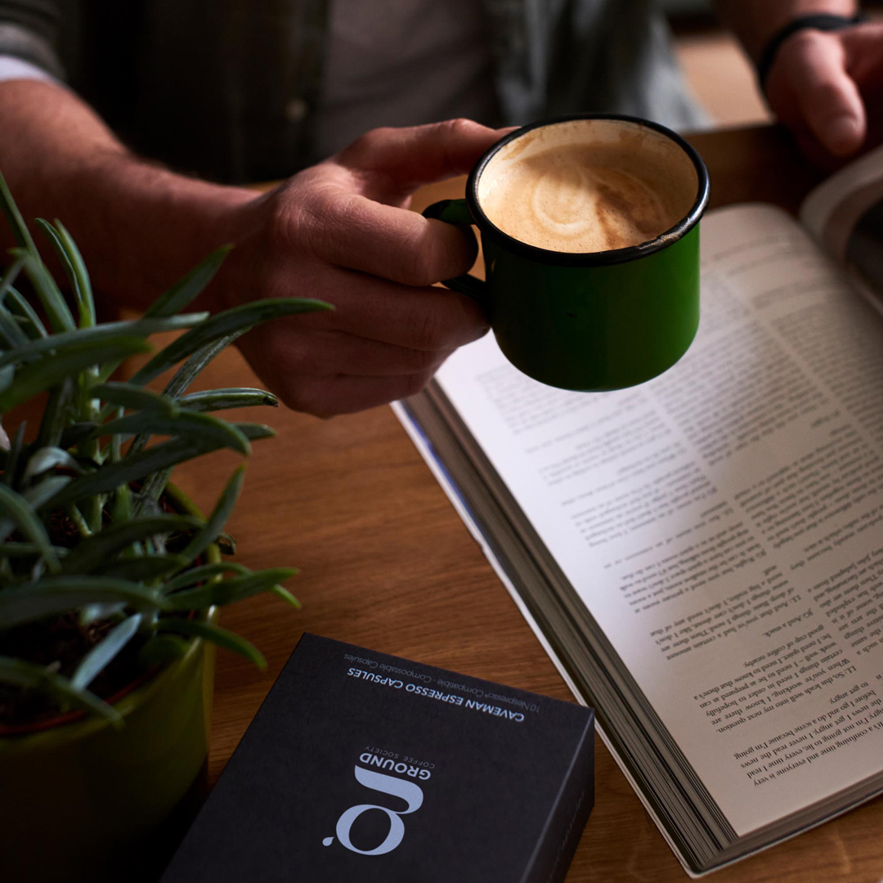

Slide 31
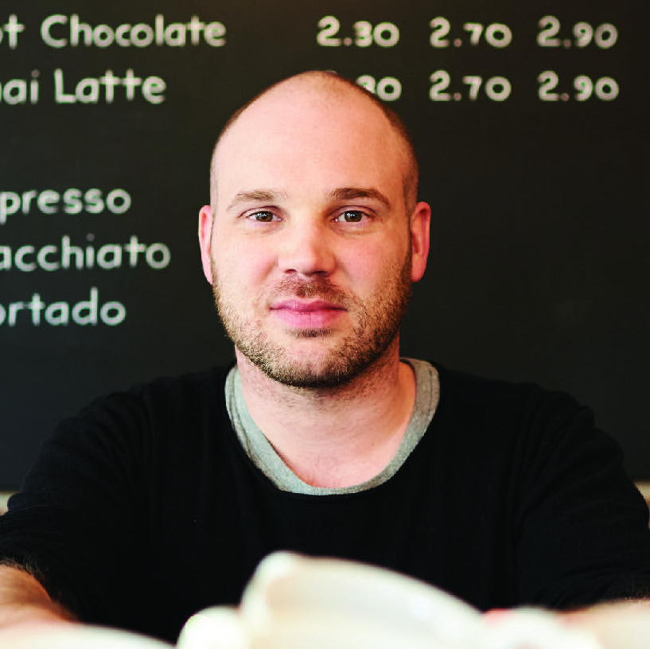
“Running this coffee company for nearly 12 years had certainly diminished my excitement for its future... Going through this project with @relishagency has most definitely reignited that excitement. It’s been such a pleasure having you work with us on this brand development project. Thank you 🙏🏼”

Slide 32
Example B2C
Notes:
B2C

Slide 33
Advanced technology enables a pocket-sprung mattress to be rolled for delivery = a lower price point.
British handcrafted using locally sourced natural wool
A truly better nights sleep from a luxury natural sheep’s wool mattress
Functional Benefits
External Benefits
I feel excited I can afford a better product that’s better for the planet
I have peace of mind that Holme Valley is timeless British luxury – a quality product
I feel rested and rejuvenated on a luxurious, hand-crafted, natural mattress
Emotional Benefits
Better affordable natural sleep through British craft and innovation
Our Values
Innovation
British Craftsmanship
Customer Focus
Internal Values
Pioneering High-Tech, Youthful, Effective, Imaginative, Expert, Sustainable, Original
Fastidious Creative, Diligent, Excellence, Reliable, Refined, Safe, Confident
Caring Friendly, Natural, Reassuring, Authentic, Comforting, Charming, Humble, Playful?
Our Personality

Slide 34
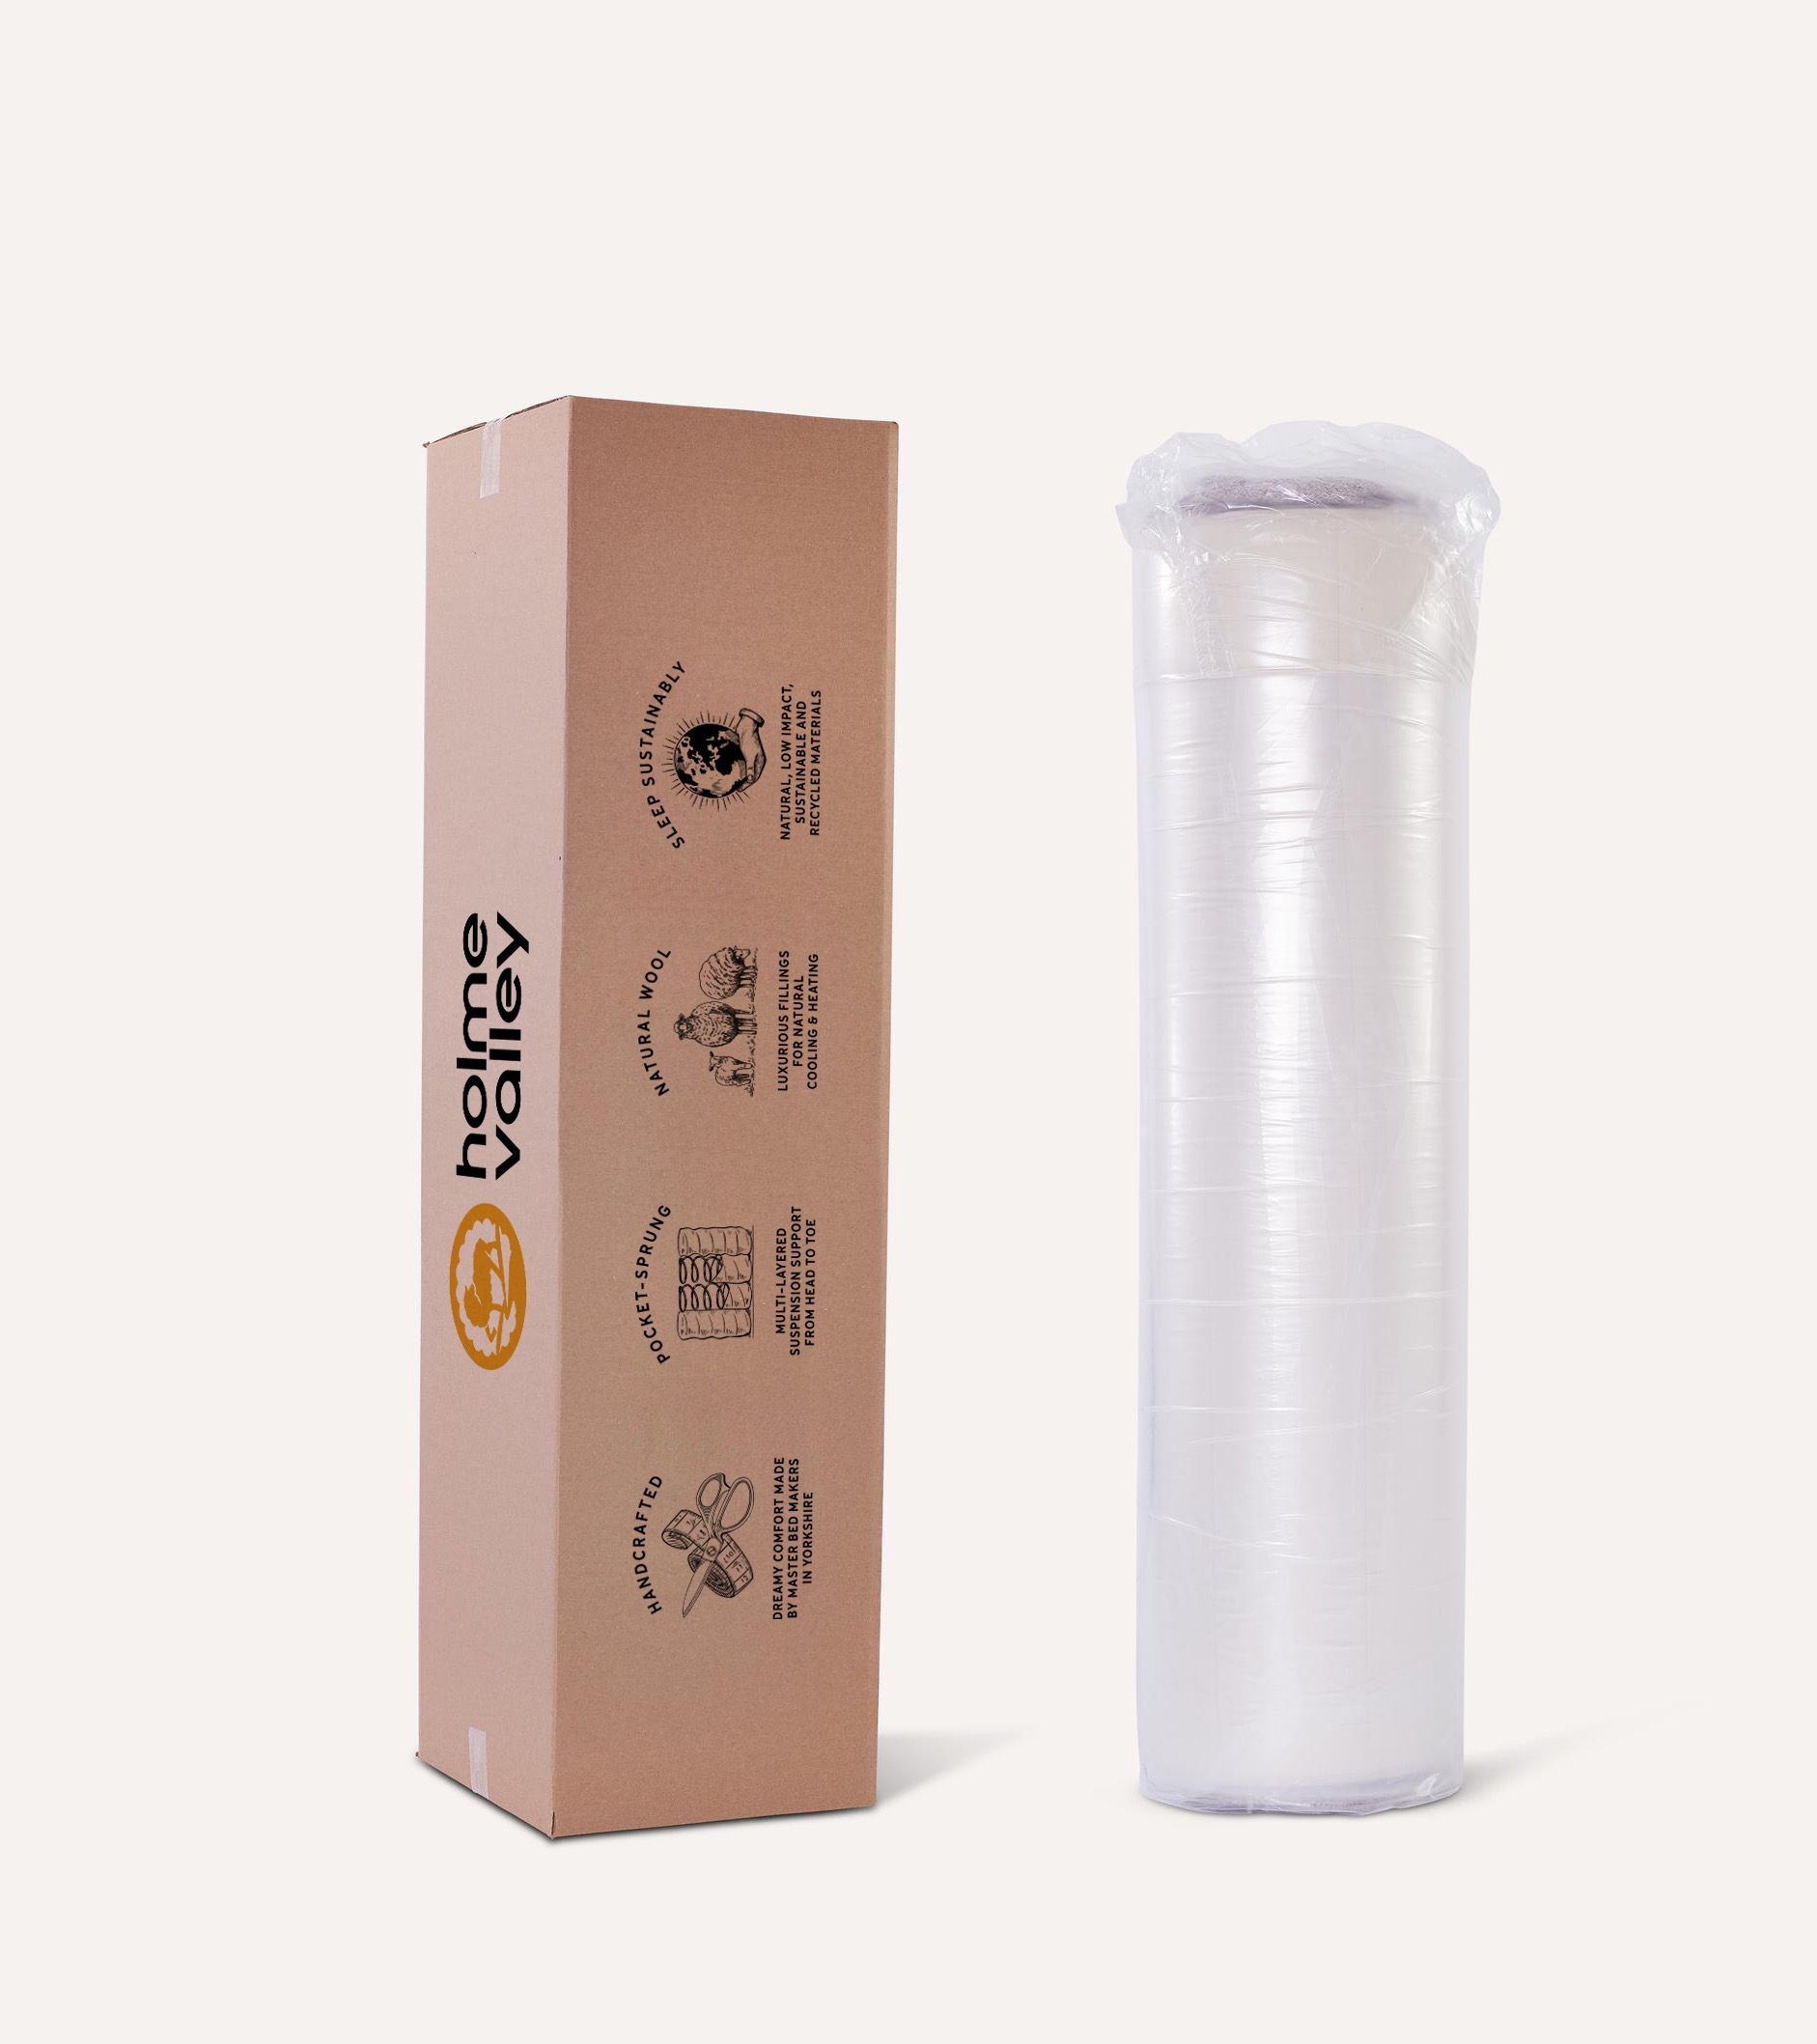
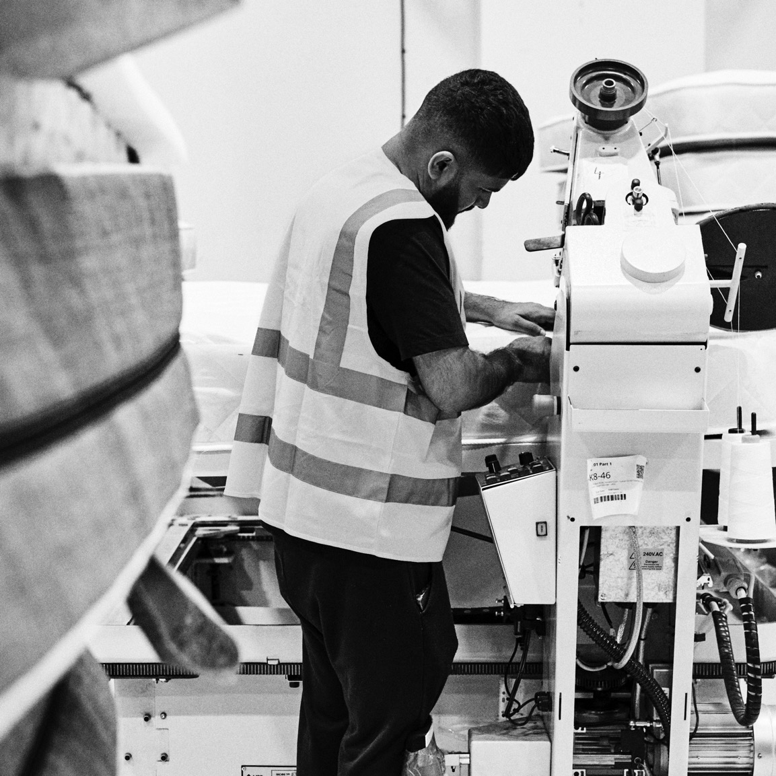
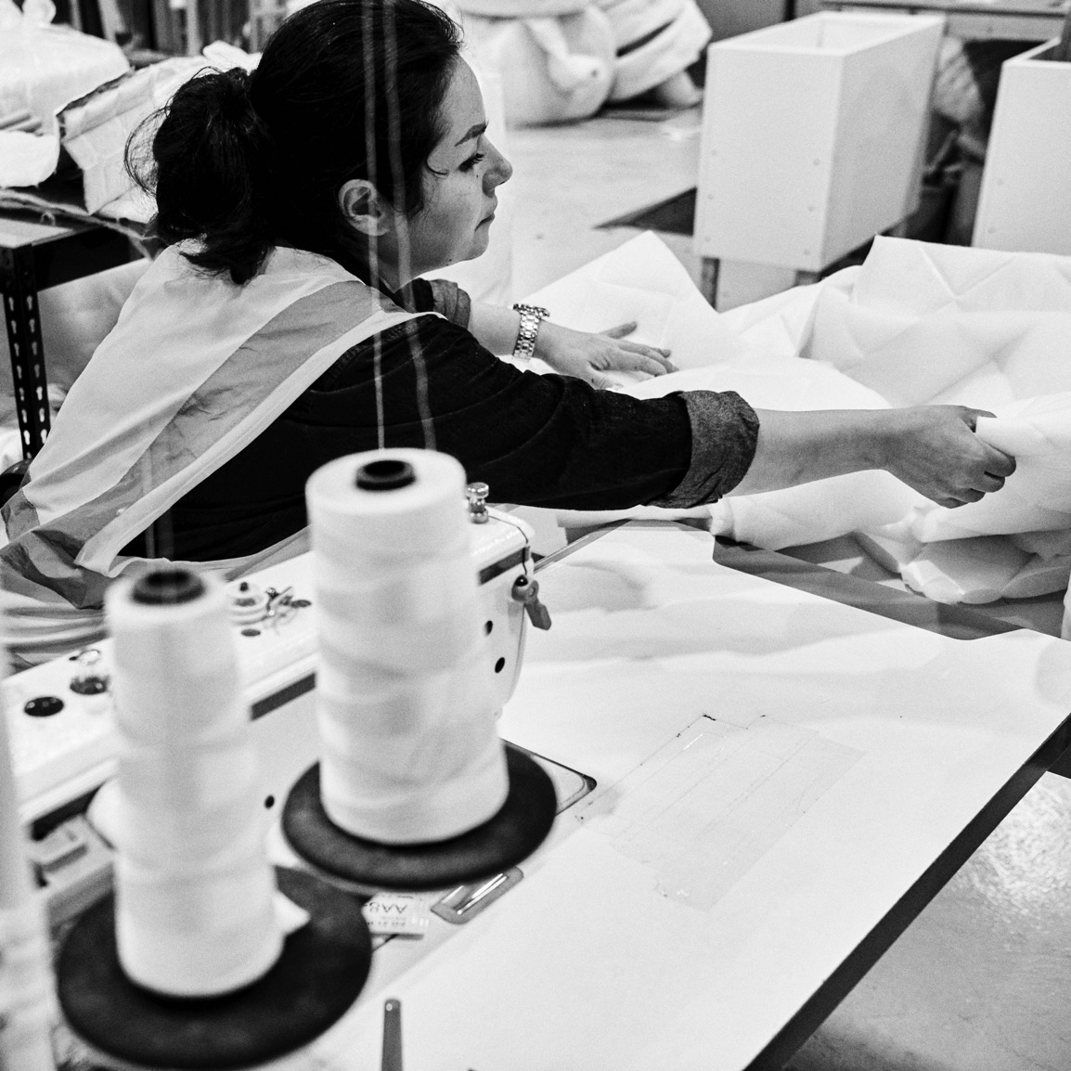
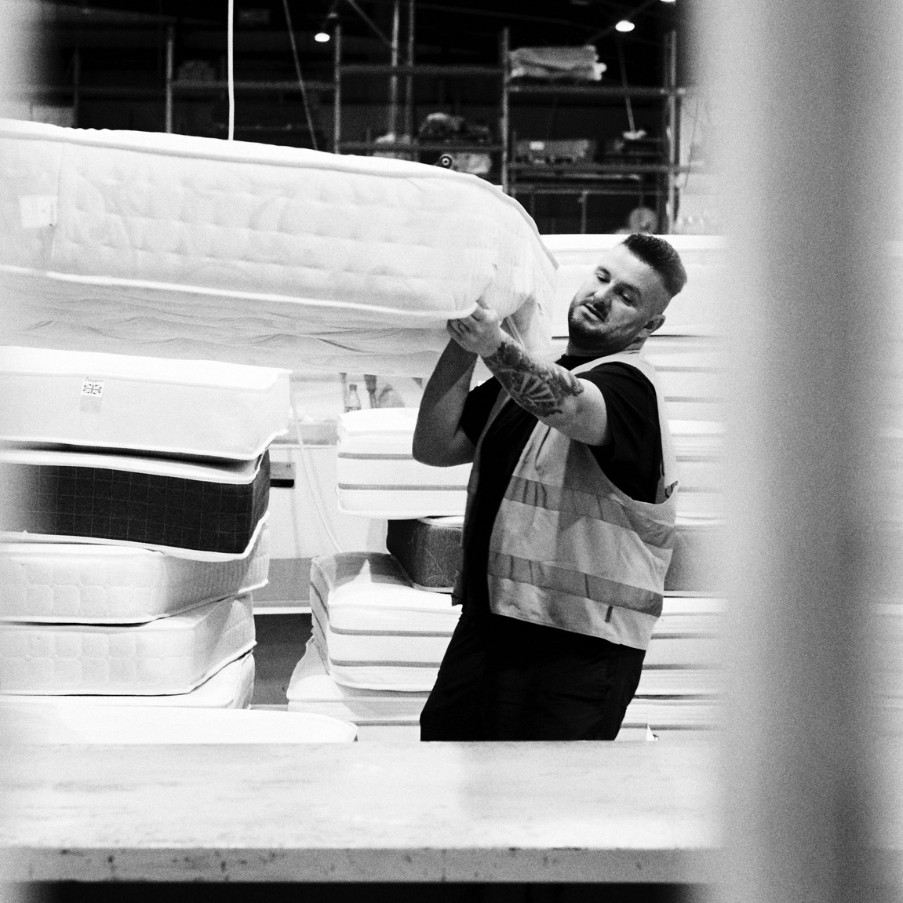
Define. your brand
Notes:
Photography & Packaging

Slide 35
Define. your brand
Notes:
Informed all comms

Slide 36
Define. your brand
Notes:
Hand drawn icons

Slide 37
Brand essence exercise
Find your enemy: Pick a fight
Pick a competitor that grinds your gears (they are now the enemy)
What is it about them you don’t like?
Is the opposite of this a strength you can own?
How would you declare war?
Notes:
Declare war: Overt or public? How would it champion the consumer? How would you rally your troops in your organisation? What would you do if they fought back?

Slide 38
del@relishhq.com relishhq.com

